Slide 1
Health and wellbeing
Tim Buescher
Lesley Gratrix

Slide 2
Thanks for having us!
We are really sorry we couldn’t spend more time with you to look at more strategies to enhance your health and well being but even so, we hope discussing your feelings and views around what affects your resilience was cathartic!
Those in the first group identified some important issues which affect you all as newly qualified teacher, and those in the second group looked at these to suggest some strategies to support health and well being.
What we have done on these slides is offer some suggestions to consider to keep a healthy mind and body. We hope they hep, but please do contact us if you need any information.

Slide 3
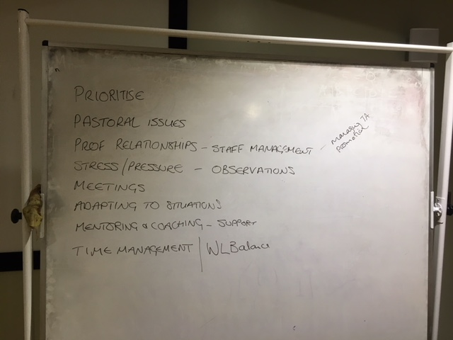

Slide 4
Healthy body and mind
Keeping fit and healthy is vital to remain resilient. Having chatted to a number of you, on the next slides are some of your ideas, and ours.
This isn’t about telling you things you already know, its just some suggestions to consider to enhance your health and well being as you go about your working life.

Slide 5
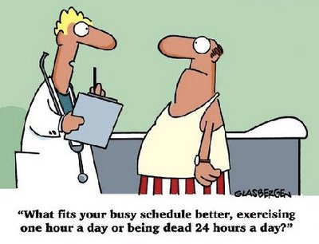
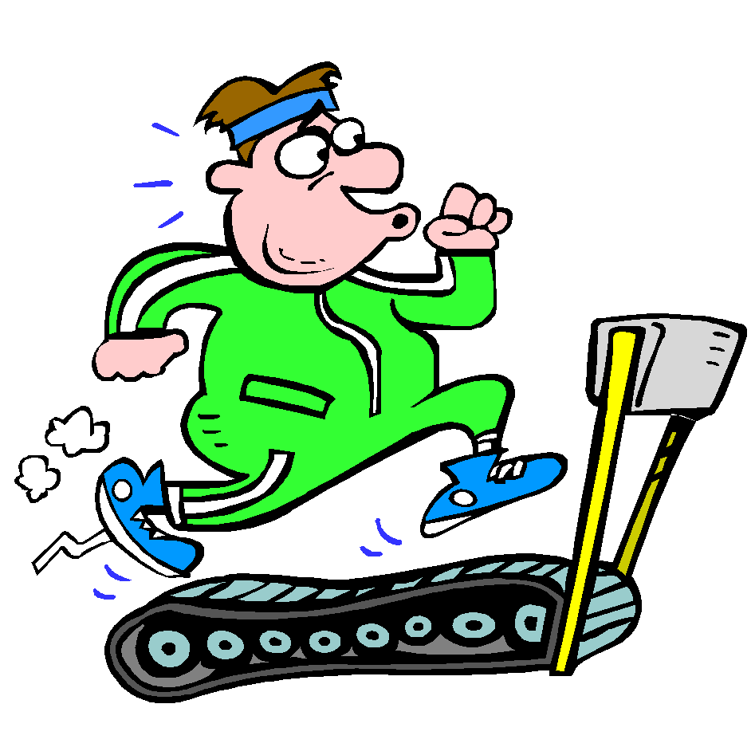
Exercise
Even short periods of exercise in the morning can contribute to energy levels that support a regulated sleep-wake cycle (Circadian rhythms). Moderate and regular exercise decreases cortisol levels (a stress hormone) and even a 10-minute brisk walk can reduces anxiety and increase daytime energy.
Could you walk to work?
Do you get out into the playground and walk around?
Vitamin D – getting outside boosts your vitamin D (the sunshine feel good vitamin)
A great time to practice some stress busting breathing exercises, and the increase in oxygen boosts your brain
30 mins of moderate exercise daily will promote fitness and release endorphins (which make you happy!)

Slide 6
Eat healthily
Craving carbs and sugars? Always grabbing a bar of something as you are in a rush? A healthy diet contributes to good immunity, keeps weight under control and thus exercise more manageable
Mars bars may seem like a good idea at the time but what about swapping for granola bars?
Keep a food diary and then spend some time considering what you could swap out for a healthier “on the run” option.
Fruit and nuts are just as easy to stash in your desk drawer.
Is lunch a snack in the staff room? What about eating with the children? A good filling school lunch and respite from the phone or emails. Even once a week will make a difference.
Water – the evidence suggests water helps concentration, wellbeing and your hair and skin – carry it everywhere the benefits are massive and will help cut out caffeine and sugar. ( a good 2 litres a day is the minimum to aim for)
Watch the caffeine intake
Alcohol – consider how much, and when you drink, could you change every other drink to alcohol free? Alcohol can contribute to stress and stress related issues.
Keep your diet balanced

Slide 7
Are you on the email merry-go-round?!
Our lives are ruled now by electronics. Emails are a massive distraction and people often feel “on edge” waiting for the next one that comes in.
Set up specific times for answering emails – are they all life or death? What about allocating the first half an hour each day to deal with these?
Could you set up an out of office to inform people you will answer within 3 working days? That you do not answer them in the evening or weekends? If you opt to do this, stick to it!
Take emails off your phone. Brave I know, but you might find it liberating – we did once live this way!
Get rid of that ping and alert when ones drops into the in box
Do you need to email? Get up and speak to the person.

Slide 8
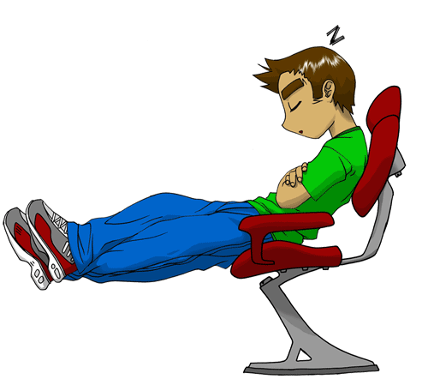
Sleep
Not having enough sleep can impact on how you deal with stressors and this in turn can affect your resilience which then increases your stress. Adults need at least 7-9 hours good quality sleep every night. Are you getting this amount?
Circadian Rhythms (or sleep/wake cycles) If you are sleep deprived, you will realy notice circadian lulls such as just after lunch.
Develop routines – wind down,
switch of gadget (the light emitted has shown to have a massive effect on sleep)
Have a bath or shower
Listen to music or read rather than the TV
Stop drinking alcohol at least an hour before bed
Try to have a set bedtime
Wake to daylight

Slide 9
Healthy Mind
Developing and maintaining an awareness of our physical and emotional signs of stress through mindfulness can help us to avoid being led along by our reactions
Try accessing Headspace free trial and give it a go for yourself
Mindfulness: finding peace in a frantic world by Mark Williams and Danny Penman (this comes with a CD of guided meditations)
Be compassionate to yourself - try not to get caught up in regret or anger over the past or worries about future achievements.
You might want to read The Compassionate Mind by Paul Gilbert if this idea speaks to you

Slide 10
A model for self-compassion
Regret and resentment over past events
Appreciation of what is happening for you now, in this moment
Worry about future consequences and goals

Slide 11
Some useful mindful tips
Some people find it easier to use short bursts like the three-minute breathing space (you can hide in a cupboard, or your car and get a quick bit of perspective)
In some workplaces, groups might come together at the beginning of the day and do a longer meditation together – I can recommend it but you will need to be prepared to be a strident advocate for this in the initial stages of persuading your colleagues to join in. In the p[ast I have used this at the beginning of meetings, too.

Slide 12
Alternative approaches
For some people, focussing on their breathing just doesn’t seem to work. If it isn’t for you, you could find another focus for your attention
A favourite image – some people use pictures
or mental images (e.g lying on a beach) – this is known as visualisation
A piece of music
Nature – a mindful walk at lunchtime or into work in the morning, paying attention to the sounds, smells and sights of nature

Slide 13
Mental health concerns
In some cases, you may wish to seek advice or support for yourself or a colleague. In addition to the resources available through your employer and your union, you might want to use these contacts:
Your GP
Mind: https://www.mind.org.uk/
Samaritans: https://www.samaritans.org/
East Riding Council website: http://www2.eastriding.gov.uk/living/health-and-wellbeing/mental-health/working-age/
A particularly useful web resource is: https://www.getselfhelp.co.uk/ which covers a range of topics
Sometimes we might not want to talk to our friends, colleagues or family about our mental health but the support they can offer, knowing us better than any of these agencies, can be invaluable. So please talk to someone you trust.

