Slide 1
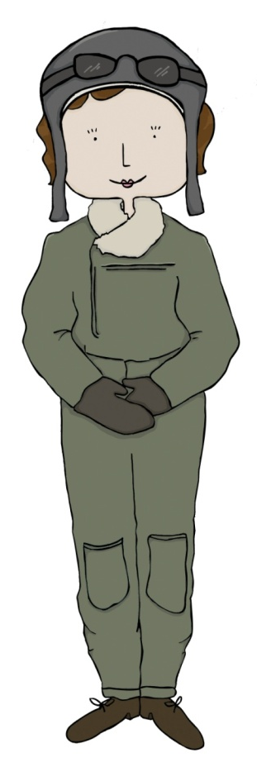
Zoe Martin
Education Programme Developer
Heritage Learning

Slide 2
Who we are...
Heritage Learning Heritage Learning is a team of cultural and creative learning specialists based in Hull. We manage and deliver all of the creative and cultural learning programmes across Hull’s museum, Ferens Art Gallery and Hull History Centre sites.
Heritage Learning is an independent self-funded organisation operating on a not-for-profit basis. The organisation sits within Hull Culture and Leisure Ltd.
www.heritage-learning.com

Slide 3
The Hull Curriculum concept...
Hull is the 2017 UK City of Culture
The Hull Curriculum is designed to celebrate Hull’s rich cultural and historic assets.
Evokes a deep sense of pride and appreciation of the unique city in which we live.
Brings the history and culture of Hull to life for primary school pupils.
Supports Hull teachers to enrich the delivery of the National Curriculum.
Inspires children to develop their knowledge and support development of key skills and personal aspiration.
Currently, 41of Hull’s primary schools are teaching the Hull Curriculum

Slide 4
The 20 key histories...

Slide 5
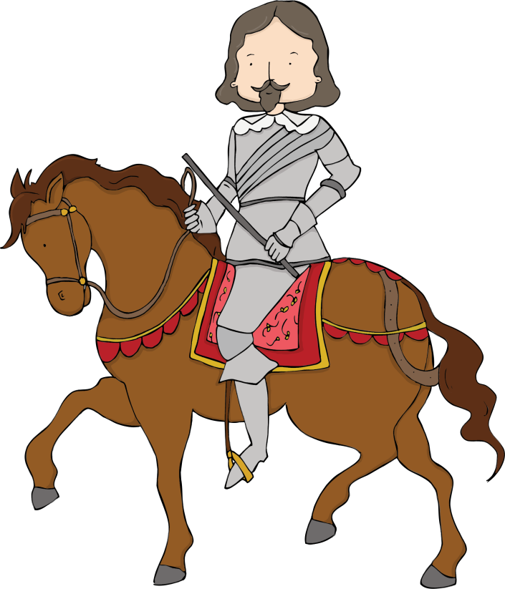
How do schools engage?
The Hull Curriculum 2017 - 2020 offer...
Standard Digital Package
Support in teaching the Hull Curriculum
Interactive Digital Platform
Hull Curriculum School Roadshow
Premium Award Package
Standard Digital Package
Pop-up exhibitions
Priority access to linked learning programmes and creative projects
National Heritage Schools Award

Slide 6
Upcoming CPD… Save the Date!
2 May 2018, 10am – 4pm
Beyond 2017 – Using arts and culture to enhance your teaching
Keep your cultural momentum with our annual creative CPD event for primary teachers.
Featuring outstanding exhibitions at the Ferens and Hull Maritime Museum, inspiring speakers and activities, our award winning Hull Curriculum resource and new look Heritage Membership scheme, we’ll keep your creativity flowing!
Look out for further details
Don’t miss out, book your place now.
Hull Curriculum and Heritage Members (SSA) are eligible for three free places per school.
Non-members - £50 per person.
To book your place, contact the Heritage Learning team on 01482 318733 or heritagelearning@hcandl.co.uk

Slide 7
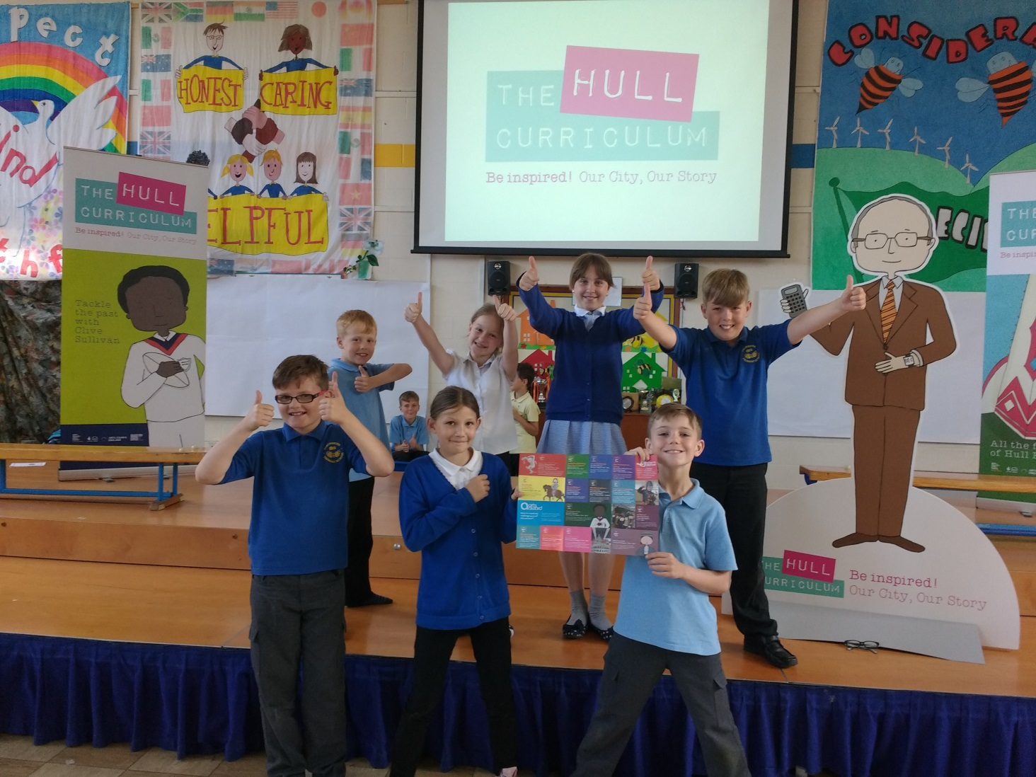
School Roadshow

Slide 8
How do schools engage?
The Hull Curriculum 2017 - 2020 offer...
Standard Digital Package
Support in teaching the Hull Curriculum
Interactive Digital Platform
Hull Curriculum School Roadshow
Premium Award Package
Standard Digital Package
Pop-up exhibitions
Priority access to linked learning programmes and creative projects
National Heritage Schools Award

Slide 9
Pop-up exhibitions…
Five exhibitions, five key histories
Resources, handling objects and exhibition equipment to support the Hull Curriculum key histories of Isaac Reckitt, Mary Murdoch, Sport in Hull, Transmigration Through Hull and Hull Fair
Strong literacy focus and output with children creating their own high quality exhibition at the end
Available for half term bookings from after February Half Term
Includes original and replica objects to inspire cross-curricular work, high quality source material and interactive elements
Planning support and teaching resources provided to
help you get the most from the exhibition
Suitable for Key Stages 1 and 2

Slide 10
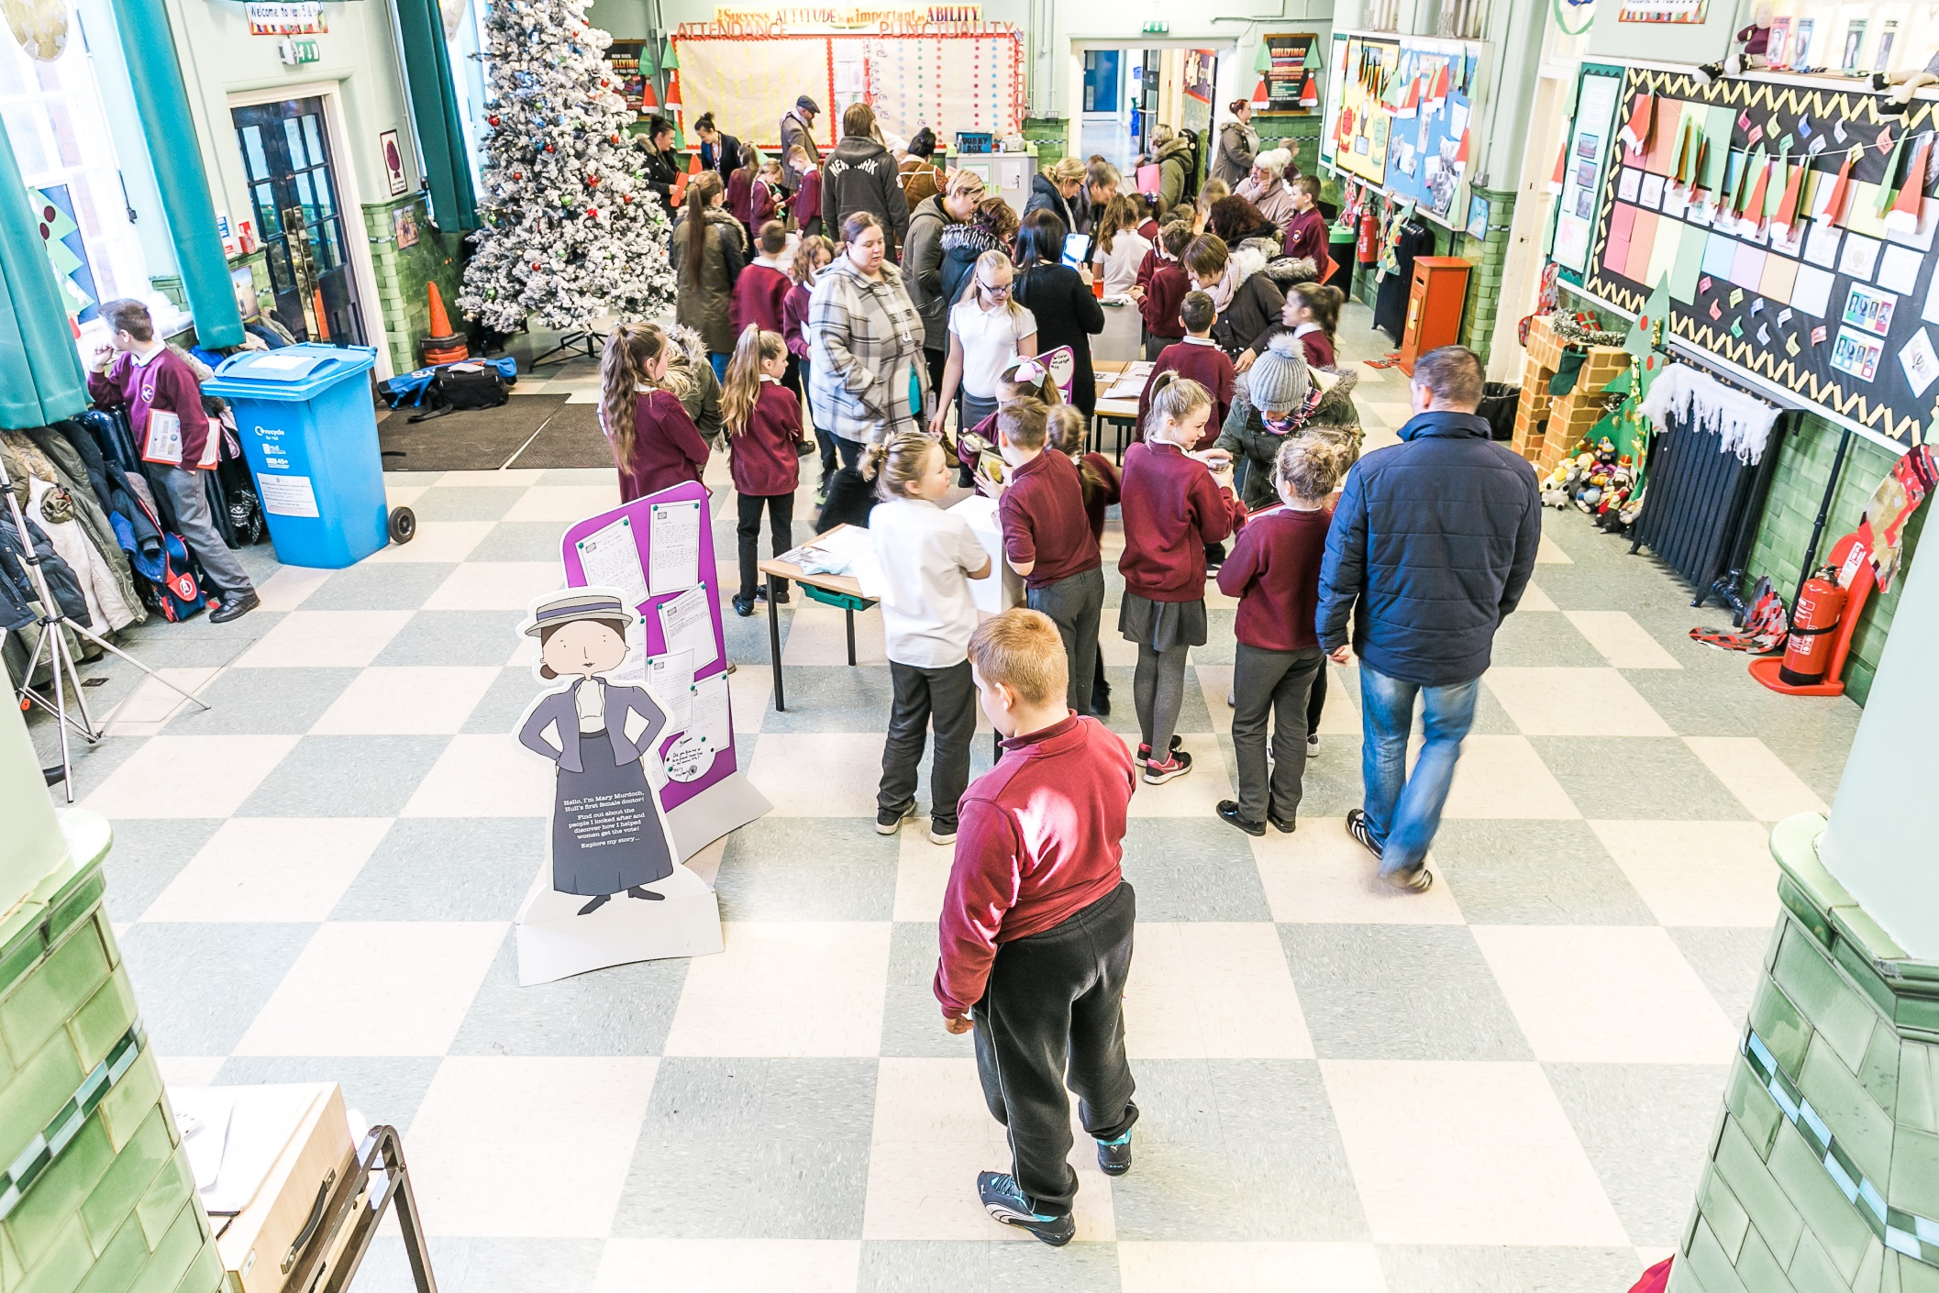
“They’ve been really hooked, they have really enjoyed it. Every one of them was engaged in the pop-up exhibition. There’s been a point to their work at the end of it. It’s not just a piece of work that will go in their topic book.”

Slide 11
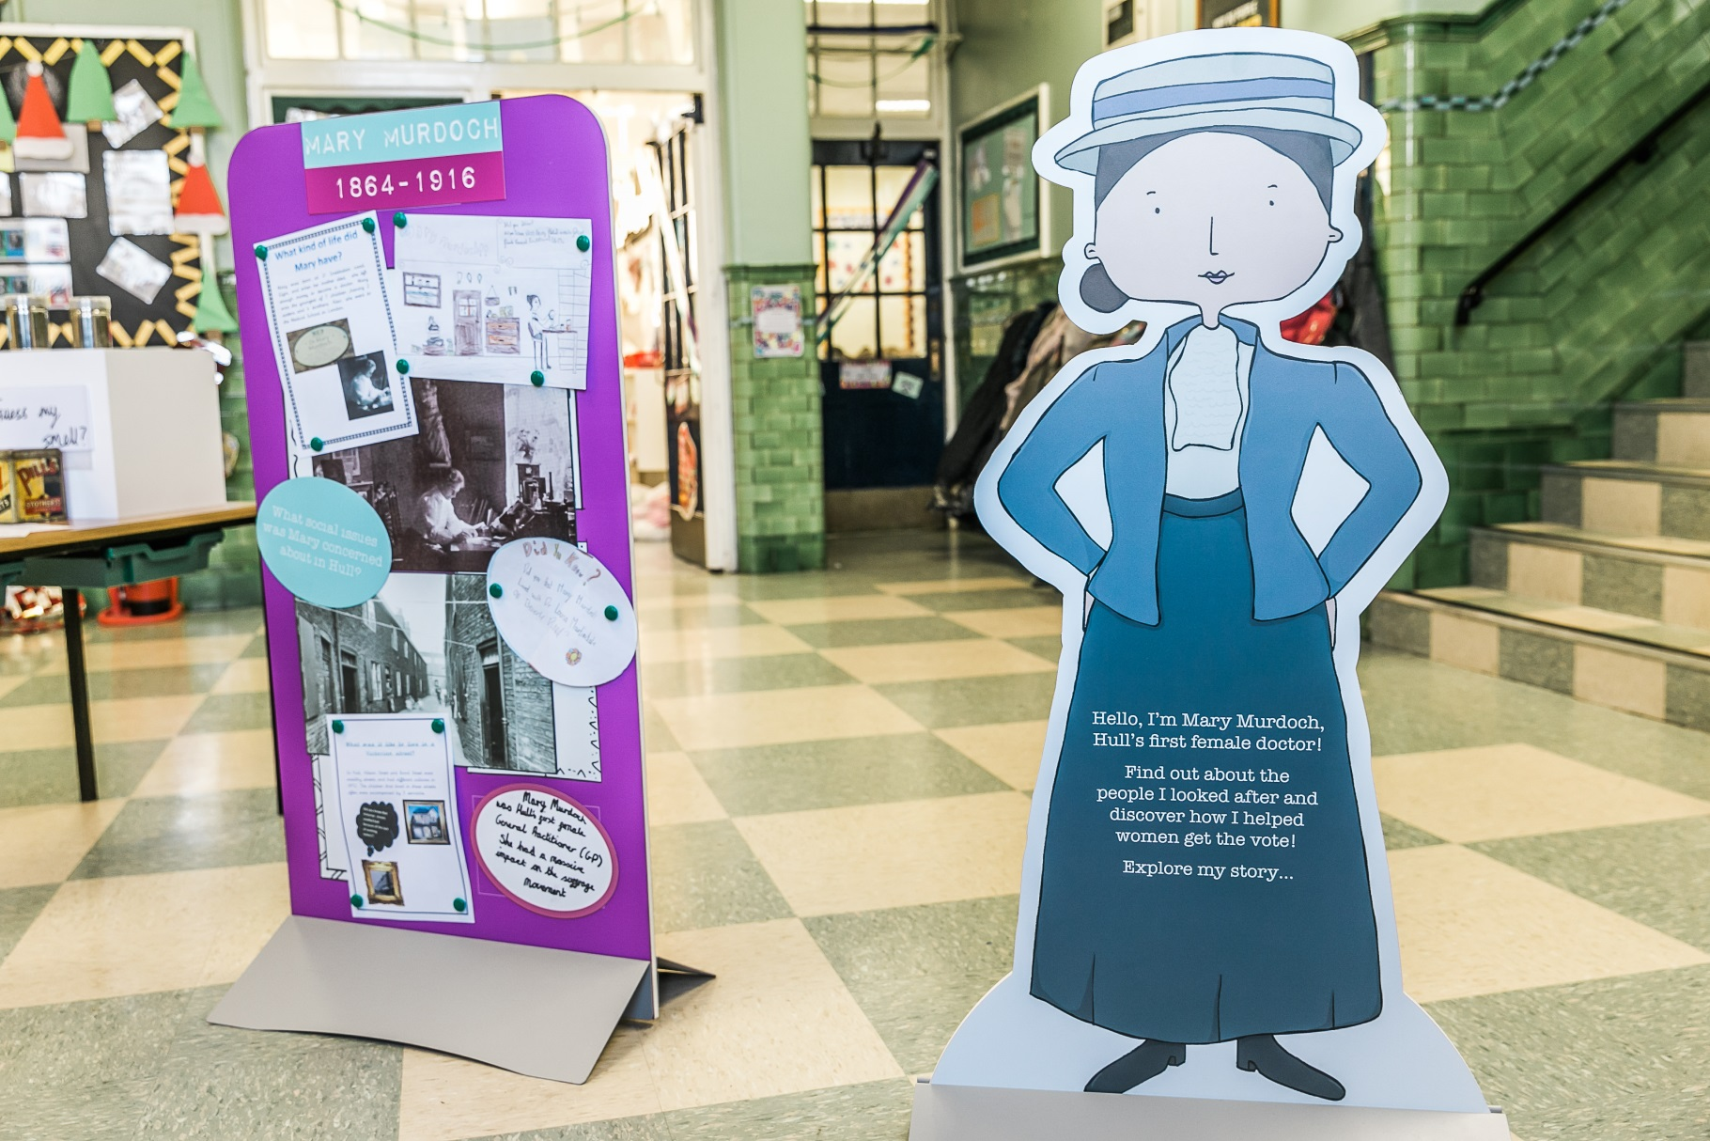
The character was fab because they could visualise what kind of person she was. I know it wasn’t a realistic image, however, it helped them place it in history because of the clothes. That was really useful.

Slide 12
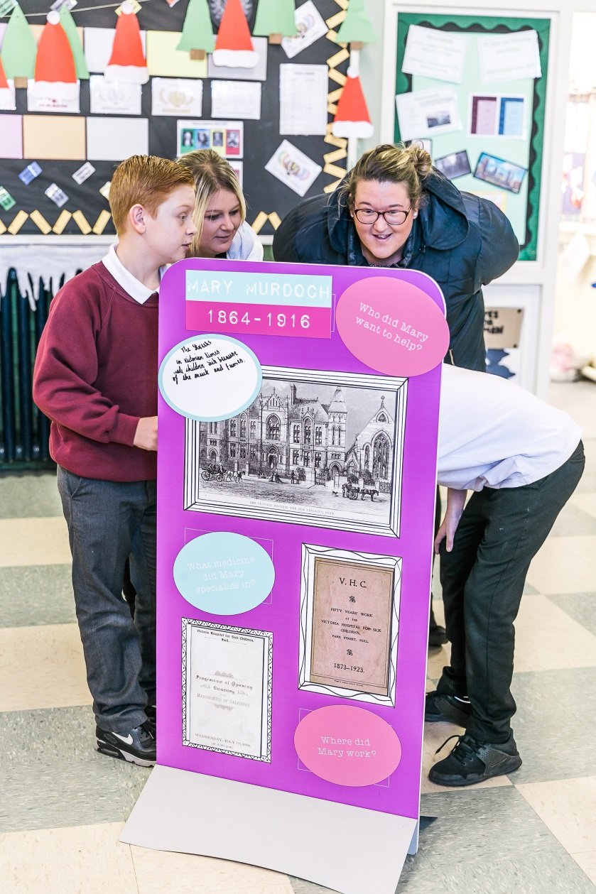
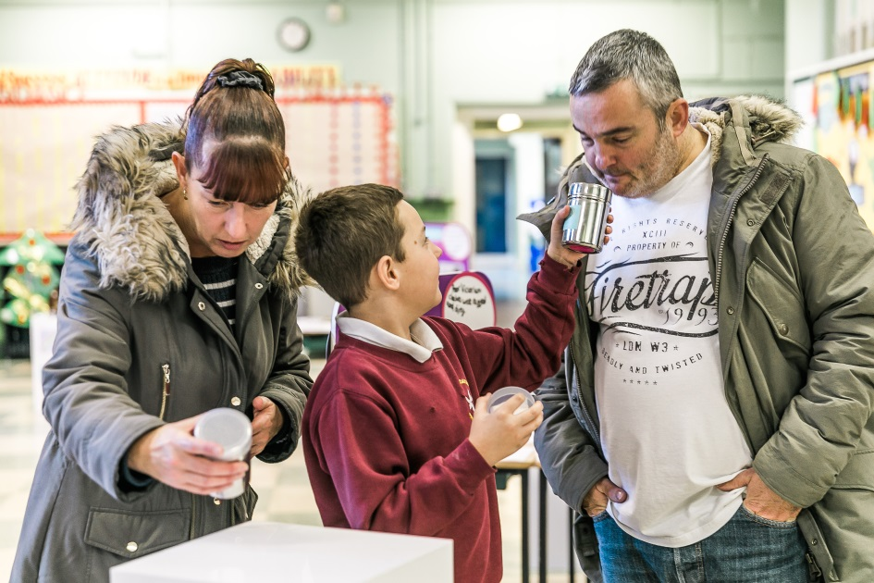
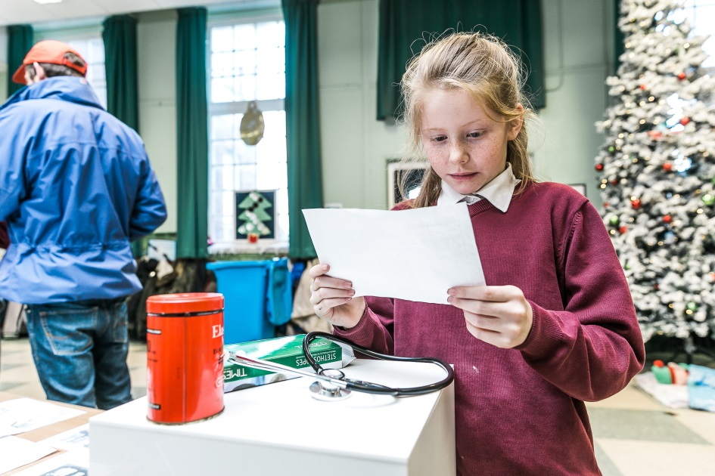
“The history is real; it’s in front of them. I can’t go on enough about having some images, something 3D – an object – in front of you. Whether it’s a picture, a magazine or whether it’s the Votes for Women flag, it just sparks their imagination much more.”

Slide 13
How do schools engage?
The Hull Curriculum 2017 - 2020 offer...
Standard Digital Package
Support in teaching the Hull Curriculum
Interactive Digital Platform
Hull Curriculum School Roadshow
Premium Award Package
Standard Digital Package
Pop-up exhibitions
Priority access to linked learning programmes and creative projects
National Heritage Schools Award

Slide 14
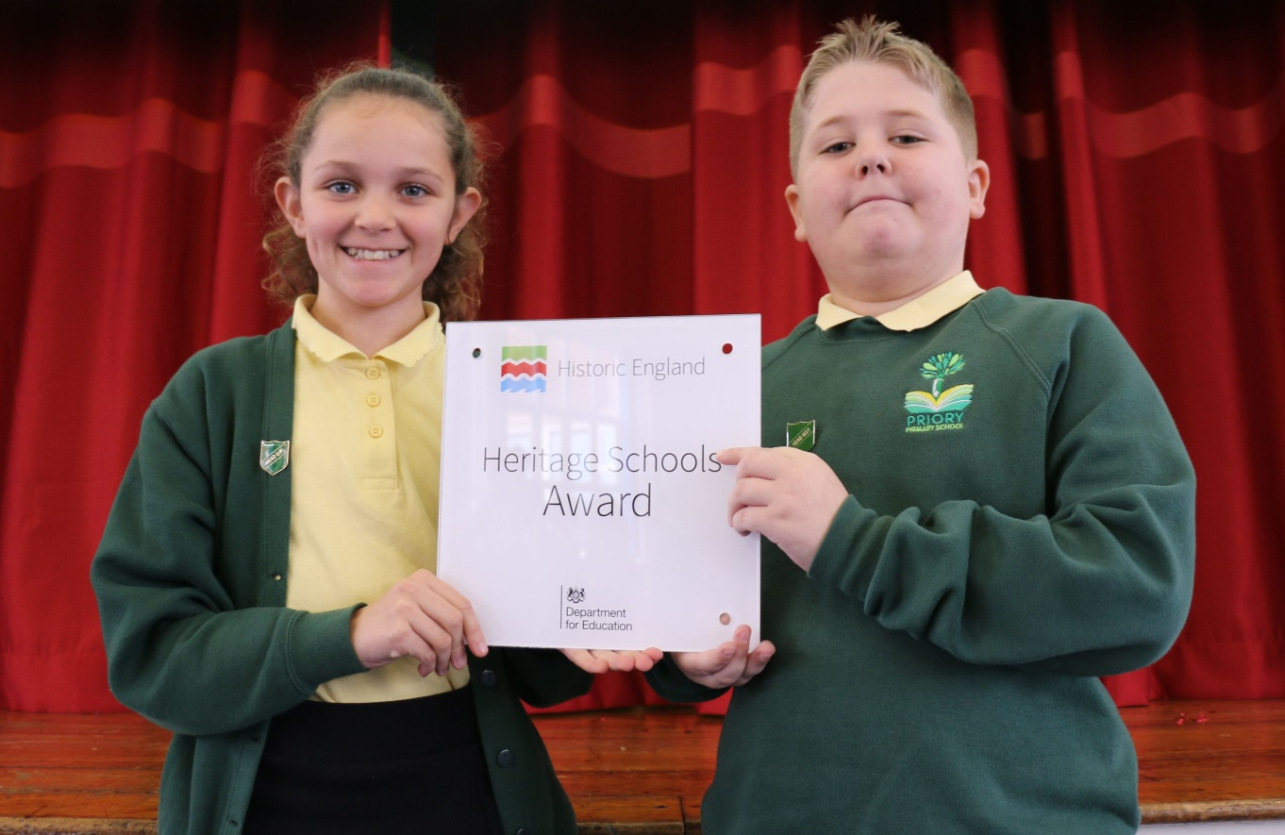
Heritage Schools Award…
Gain recognition for your school’s dedication to teach about your local history and heritage. It’s not too late to apply.

Slide 15
Just a chair?

Slide 16
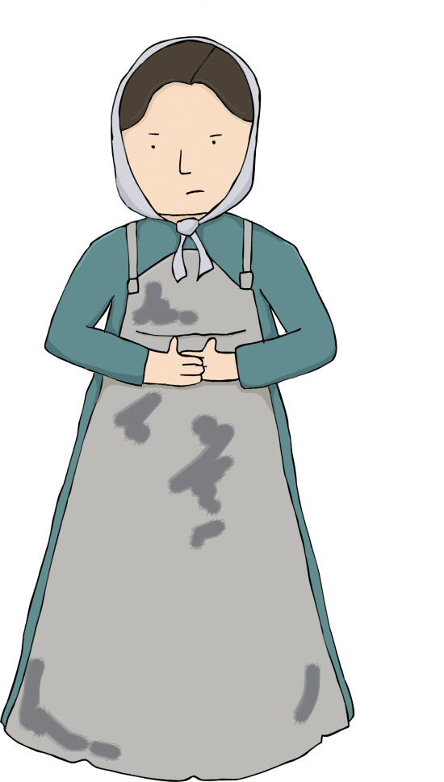
Your challenge… 1
Get inspired by the objects and try and match them up to one of the key histories.
Trying and work out what it is. Take inspiration from the chair activity by asking questions about the object. Discuss with your group.
Once you think you know what it is, which of the 20 histories does it link to?

Slide 17
Your challenge… 2
Create a cross-curricular topic plan linked to one of the Hull Curriculum key histories.
Which history are you going to focus on? Which year group/key stage are you focusing on?
Inner circle – what questions have you go about this history? Think about what questions your pupils would ask. These questions can act as lines of enquiry across your cross-curricular plan.
Outer circle – linked to your questions, what would you teach?
Think about the different curriculum areas.
What else could you do to bring the history and the topic to life? Visits to one of the museums? Resources such as a pop-up exhibition/object loans?

Slide 18
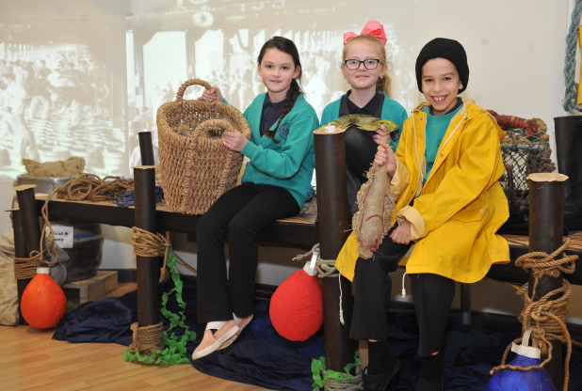
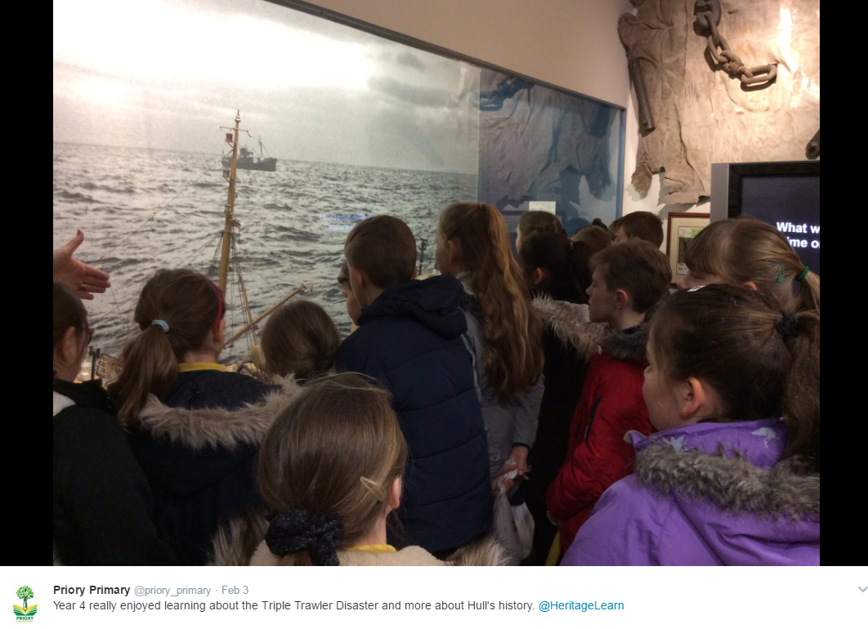
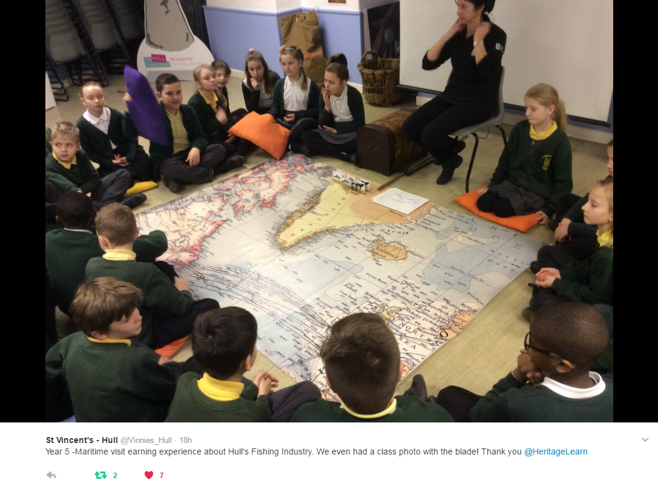
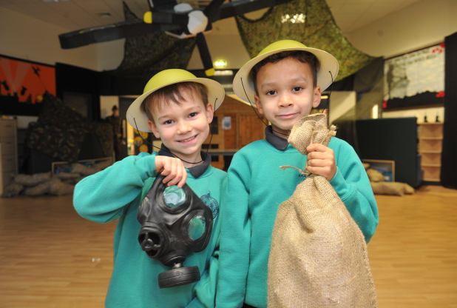
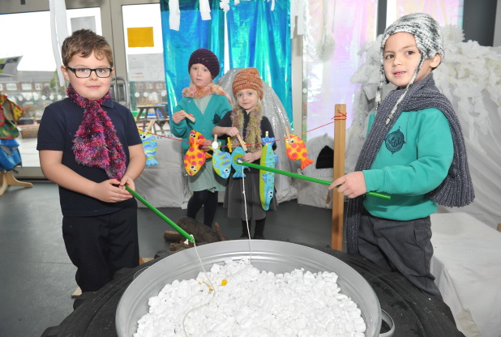
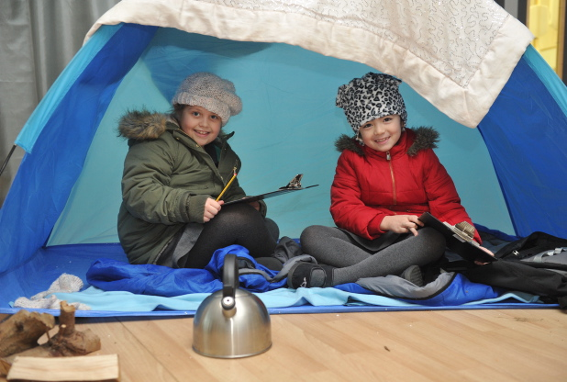
How are schools using it?

Slide 19
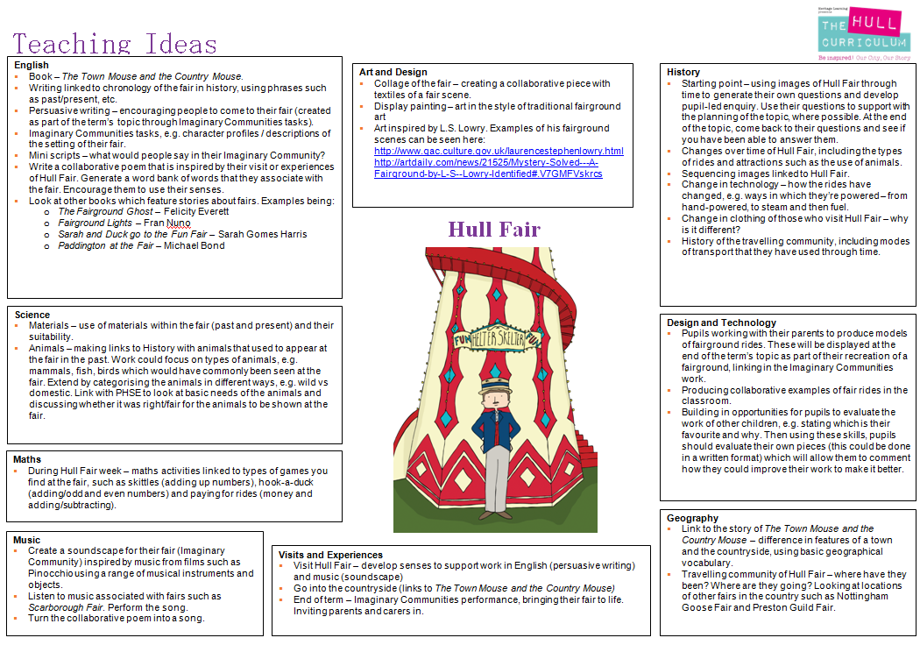
The Green Way Academy (KS1)

Slide 20
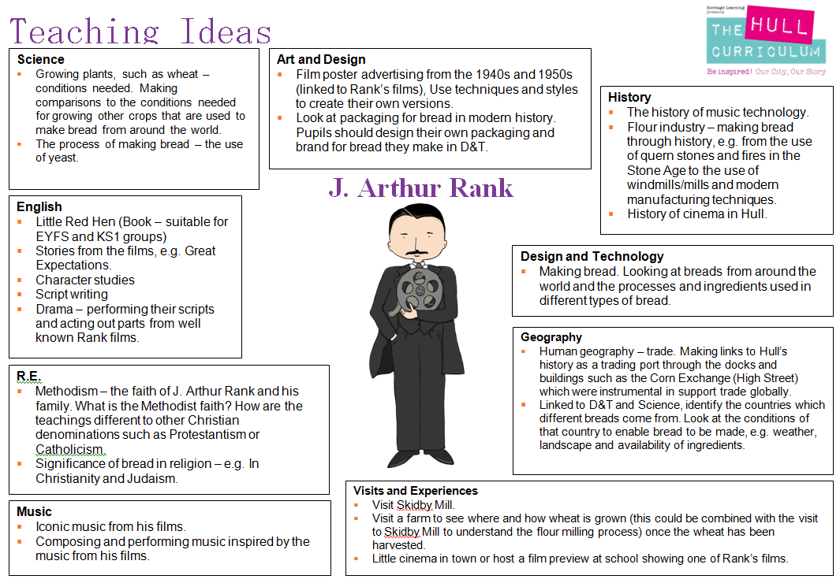
Ings Primary School (KS2)

Slide 21
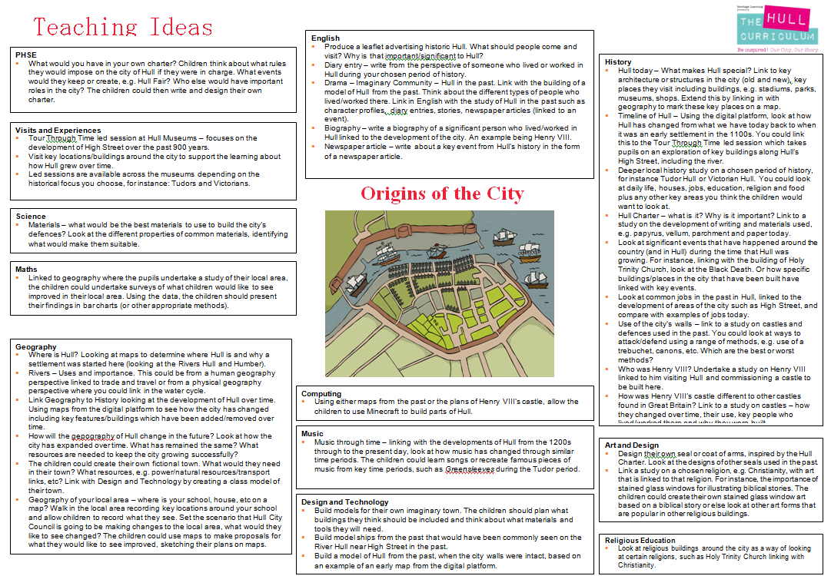
Sutton Park Primary (KS2)

Slide 22
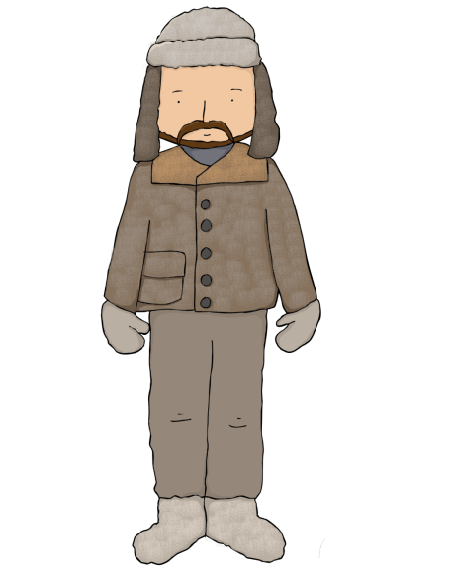
Ongoing support...
zoe.martin@hcandl.co.uk

