Slide 1
Reflecting on your teaching
Dr Julia Lawrence
Head of Teacher Education
University of Hull

Slide 2
Aims of the session
How reflecting on your own practice can support your induction and development as a teacher during your NQT year.
How different tools can be used to support you to develop as reflective practitioners.
How to improve your knowledge of practical examples of tools which can be used within the school environment.
How to identify strengths and challenges in using this type of approach in schools

Slide 3
Links to the teachers’ standards
Standard 2. Plan and teach well structured lessons
Reflect systematically on the effectiveness of lessons and approaches.
Standard 8. Fulfil wider professional responsibilities
Develop effective professional relationships with colleagues, knowing how and when to draw on advice and specialist support.
Take responsibility for improving teaching through appropriate professional development, responding to advice and feedback from colleagues.

Slide 4
Loughran, J.J. (2002) Effective Reflective Practice: in search of meaning in learning about teaching. Journal of Teacher Education, 53 (1) 33 –43.
“Reflective practice has an allure that is seductive in nature because it rings true for most people as something useful and informing. However, for reflection to genuinely be a lens into the world of practice, it is important that the nature of the reflection be identified in such a way as to offer ways of questioning taken for granted assumptions and encouraging one to see his or her practice through others’ eyes. The relationship between, time, experience, and expectations of learning through reflection is an important element of reflection” (Loughran, 2002: 33).

Slide 5
Defining reflection
“active, persistent, and careful consideration of any belief or supposed form of knowledge” (Dewey, 1933, p.9).
“it leads the teacher to make meaning from the situation in ways that enhance understanding so that she or he comes to see and understand the practice setting from a variety of viewpoints” (Loughran, 2002, p.36).
“ability to look back, rethink, and expand one’s view of a classroom enables pre-service teachers to examine the effect that their actions and their students actions have on teaching and learning” (Rhine and Bryant, 2007, p.347).
“as a self - critical, investigative process wherein teachers consider the effect
of their pedagogical decisions on their situated practice with the aims of improving those practices” (Tripp and Rich, 2012, p.678).

Slide 6
Developing reflection
Basic thinking
Problem analysis
Well defined and crafted
“our capacity and ability to engage effectively in the reflective process is progressive in its development” (Lawrence, 2017, p.84).

Slide 7
The safety reins are off!
Transition to NQT:
Isolated
Powerless
Lack of control

Slide 8
Visual stimulated recall (VSR)

Slide 9
Developing reflective practice
Reflecting on practice is integral in effective teaching and learning.
A range of models of reflection exists.
Reflection develops over time moving from description (technical focused) to critique (critical focus).
For reflection to be effective it must:
be valued by those engaging in the process;
have clear criteria against which the reflection is made.
Notes:
Observing and reflecting on teaching and learning is not a new concept. Throughout a teachers career they are likely to have their teaching scrutinized to support they own development, as well as providing feedback on their effectiveness within the classroom.
Traditionally observations are undertaken to the teacher, with them receiving feedback on their teaching from an observer. In many cases this results in a one way dialogue with the observer feedback on their thoughts of the lesson, with limited opportunity for the teacher themselves to reflect on their teaching.
However, reflecting on their own teaching allows them to explore and explain the decisions they have made in preparation for, during and after the lesson.
Literature as detailed within the article identifies a range of approaches to reflection.
Predominantly levels of reflection have been identified as moving from a descriptive / technical focus, through a deliberate / conceptual / justification stage and culminating in a level of critique.
(van Mann (1977), Day (1993) and Tsangaridou and O’Sullivan (1994))
However in supporting teachers to become more reflective, providing a reflective structure allows scaffolding of learning to be undertaken. In essence, it allows the teacher to focus on specific aspects of their teaching rather than just providing a description of what they have done.
To support this focused questioning was undertaken as part of the pre and post lesson discussion aspect of the study.
For example during pre lesson discussions, the focus was on what they wanted the pupils to achieve by the end of the lesson, and how would they know they had been successful.
In respect of the post lesson discussion, teachers were asked to reflect on the following questions.
Based on your lesson objectives, what specific evidence do you have that the pupils achieved these and made progress?
Based on your lesson (specific observation from the lesson) for example - how could you enhance the quality of some of the pupils’ work?
Based on the PELOT characteristics (attached) provide a brief summary of how you feel you met each group of characteristics - for example how would you evidence that you presented your instructions in a meaningful, clear and concise manner?
From your lesson – describe in detail two of the things you were most pleased with.
From your lesson – describe in detail one thing you would like to improve.
Based on your evaluation what are the key PELOT characteristics you would like to focus on for the next observation?
Based on your evaluation provide a short summary of what you are intending to teach in your next lesson?

Slide 10
VEO – Why? How? What?
Video Enhanced Observation (VEO)
Why?
Value-added recording
Customisable tags
Facilitates online discussions
Affordable
How?
During lesson observations and post-lesson discussions
By self/peer/mentor/supervisor
iPad, wireless mic and receiver
Notes:
A range of data collection methods were employed.
As has previously been mentioned a focus on planning through pre lesson discussion and teaching through post lesson discussions were paramount. Further asking the teachers to comment on how their approaches over time allowed for a the impact of the process to be reviewed. Further how these changes were to be embedded in personal practice (through the transition plan) and more importantly across the departments (departmental development plan) provided opportunities for further review to be undertaken to identify the extent to which behaviours continued or reverted back to how they had previously been.
However a key aspect of the data collection was the use of VEO to support reflections.

Slide 11
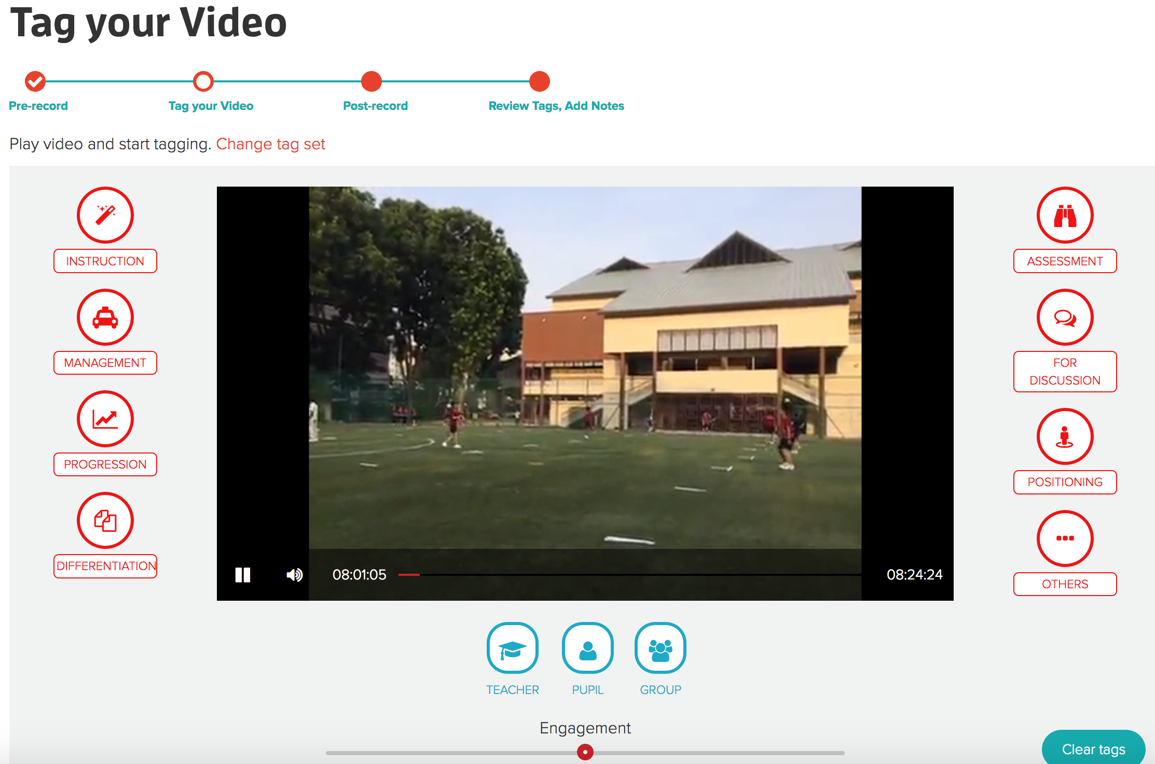
VEO allows on-the-spot/delayed tagging
of recordings.

Slide 12
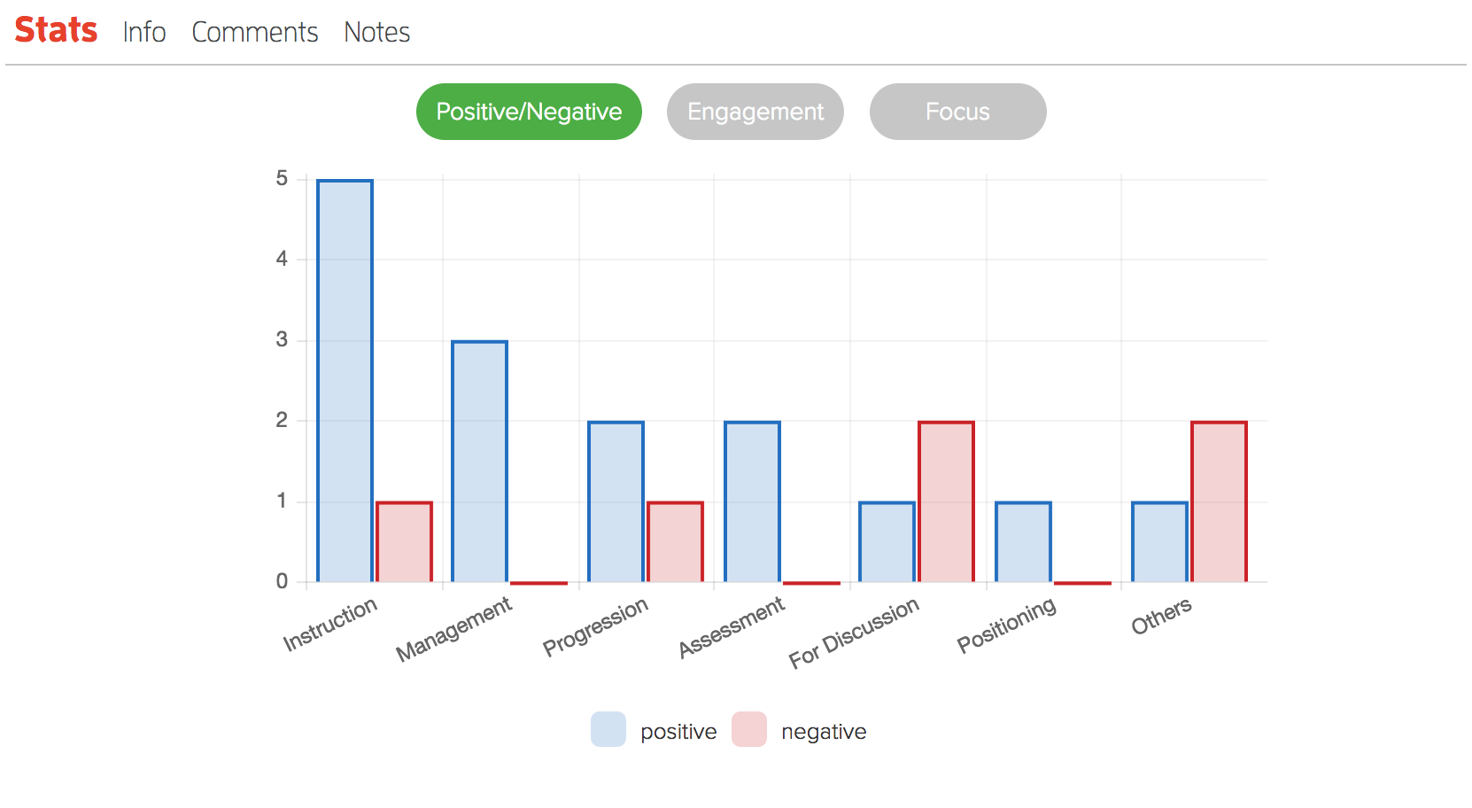
Provides statistics of the lesson observed.

Slide 13
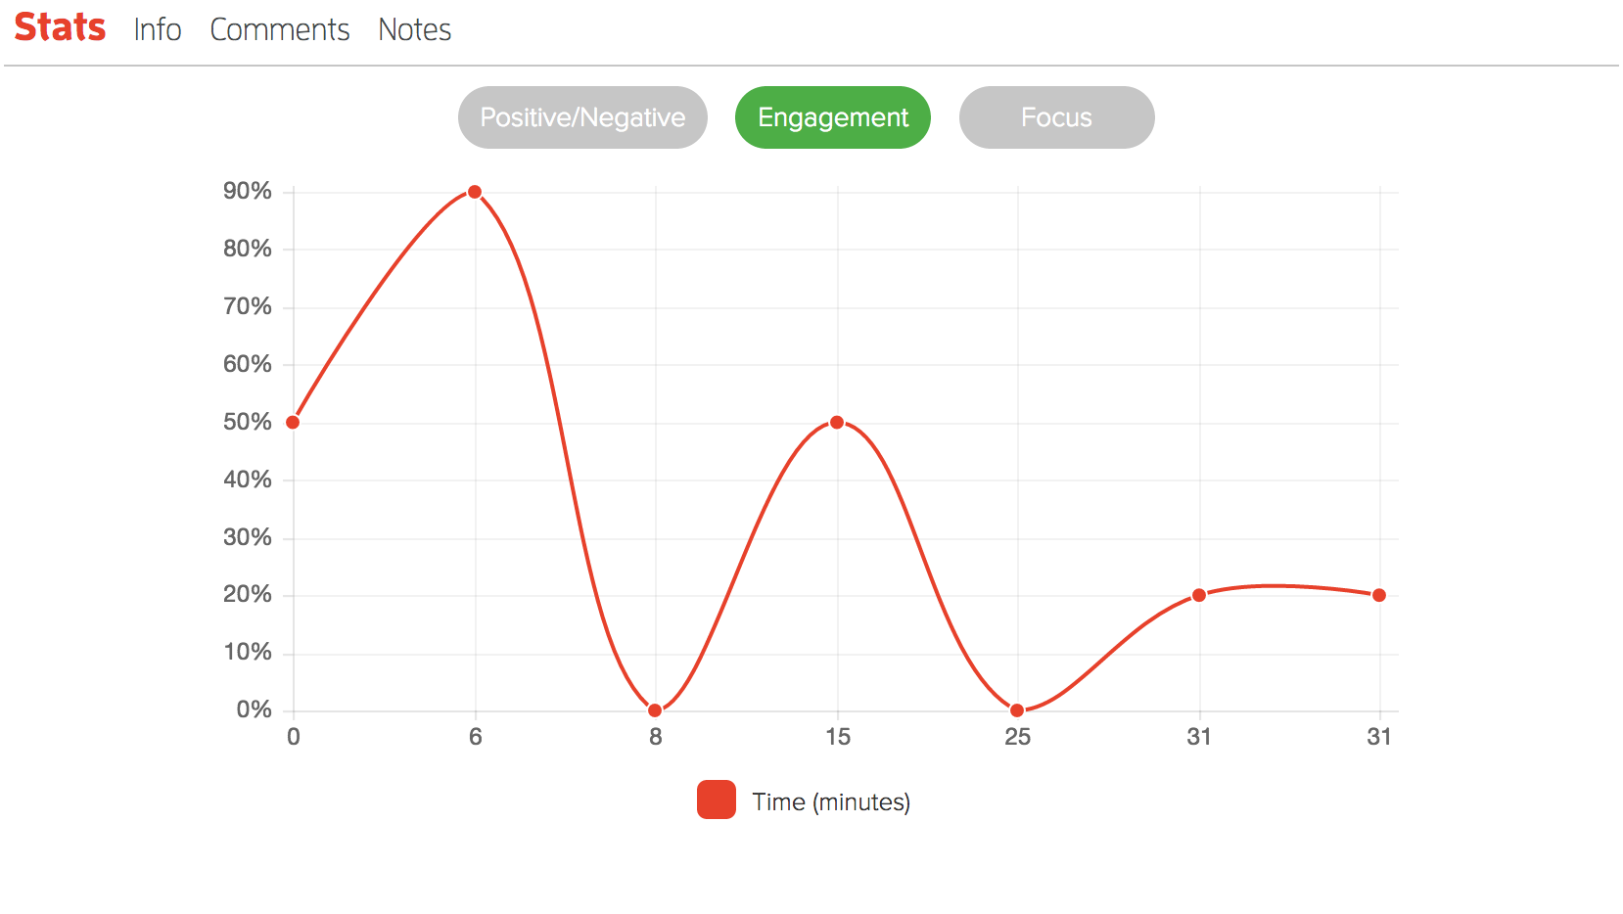
Provides statistics of the lesson observed.

Slide 14
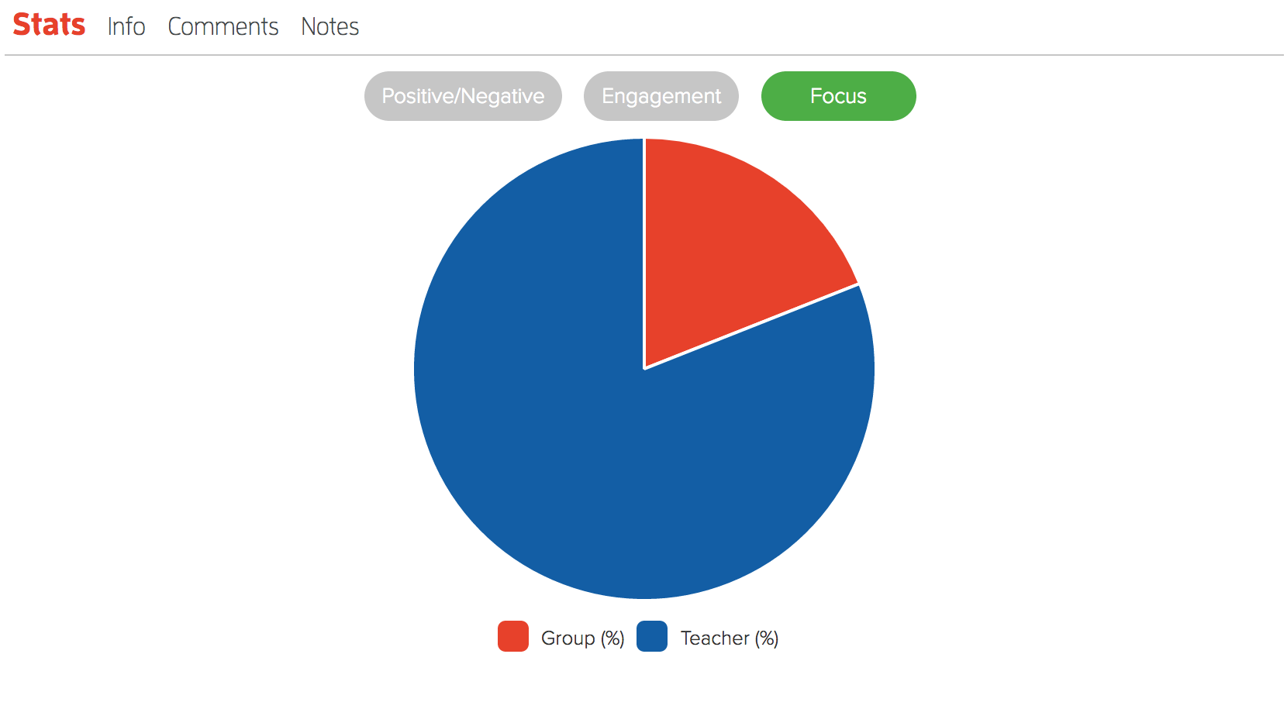
Provides statistics of the lesson observed.

Slide 15
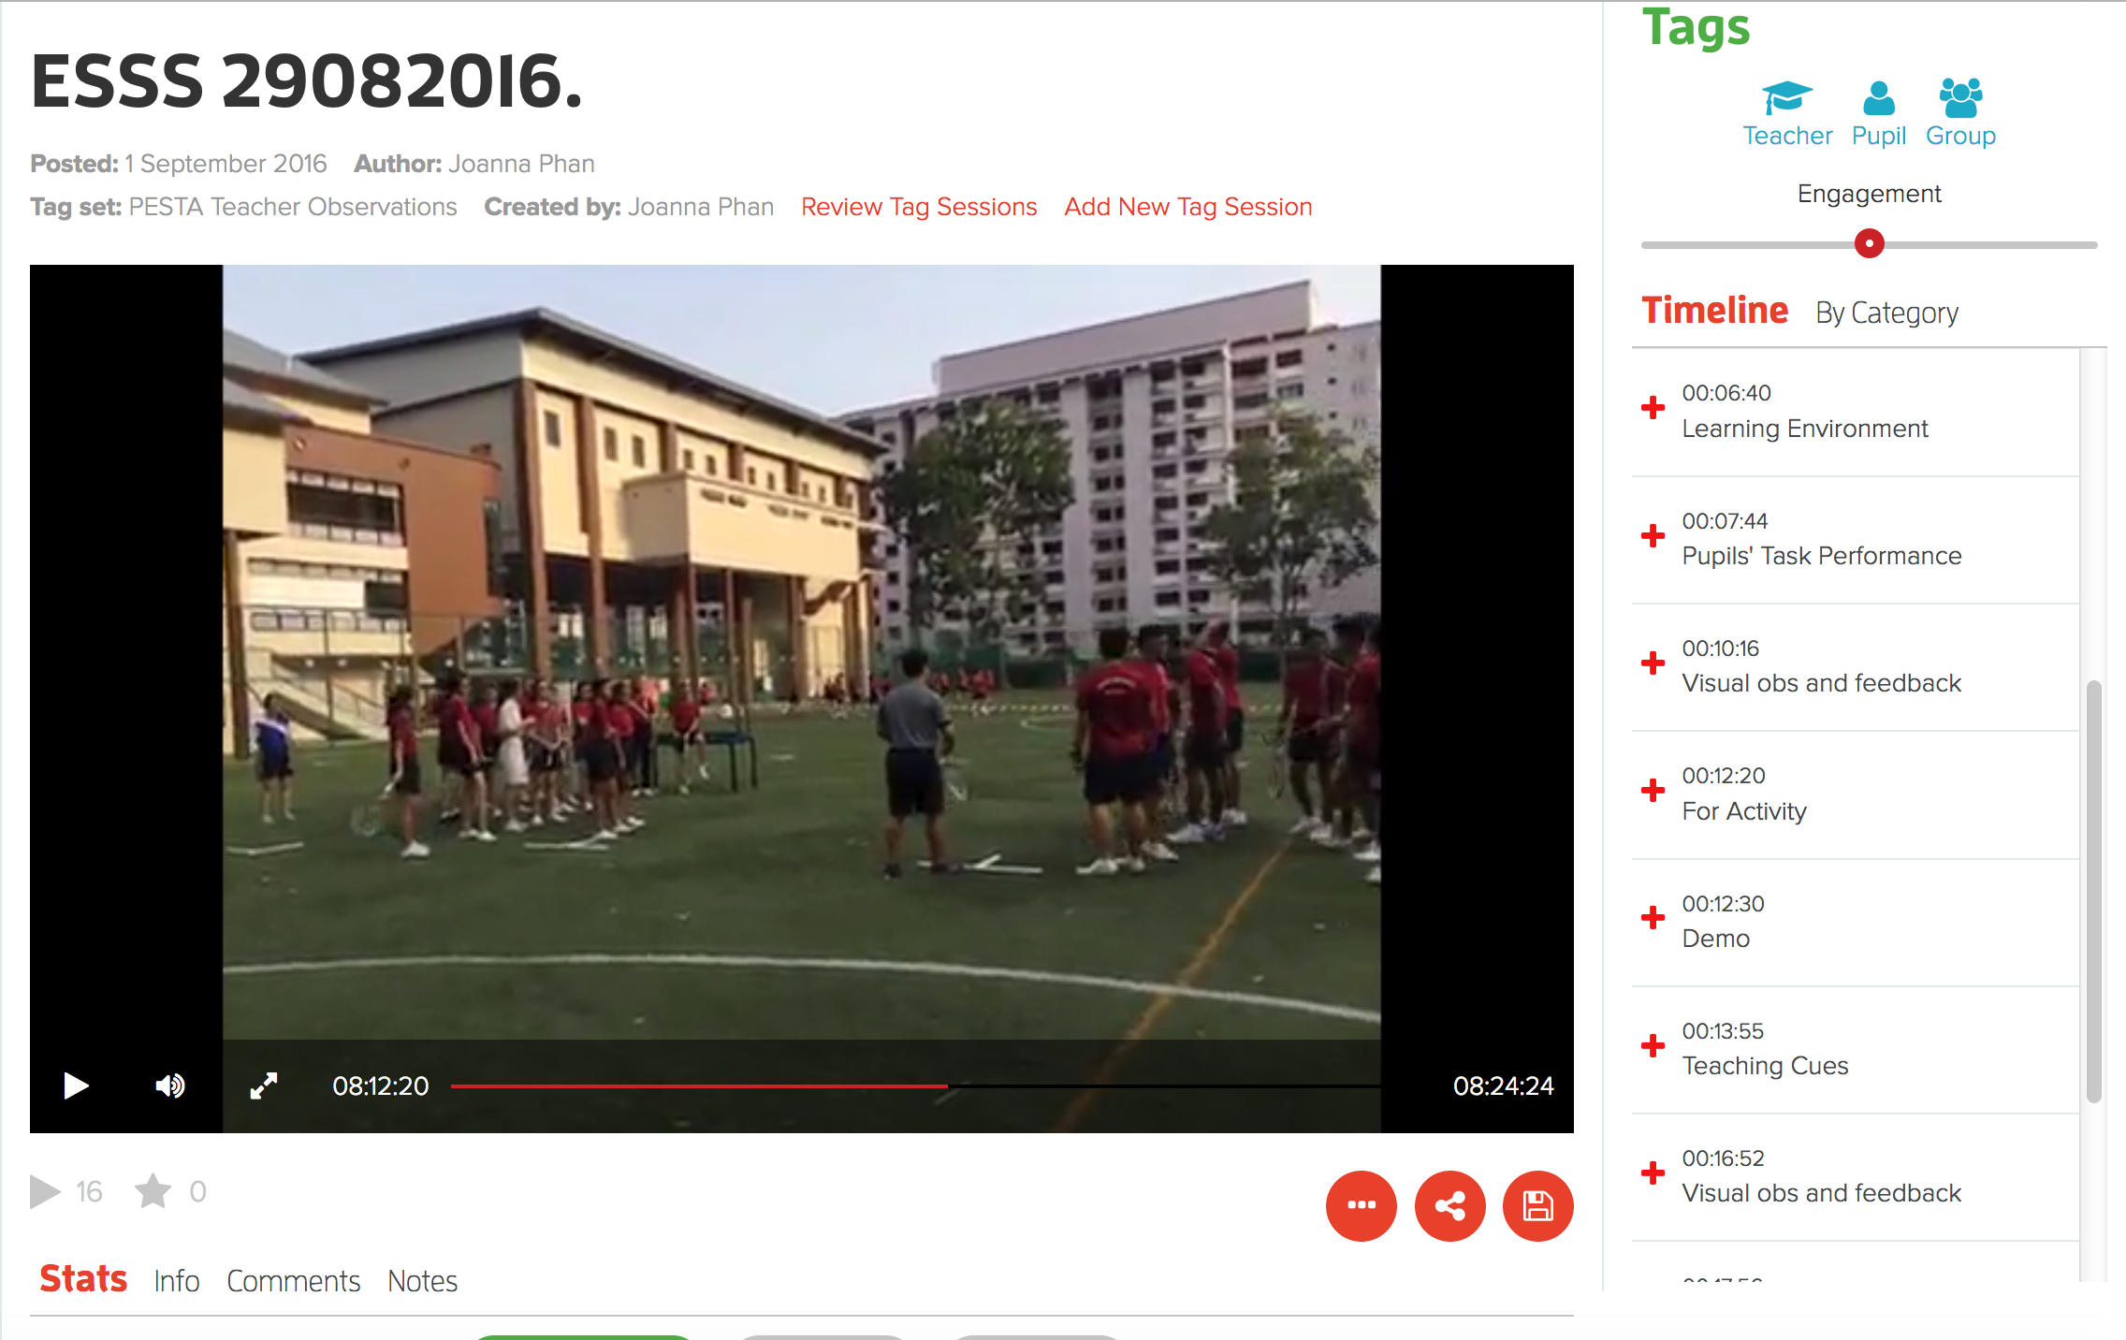
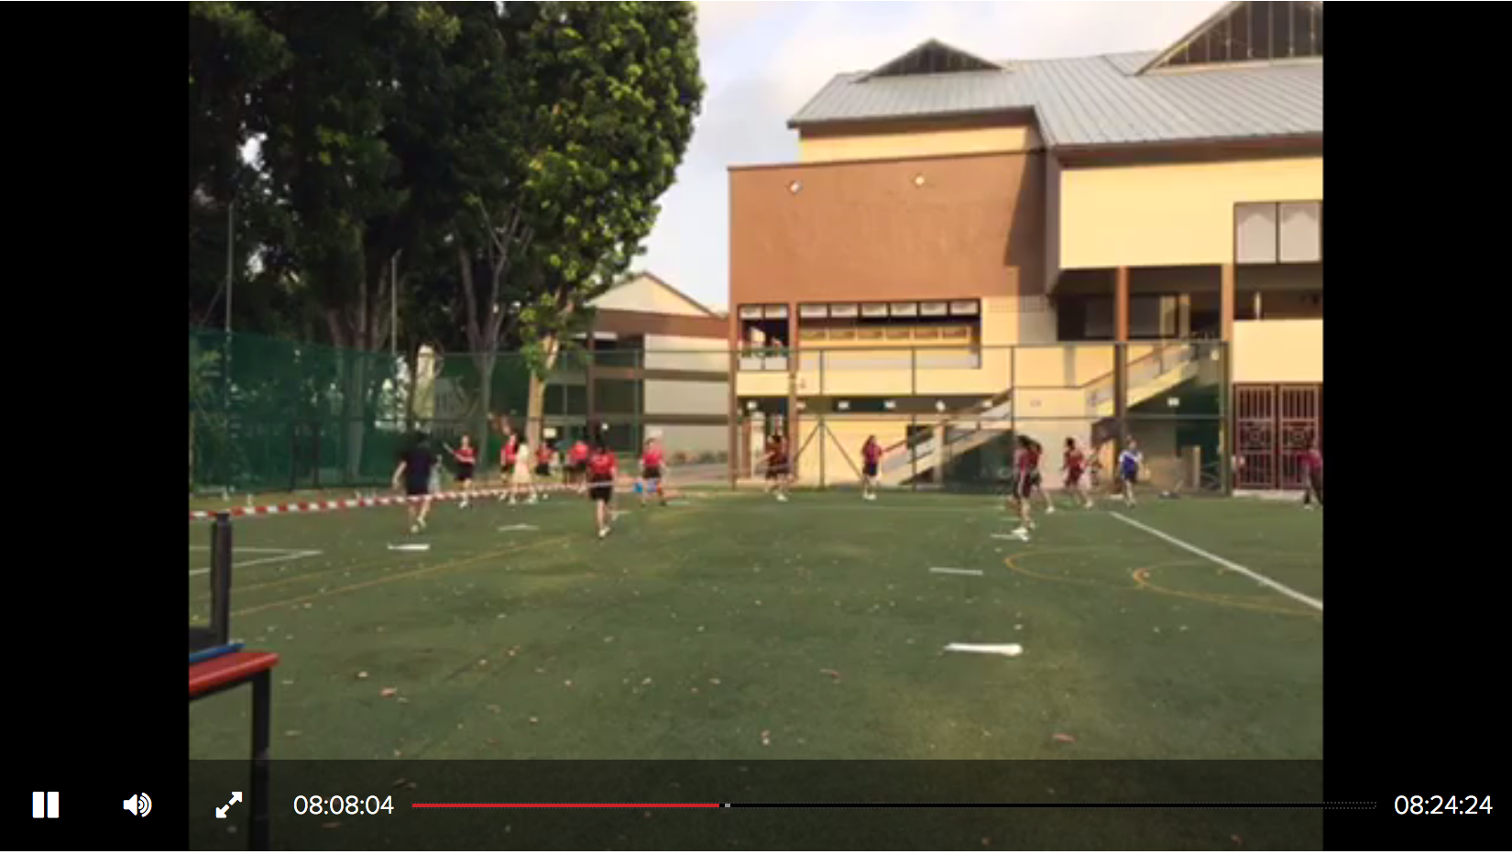
Stimulated recall during discussions;
moderates perceptions with data/evidence.
Visual obs and feedback
Common errors addressed and reminded students of cues.
00:10:16
00:24:24
00:00:00
00:24:24

Slide 16
Stimulated recall during discussions;
moderates perceptions with data/evidence.
Visual obs and feedback
Common errors addressed and reminded students of cues.
00:10:16
00:24:24

Slide 17
Impact on teaching & teachers
Increased willingness to try out new teaching approaches.
Increased confidence in teaching abilities.
Development of reflective practices from technical to situational aspect of reflection.
Notes:
I will give a specific example from either of the school for each point.

Slide 18
Questions to consider
The transition from QTS to NQT can be challenging. Hobson (2016) identifies some of issues associated with this and the negative consequence it might have on the individual as a whole. As a teacher embarking on your career, what strategies do you plan to engage with to ensure that how would you minimise any risk associated with engagement in the reflective process?
One of the most beneficial approaches to support reflections on your teaching is the use of visually stimulated recall, whichallows you to observe yourself teaching.
a. How would you feel about engaging in such a process?
b. What strategies would you employ to ensure that this was a positive experience?
c. How would you use the experience to inform your own practice?
d. How would such a process support you in evidencing your progress towards meeting your NQT standards and moving forward be used to support your professional development?
Having reviewed range of models of reflection:
a. Which approach do you feel would be the most effective to support your own professional development?
b. How do you plan to embed the reflective process in your day – to – day teaching to ensure that plan and deliver high quality lessons?

Slide 19
References and further reading
Department for Education (2011) Teachers’ Standards: Guidance for school leaders, school staff and governing bodies. London: DFE.
Dewey, J. (1933) How we think. Henrey Regney, Chicago.
Kayapinar, U. and Erkus, A. (2009) Measuring teacher reflection: development of TRS. Eurasian Journal of Educational Research, 37 144 –158.
Lawrence, J. (2017) Reflecting on your practice. In W. Jolliffe and D. Waugh (eds) NQT: The Beginning Teacher’s Guide to Outstanding Practice. London: Learning Matters.
Lawrence, J., Low, K., and Phan, J. (2016) The impact of a high intensity observation programme in Singapore. Paper presented at 6th Annual International Conference on Education and e-Learning. 26 –27thSeptember, Singapore.
Loughran, J.J. (2002) Effective Reflective Practice: in search of meaning in learning about teaching. Journal of Teacher Education, 53 (1) 33 – 43.
Rhine, S. and Bryant, J. (2007) Enhancing pre - service teachers’ reflective practice with digital video-based dialogue. Reflective Practice: International and Multidisciplinary Perspectives, 8 (3) 345 –358.
Tondeur, J., Kershaw, L.H., Vanderlinde, R. and van Braak, J. (2013) Getting inside the black box of technology integration in education: Teachers’ stimulated recall of classroom observations. Australasian Journal of Educational Technology, 29 (3) 434 –449.
Tripp, T. and Rich, P. (2012) Using video to analyse one’s own teaching. British Journal of Educational Technology, 43 (4) 678 –704.

