Slide 1
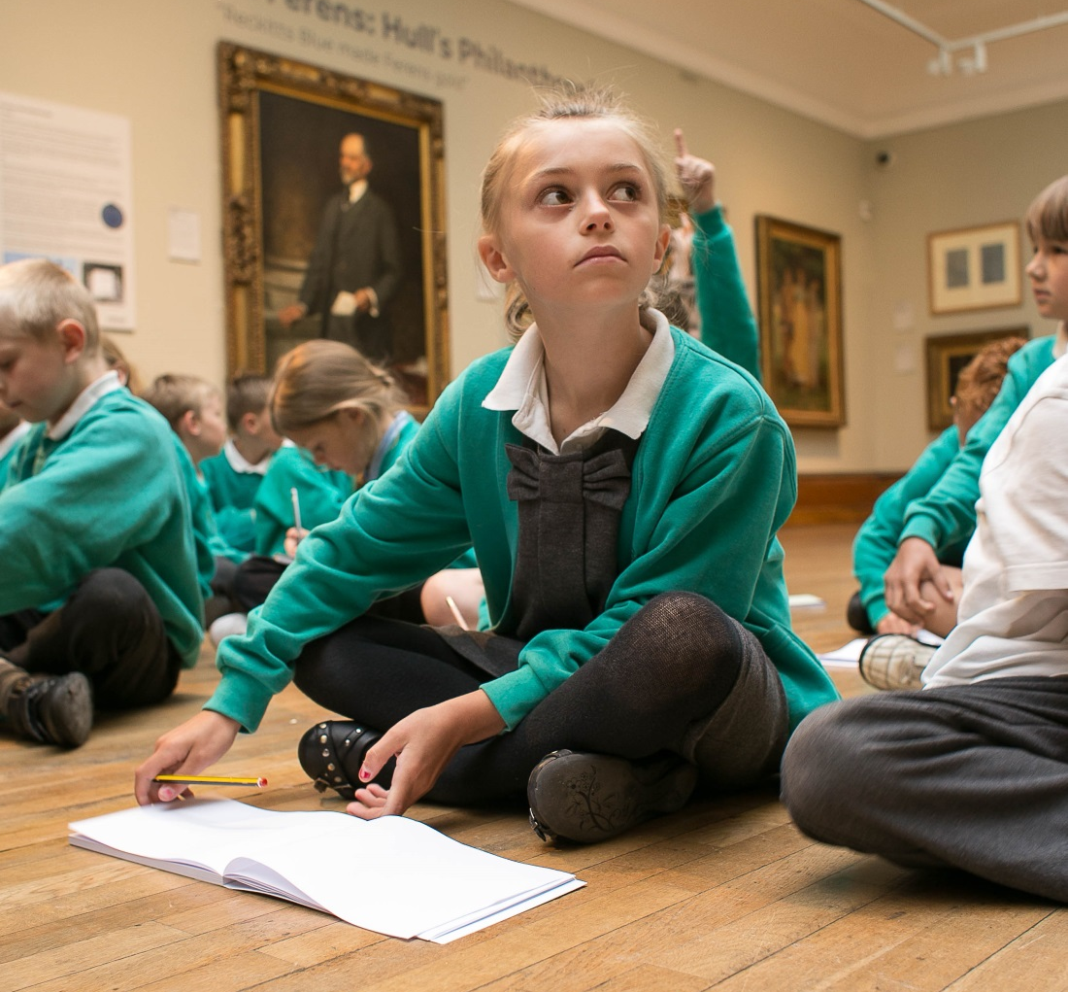
FORMAL LEARNING AT FERENS ART GALLERY

Slide 2
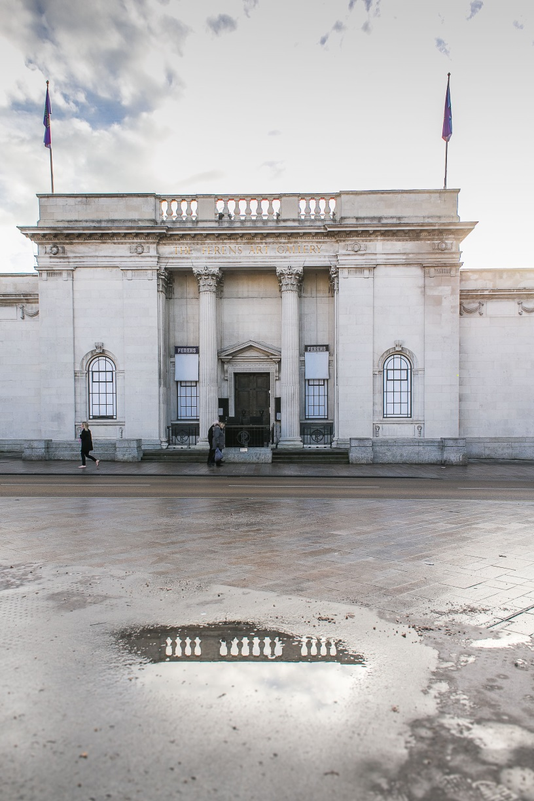
FERENS ART GALLERY
Ferens Art Gallery opened to the public in 1927, ninety-one years ago.
Thomas Robinson Ferens, who had made his fortune working for Reckitts, paid for its’ construction and initially filled it with artworks he had himself purchased including popular gems of the Ferens collection “The Sirens” and “The Lion at Home”.
On Ferens’ death in 1930 he left an endowment that ensures that artworks can be bought and the gallery kept as a free resource for the people of Hull even in today’s modern climate, with other cities being forced to sell their collections in the face of cuts and austerity.
BUT ARE ART GALLERIES STILL RELEVANT TODAY?
WHY IS IT IMPORTANT THAT SCHOOL CHILDREN ARE GIVEN THE OPPORTUNITY TO VISIT ART GALLERIES?

Slide 3
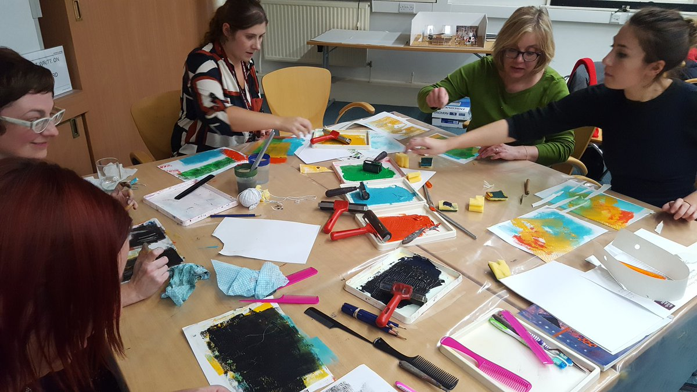
SESSIONS DEVISED THROUGH CONSULTATION
FERENS CULTURAL STEERING GROUPS
OTHER TEACHERS EVENTS
QUESTIONAIRES
ONGOING CONSULTATION

Slide 4
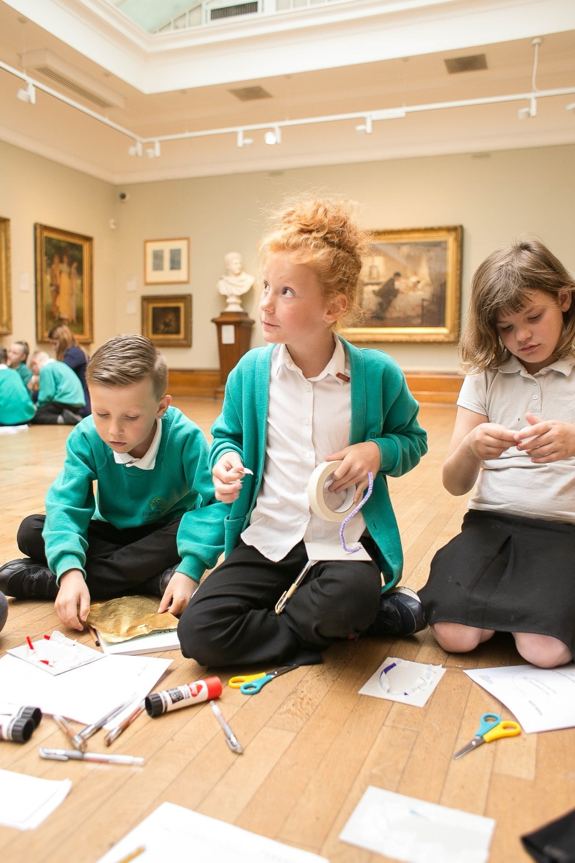
BENEFITS
LINKS TO ART AS A CAREER PATH
IMMERSIVE ENVIRONMENT
FIRST HAND ACCESS TO THE ART
TIME SPENT MOVING ABOUT
SOME FAMILIES JUST DON’T VISIT GALLERIES
CAN’T BE REPLICATED IN SCHOOL
LARGE SPACES
SOCIAL SPACE (PSED, PHYSICAL DEVELOPMENT)
CREATIVE WORK CAN BE INSPIRED BY ART ON DISPLAY

Slide 5
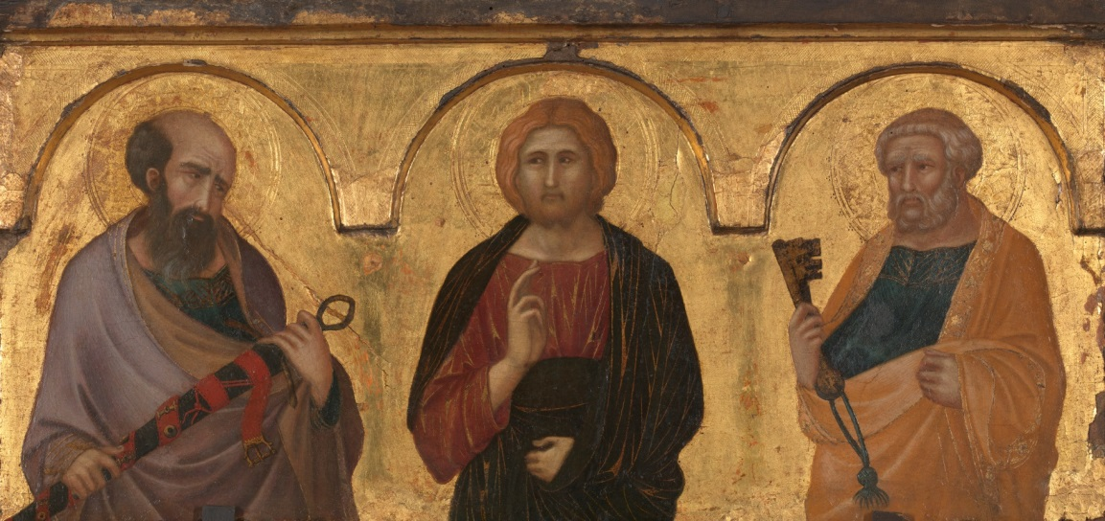
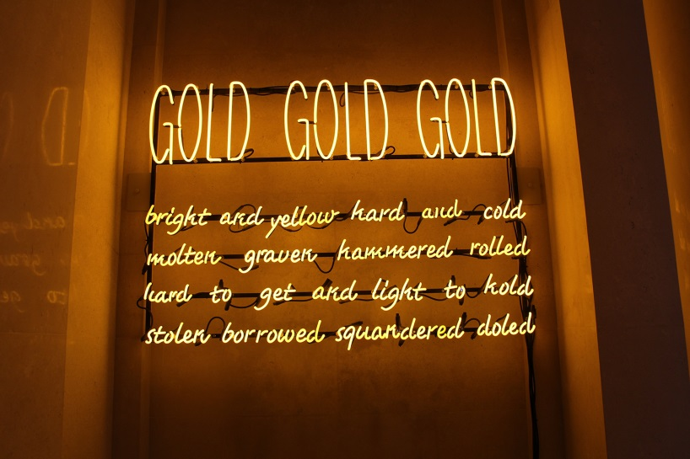
SCHOOLS SESSIONS ARE EMBEDDED INTO THE FERENS COLLECTION
SESSIONS FOLLOW THE CHRONOLOGICAL FORMAT OF THE PERMANANT COLLECTION AS THEY TRAVERSE THROUGH THE GALLERY
BUILDING CONFIDENCE AND OWNERSHIP OF THEIR GALLERY
DISCOVER HOW WESTERN EUROPEAN ART HAS DEVELOPED FROM 1320- PRESENT DAY

Slide 6
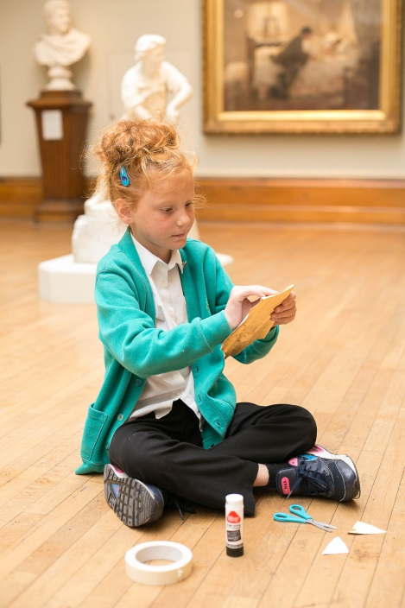
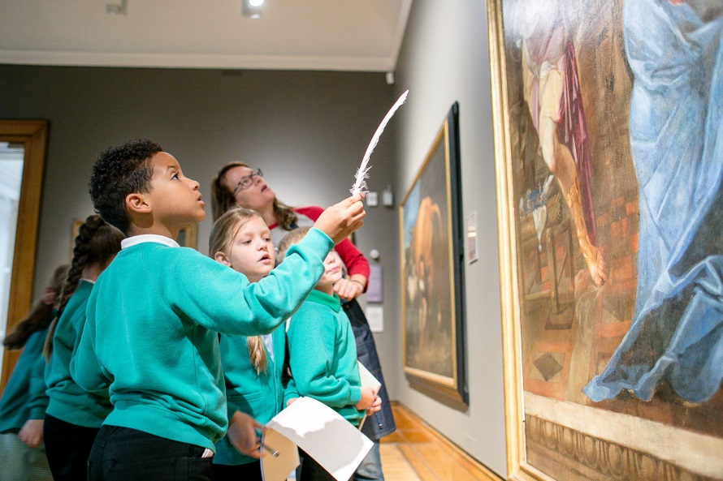
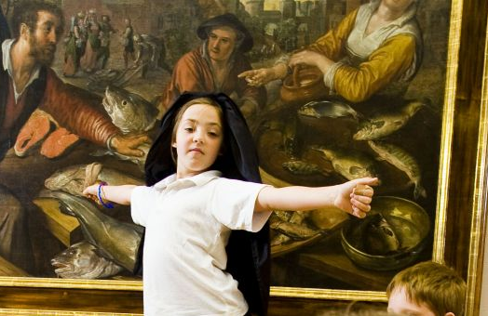
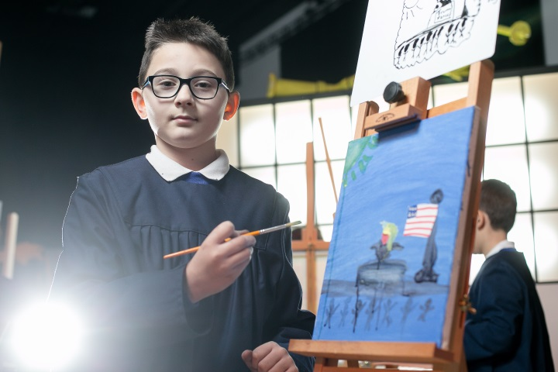
THINK!
MAKE!
INSPIRE!
SHOW!

Slide 7
DAY IN THE LIFE OF AN ARTIST SECONDARY AND PRIMARY

Slide 8
FOUNDATIONS OF ART
LINE
COLOUR
SHAPE
TEXTURE

Slide 9
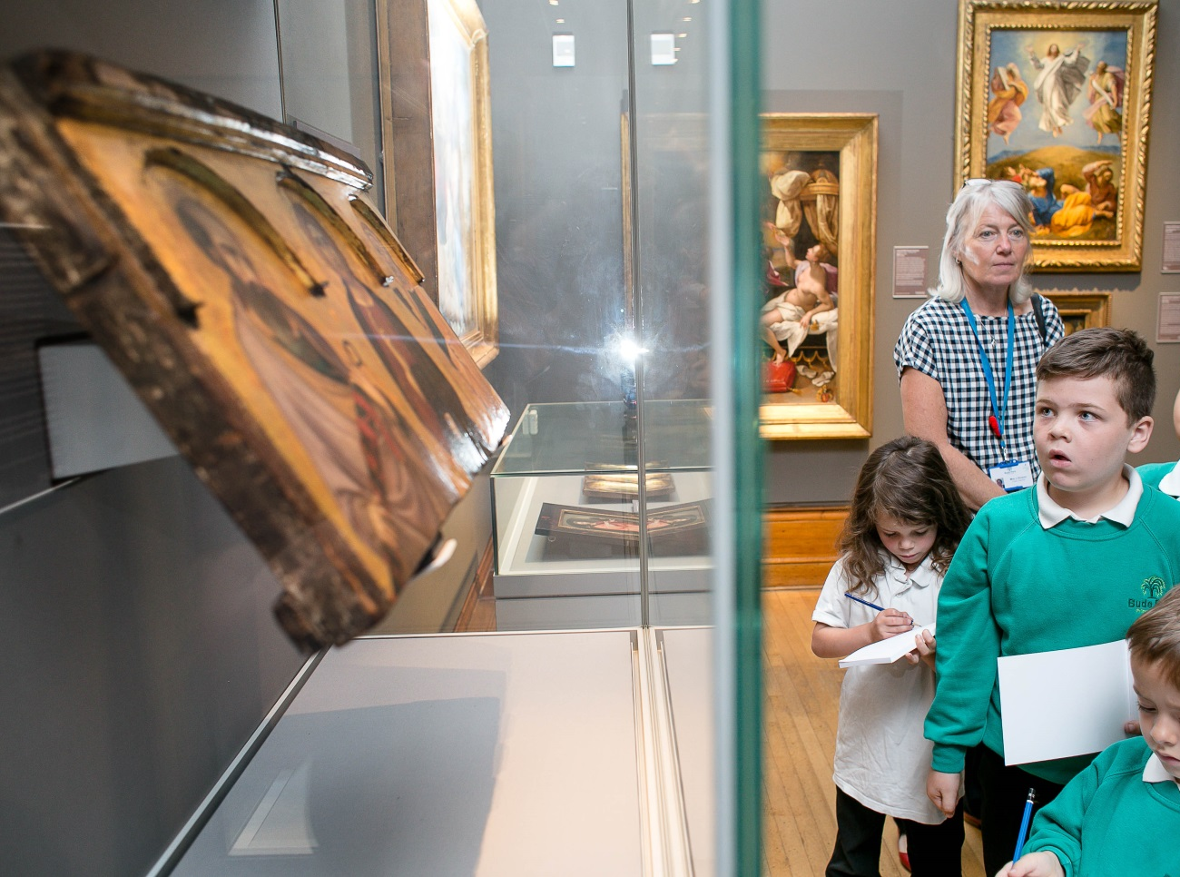
DISCOVER ART AND JOURNEYS IN ART
ON GALLERY SESSIONS FOR KS1 AND 2

Slide 10
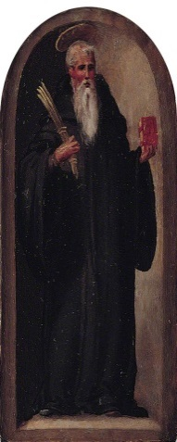
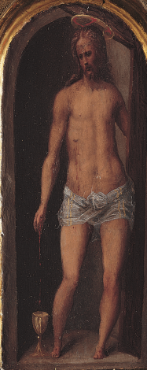
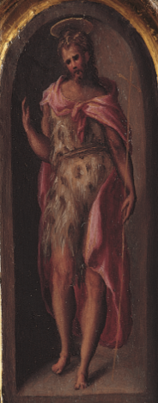
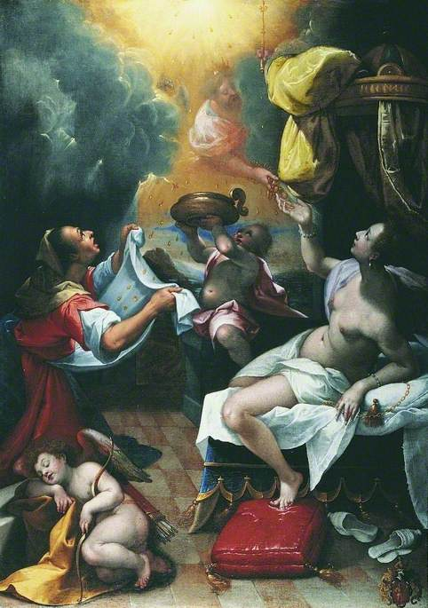
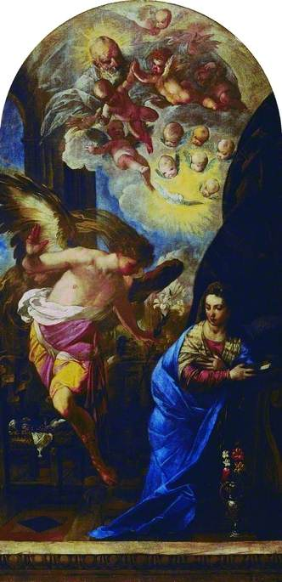
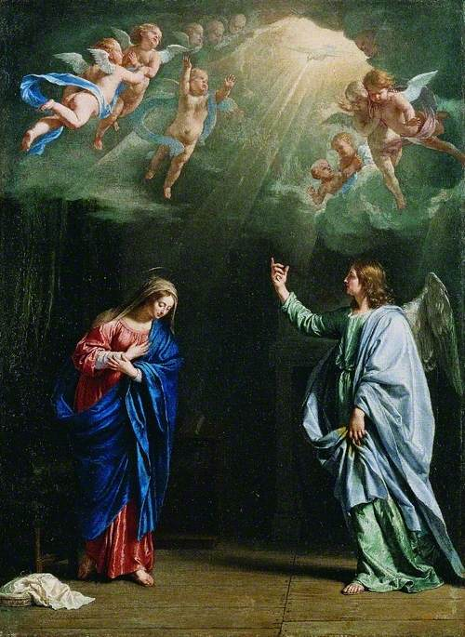
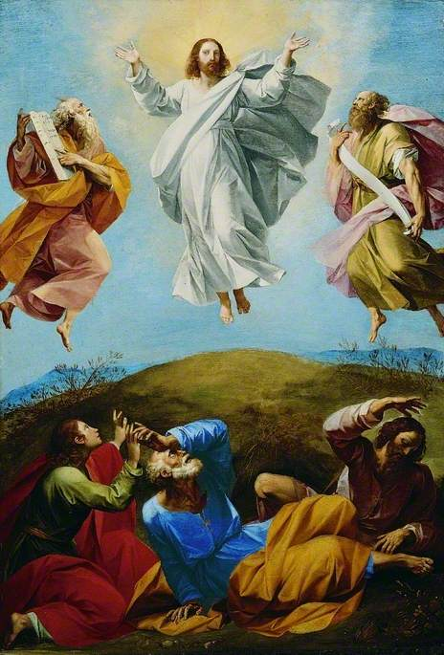
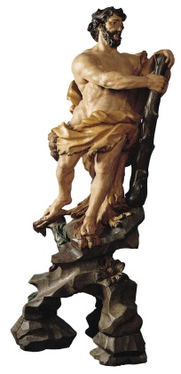
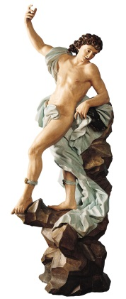
ACTIVITY
Hercules and MELEAGER
Antonio MARAgliano
C.1700

Slide 11
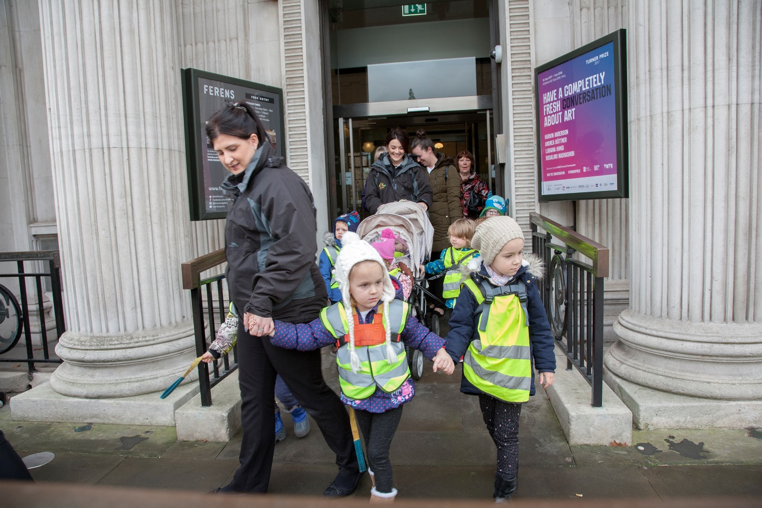
SARAH TAYLOR – ARTS AND HERITAGE PROJECT DEVELOPER
sarah.taylor@hcandl.co.uk

