Slide 1
Building resilience – first aid
Lesley Gratrix Jayne Walker
Lisa Jennison Tim Beuscher

Slide 2
Resilience
the ability of a substance or object to spring back into shape; elasticity.
The capacity to recover quickly from difficulties
Toughness

Slide 3
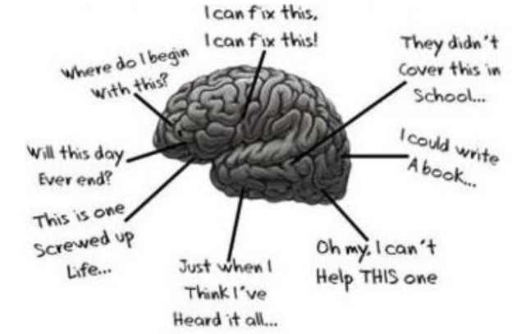

Slide 4


Slide 5
Three step approach to resilience:
Step 1: Resilience is demonstrated by the ability to reflect
Step 2: Voicing concerns and accessing the appropriate guidance
Step 3: Supervision and support and developing oneself

Slide 6

Over to you………….
…. A SWOT analysis

Slide 7
In pairs, pick one step of the three step approach, and undertake a SWOT analysis around it on the handout you have. Be prepared to feedback to the group! Come on now you ask your students to!

Slide 8
Three step approach to resilience:
Step 1: Resilience is demonstrated by the ability to reflect
Step 2: Voicing concerns and accessing the appropriate guidance
Step 3: Supervision and support and developing oneself

Slide 9


Slide 10
Building resilience
First aid = sharing solutions

Slide 11


