Slide 1

The Experience of Education for Children and Young People Looked After
(CYPLA – formerly LAC)
Dr Lisa Jones and Charlotte Dean

Slide 2
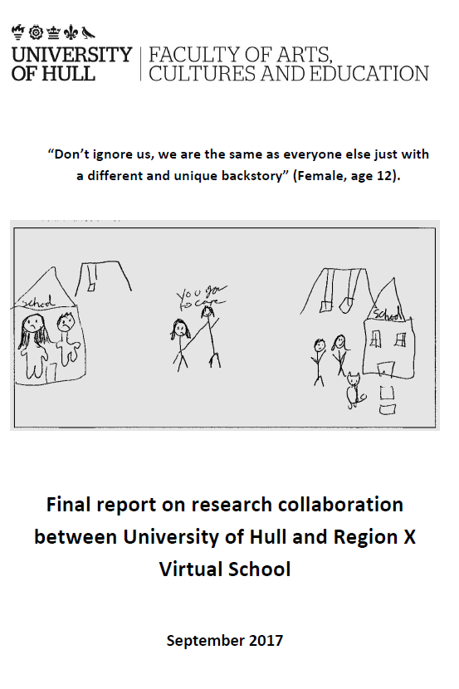
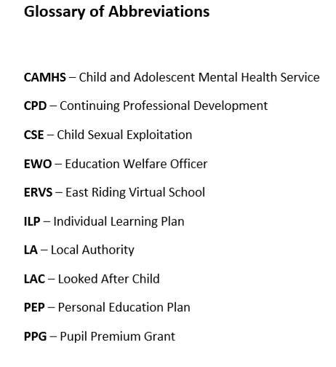
Notes:
The Inclusion and Social Justice Research Group within the Faculty of Arts, Cultures and Education (FACE) at the University of Hull have worked with a regional Virtual School to create a collaborative research project to explore the effectiveness of Virtual Schools, with the aim of exploring ways of developing educational provision for children and young people who are currently looked after by the local authority. This project, designed in collaboration with a regional Virtual School, sets out to develop a clear mapping of current research about the educational experiences of children and young people in the looked after system and, though undertaking a new study with children and young people, to develop practical recommendations to improve practices. There is very little research about the effectiveness of Virtual Schools, and none investigating the experiences of children and young people within them. This is an identified gap in the research, and one that this study set out to address.
This report summarises the initial findings from the study, undertaken by staff and doctoral students in the University of Hull, in collaboration with teachers, support workers, and children and young people in the Hull and East Riding areas. It outlines the research questions and research methods, and then presents key themes from data across three stakeholder groups: children and young people in the looked after system; support workers; and staff working in schools. It ends with a list of recommendations for consideration by the Virtual School in terms of the development of long-term practices.

Slide 3
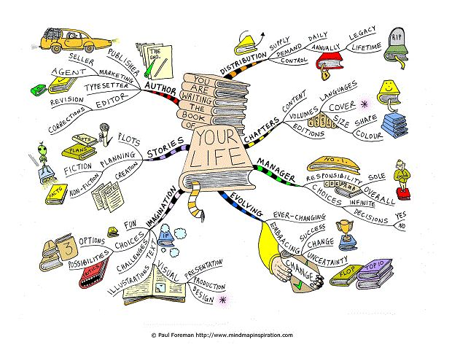
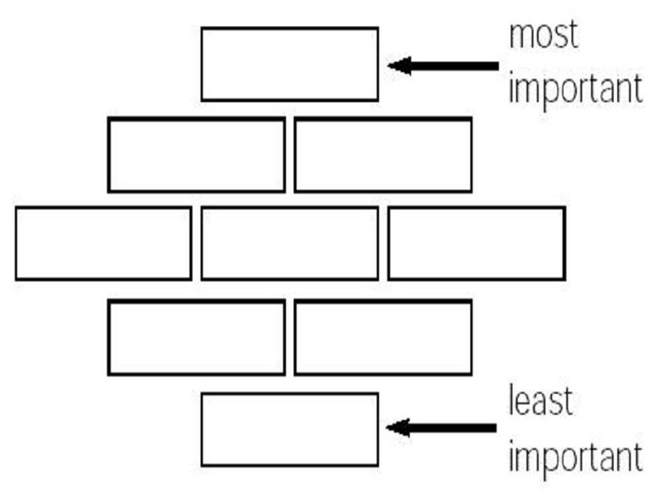
Research Methods
Participatory research with young people:
CICC Group – mind mapping/ group work
University visit – group interviews/diamond ranking with CYPLA and EWOs/social workers/support staff
Qualitative surveys: - unfinished questions/drawings for CYPLA and one to one telephone surveys for teachers/support staff

Slide 4
Ethical Considerations
CYPLA classed as vulnerable group
Ethical approval gained through University of Hull and also the Director of Children and Young People’s Services/Senior Leadership Team of local authority in which the virtual school was placed.
Names of all CYPLA, support staff, schools and local authority identifiers not to be used.

Slide 5
Key Themes: Children and Young People
“We are the same”
“If there is one thing that I want people to know about being a ‘looked after young person’ in school it would be … we are the same” (Female, age 12).
“It’s because people see you as a different, and like a completely different person. It’s like you’ll go to school and maybe for the first couple of months they won’t know you’re in care and then you’ll tell like one of your closest friends and it’ll just get out and then they’ll see you not even as the same. It’s like you’re a completely different person, you know, you don’t even, shouldn’t even be there” (Male, age 15).
Notes:
The question of feeling different from ‘normal’ students (the word ‘normal’ was used frequently) was discussed at length during group interviews and was also raised in several of the responses in questionnaires. Young people drew attention to many ways in which they felt ‘different’. Some of these were positive, such as receiving additional resources (‘free stuff’) and extra support. Others were positive in themselves yet had had negative knock-on effects (such as getting a taxi to school and thus being identifiable as a looked after young person). Others were simply negative, such as being bullied, or feeling that teachers made negative assumptions about them.
The importance of wanting to feel ‘the same’ as other students cannot be over-stated. The analysis of data from children and young people indicates that this central issue underpins their experiences of being in school. All of the other themes, outlined below, can be inextricably linked with this.

Slide 6
Significance of being ‘pulled out’ of class
The best thing about being a ‘looked after young person’ is … you get to go to groups in the middle of class (Male, age 11)
The worst thing about being a ‘looked after young person’ is … leaving class for meetings (Male, age 16)
“Well, yeah, I’ve got my PEP on Friday and then although I’ve explained to like pretty much everyone who knows me like why I’m leaving lessons for my PEPs and LACs and stuff, they will still ask me and like it can be quite annoying … we do like Christmas exams and stuff … which I want to do good for so I can stay in like the top sets and all that, but it’s going to like put me back” (Male, age 13)
Notes:
Many of the children and young people drew attention to getting ‘pulled out’ of class for PEP meetings, LAC reviews, group sessions and extra tuition. Some of these saw this as positive but the majority raised it as a significant concern. Some even said that it was the ‘worst thing’ about being a looked after young person in school. There were three main reasons for this: 1) it affected their learning, such as one participant who reported missing in-class tests and not being allowed to re-sit these (Male, age 13); it meant that their looked after status became visible to others, or they have to make a decision to lie to their peers (“to be honest I used to tell them I was just like twagging lessons” – Male, age 16); c) it marked them out as different (“obviously a normal student in class wouldn’t just be taken out of the class … It can be a bit annoying sometimes because you get taken away of lessons and then you get people questioning you” – Female, age 16).

Slide 7
Sensing being ‘treated differently’
“I get free school dinners” (Female, age 11)
“I get to go on free trips.” (Male, age 13)
“The best thing about being in care is like education wise I think is all the sort of stuff that you can get like, free stuff like I got a laptop to help me with my stuff which actually really helped ... because I use like the Microsoft Word and stuff to like help me get homework done because it’s like a lot faster” (Male, age 15).
“The best thing about being a ‘looked after young person’ is … you get the support you need” (Female, age 12).
“The best thing about being a ‘looked after young person’ is … being prioritised” AND “The worst thing about being a ‘looked after young person’ is … being different” (Female, age 14).
Notes:
There were numerous references, as illustrated above, to the resources and additional support that came with being looked after. From the data, this was overwhelmingly the most frequent response to many questions. These additional resources and support were universally seen as positive and as making a contribution to being able engage in classes and complete homework.
There were also other notable patterns in the data that indicated that being ‘treated differently’ had negative connotations as well as positive ones. Some spoke of how they felt additional pressure to do well (“The worst thing about being a ‘looked after young person’ is … some teachers either under or over estimate me” - female, age 12). Others said that they felt that teachers were more lenient with them (“if I haven’t got my homework in, my teacher will let me off like say, “Oh, well you’ve probably been doing something, oh so you’ve been in care,” and stuff, so … and then like a lot of my friends have been getting annoyed with me simply from it …” – male, age 16). Another felt that his teacher deliberately ignored him in class (“you’ll be in a lesson and you might put up your hand but there might be no one else with their hand up and they’ll automatically not choose you” – male, age 15). All of these issues were perceived by young people as being a consequence of ‘stigma’ and ‘assumptions’ from teachers (“I think a lot of teachers see us as not important because they think even if they do help us we’re still going to fail, we’re still going to, you know, not succeed” – male, age 16).

Slide 8
Bullying seen as the norm
“I know a lot of people like myself have gone through a lot of bullying for being in care, and especially when I first came into care bullying was really bad, but luckily people get used to it, but when you first go into care it is a big problem” (Male, age 16)
“It’s just like your friends turn on you” (Male, age 15).
“I got picked on for being different and got told I was a teacher’s pet” (Female, age 11)
Notes:
Several participants talked about bullying during this study, though not in depth. For some, it almost seemed to be ‘par for the course’ (i.e. ‘luckily people get used to it – male, age 16; “it can also determine who your best friends are and who your enemies are” – male, age 15). Bullying was attributed to being ‘different’ and to ‘standing out from the crowd’. These issues were exacerbated when the visibility as a looked after young person was increased. One young man, for example, explained that he arrived at school in a taxi and ‘for a long while everyone would know me as the kid who gets a taxi, the kid who’s in care’ (Male, age 16).

Slide 9
Concern over privacy and information sharing
“If I could improve one thing about being a ‘looked after young person’ in school it would be … not letting them know you’re looked after” (Male, age 16).
“What about when, you know, people, other people are talking about you but you don’t … You don’t know who they are” (Male, age 15)
“It just – information gets around too much, doesn’t it?” (Male, age 13).
Notes:
Many of the young people in this study were concerned about whether others knew that they were looked after, and in particular, about whether they were able to keep this private. This applied in relation to teachers, to support staff, and to other students. In group interviews, there was discussion about which of the teachers in their schools knew they were looked after, and if so, how they knew this (“I think a lot of the teachers do know, I’m not sure how” – female, age 16). Some participants wanted this information to be kept more private. One explained how he had started to exclude unnecessary people from his PEP reviews because he did not want so many staff to be there whilst his personal circumstances were being discussed.
With regards to peers, there was a real tension between wanting their status as a LAC to be private and only shared when necessary and a desire to want to know which other children in the school were looked after. One young man stated that he would like to ask the school “If they actually know how many students are looked after in the school” (male, age 16). The reason for this, he explained, was “Because then you don’t feel singled out, like I had…well my best friend in school he was looked after as well so I obviously had someone but if I didn’t have him then I would have felt different.”

Slide 10
The need for staff training
“Well, I think one of the things you could ask is like asking the teachers when they go to their teachers training day would they mind like, you know, ... like not knowing how to cope with us… if they do half hour on that day with the designated teacher like learning from him or her on how to cope if a child does come to you instead of just like sending them to the Head of Year or some, or the designated teacher” (Male, age 15)
“And so, I’ve had to – I had to – it gets annoying having to explain something over and over again” (Male, age 16).
“If there is one thing that I want people to know about being a ‘looked after young person’ in school, it would be … it’s not always hard but it mainly is, we sometimes look silly for crying in class about the slightest thing, we can’t help it though” (Female, age 12).
Notes:
In response to questions about what might improve their school experience, several young people talked about the need for staff training. This seemed to be as a result of experiences of feeling as if teachers and support staff made assumptions and did now know much about being looked after. Some felt that they were frequently ‘training the teachers’ by responding to questions about how the looked after system operated. Others felt that teachers were nervous around them and simply sent them to the designated teacher if there were any issues, rather than trying to respond themselves.

Slide 11
Key themes: support staff
The most notable observation made during the analysis of data from the support staff was the remarkable similarity with that of the children and young people. This is significant because it indicates, in itself, that the support staff have close, supportive and empathic relationships with looked after children and young people.
Support for children and young people
School structures and processes
Challenges for schools
Teacher training
Notes:
Finally, support staff raised the issue of teacher training (as had the children and young people). One posed the questions: “do teachers feel they received adequate information in their teacher training about meeting the needs of looked after young people? Have they had CPD training since? What training have designated teachers had? How does the designated teacher disseminate information to other staff members? Do they then do the designated teacher training we offer as a local authority, and then did they do a session with their teachers in school?” These are important questions to address.

Slide 12
Key themes: teaching staff
Increased administrative responsibilities Educational Welfare Officers or Social Workers would previously have come in to complete the PEP in school, this is now delegated to the school to complete in advance. “Some of these PEPs are really massive documents at 30-40 pages long, they take a long time to do!”
Working with other Virtual Schools/Local Authorities One school that we spoke to had students who were LAC from 27 different local authorities. “Every different VS and LA has a different format for the PEPs and has a different mechanism for distributing and completing them and it’s the same for the PPG.”
Notes:
It was interesting to note that when speaking to the key teaching staff involved with LAC in schools that each school had invested considerably in employing extra staff specifically to support LAC. These roles were seen as being vital, as the care and support needed for LAC was over and above what could be managed by the role of designated teacher. One school reported “I think that this is increasingly the case across a number of schools because of the increase in expectations placed on the school around LAC, the designated teacher, because of teaching commitments, hasn’t got the time to dedicate what’s needed to oversee them so it gets delegated to a member of staff whose sole role it is to carry out this function.”

Slide 13
Relationship with Social Care Services - often faced difficulties in this area because of the restricted availability of social workers and also their understanding of the education system.
Training - Specific training for teaching staff working with LAC around the issues that they may face varied across different schools
LAC being treated differently - given more lenience in terms of behaviour, achievement and academic progress. Negative behaviour in particular was tolerated and dealt with differently for LAC.
Notes:
Teaching staff identified that “Different social workers do things differently, so you have a multi-disciplinary team where everybody has different ways of working and it’s different in each PEP meeting you go to.” It was pointed out that social workers often do not attend PEP meetings “I had one the other day where the social worker and the parent didn’t even turn up.” which then can cause problems in the subsequent continuity of the PEP meetings in following up of actions and sharing information.
teaching staff generally felt that training specific to working with LAC was lacking both within the school and as part of their initial teacher training programme. “I had no training [in working with LAC] on my PGCE, it’s just been a case of picking it up as I go along.” This sentiment was echoed by another teacher, particularly in relation to the completion and involvement in PEPs “You just have to pick it up and hopefully, if you’ve done something wrong, it gets identified before the meeting takes place or it can be easily rectified because sometimes that can be a bit of a challenge.”

Slide 14
Notes:
That serious consideration is given to the issue of the timing of PEP meetings and LAC reviews, especially when these involving ‘pulling out’ children from class. Data overwhelmingly suggests that this is a major concern for looked after young people in terms of a) their education; b) their ability to keep their looked after status to themselves; c) their concerns with being marked out as ‘different’ from their peers. Support workers and school staff indicate that this contributes to the decision for some looked after children to not attend these meetings.
That additional resources and support continue to be made available to looked after children and young people. These were stated to be the ‘best thing about being looked after’ by a sizable majority of participants in this study and they appear to make a significant contribution to young people’s ability to engage in school. Data from schools, nonetheless, suggested that the processes for accessing the Pupil Premium Grant were more demanding through ERVS than through virtual schools in other authorities; this might warrant further investigation and discussion.
That support staff continue to be able to develop strong relationships with children and young people so that the latter can feel known and understood as individuals. The convergence in data between the young people and the support staff indicates that this is a central strength of ERVS.
That more information and training is offered to teachers and support staff within schools so that looked after children and young people do not get asked inappropriate questions. This training should include challenging assumptions about why young people are in the looked after system and how to respond appropriately in a classroom setting. This includes thinking about when it might – and might not - be appropriate to treat someone differently because they are looked after.
That consideration is given to how looked after children and young people might be able to build and maintain relationships with one another. This entails recognising that although most want to retain their privacy, they also want to know who else is looked after so that they do not feel alone.
That a more joined-up approach to the completion of PEPs be adopted across local authorities and a standardised PEP template with clear guidance with accompanying training be established to support new staff in the completion of PEPs.
That when changes are to be made by ERVS in terms of the administration of PPG or completion of PEPs, key stakeholders within the schools are included in consultations to work collaboratively on how these changes will work in practice.

Slide 15
Activity - Overcoming Barriers
Return to the key recommendations (identified earlier)
In small groups, discuss these and make some suggestions for how teachers, schools (and society more generally) might work to overcome these
Be prepared to share your ideas with the whole group

Slide 16
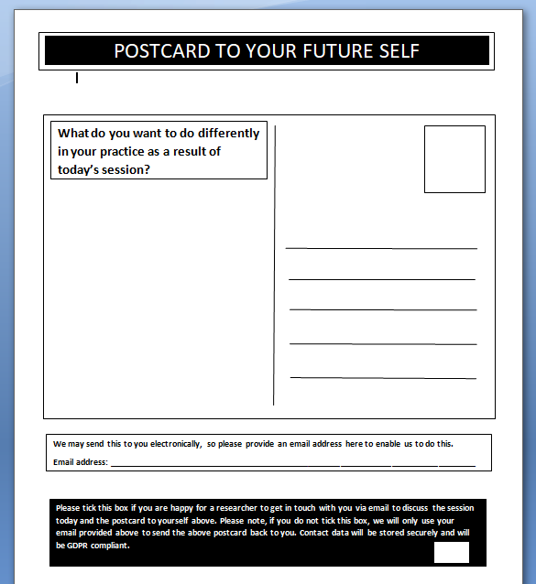
Now, time to complete your postcards to your future self…

Slide 17
“If I could tell my teachers one thing about what it’s like to be a ‘looked after young person’ in school it would be … don’t ignore us, we are the same as everyone else just with a different and unique backstory” (Female, age 12).

Slide 18
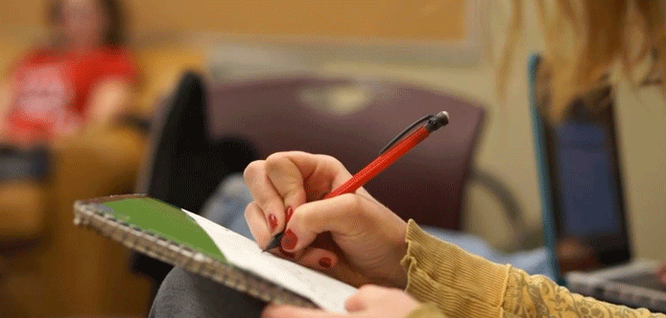
Thank you for listening!
Please take a few minutes to complete the second half of your evaluation form.

Slide 19
Useful reading:
DfE (2014) SFR 49/2014: Outcomes for children looked after by local authorities in England as at 31 March 2014, issued 10 December 2014. London: DfE.
DfES (2006) Care Matters: Time for Change. London: The Stationary Office.
Guishard-Pine, J, McCall, S & Hamilton, L, (2007) Understanding Looked After Children. London, Jessica Kingsley Publishers.
Jackson, S (2010) Education for social inclusion: Can we change the future for children in care? London, Institute for Education.
Ofsted (2012) The impact of virtual schools on the educational progress of looked after children. Manchester, Ofsted.

