Slide 1
Wellbeing for teachers and pupils

Slide 2
Objectives
To explore new programmes that can help with pupils wellbeing.
Different strategies to help with teachers wellbeing.

Slide 3
Practical programmes

Slide 4

Jump Start Jonny
Fun workout videos to get children active in school and at home.
Range of different dances to songs, high intensity songs to refocus children. Does also include 'cool down/ relaxation' songs to calm hyperactive children/ a class down.
Available and accessible through a class laptop and to be shown to the children through interactive whiteboard.

Slide 5

Just Dance
Short dance routines to help refocus children.
Similar to Jump Start Jonny however most dances are performed in pairs so builds team working skills.

Slide 6
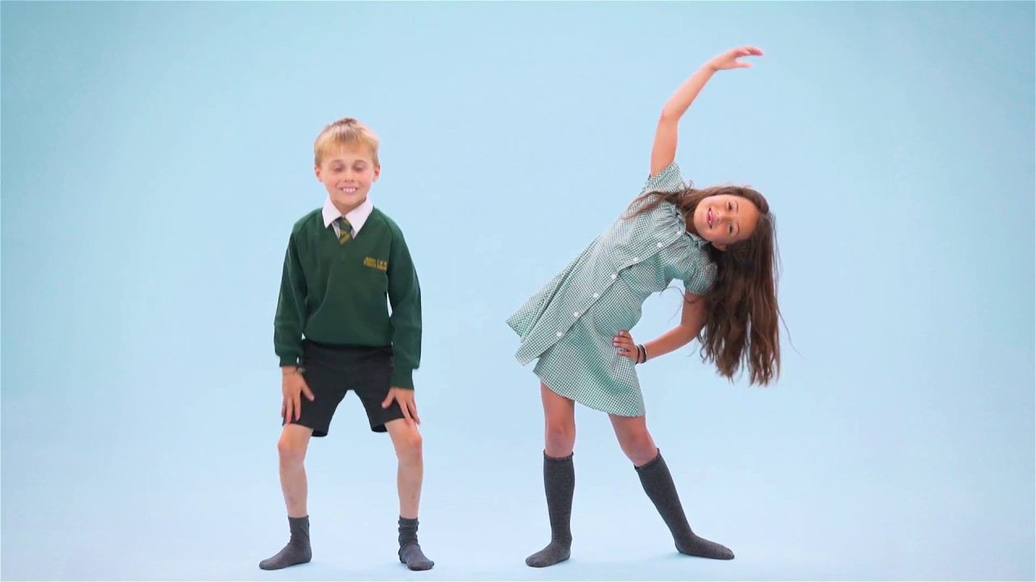
“Wake Up Wake Up”
KS1
Popular ‘Wake Up’ dance ideal for breakfast club, beginning of the day or post lunch.

Slide 7
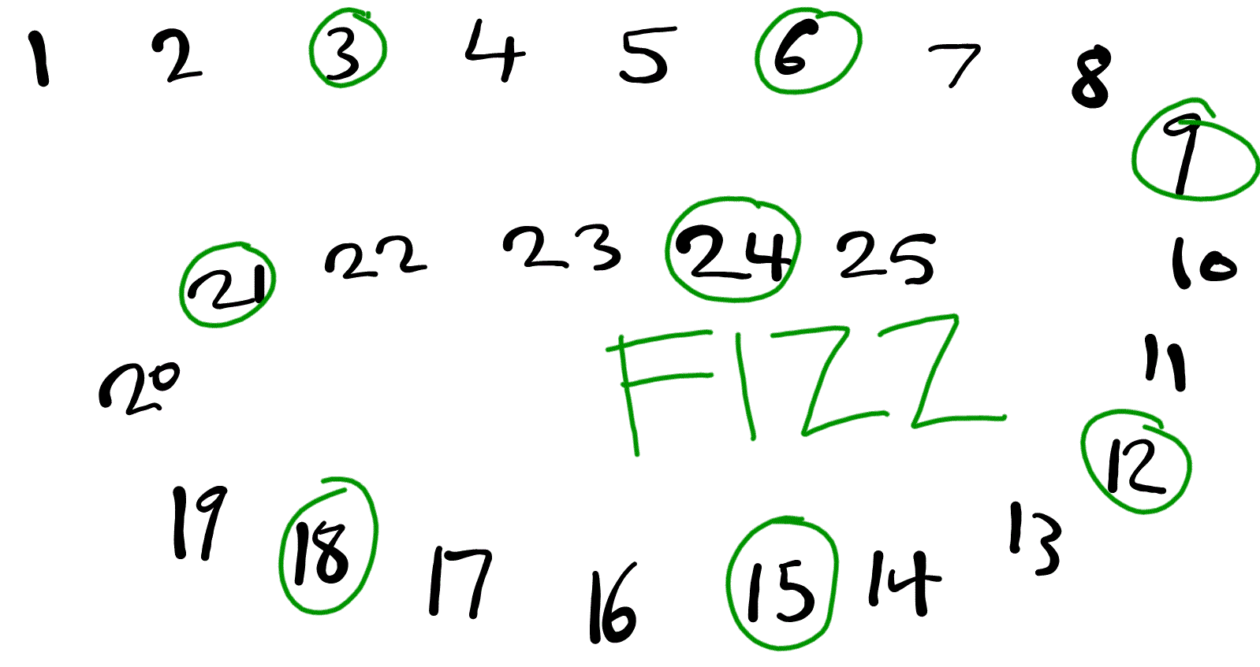
Buzz Game
Buzz Game is a group word game for children to teach them about timetables.

Slide 8
Buzz Game: Primary/ Secondary
As a counting game:
Choose a number of the day, say 8. One child begins and counts aloud ‘One,’ then the next child says, ‘Two,’ the next child ‘Three,’ play continues around the circle with the children saying the next number in line as quickly as possible until the chosen number, in this case 8, is reached.
Instead of saying the number aloud the child due to count says, “Buzz.” The next person starts at one again and play continues as before, the aim being to count in sequence, follow the play around the group and speak as quickly as possible without making a mistake. So in this example, play would go – 1,2,3,4,5,6,7,buzz! 1,2,etc
Multiplication
For example, five times tables. Every 5th person in the group, will replace their number with the word ‘Buzz’.

Slide 9
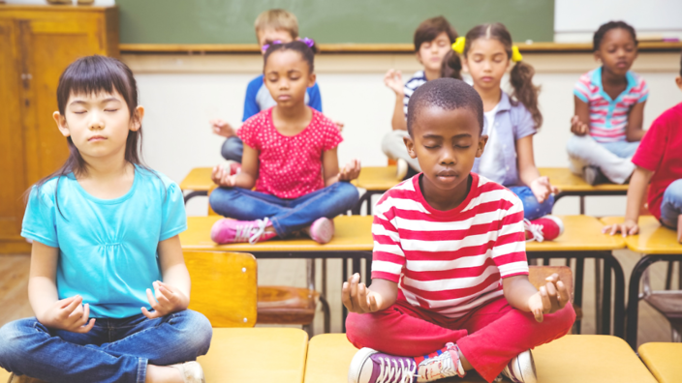
As a class, lets learn something new together
For five minutes a day, the teacher can decide on different activities/ subjects that the children could learn per day.
  Activities can vary depending on subject and mood of the class.
Could incorporate relaxation/ meditation sessions to focus on wellbeing.
I implemented “relax” moments three times a day.

Slide 10

Primary: The Worry Monster
The worry monster- a worry monster that can be purchased online for children to write notes on what worries them for the teacher if they don't feel comfortable about saying it in person.
  Well being mentors- children nominated by the class to be in charge of promoting well-being.

Slide 11
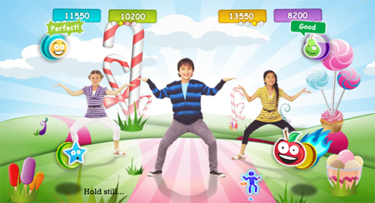
Just Dance: Children
Short dance routines to help refocus children.
Similar to Jump Start Jonny however most dances are performed in pairs so builds team working skills.
Energetic to relax

Slide 12
Energiser: Thinking whilst moving
Activity can be adapted to any subject
Classroom based activity involving every individual
Example
Now your turn…

Slide 13

Secondary: Meditation
Increase focus, reduce stress
Different approach
  What is meditation?
  What are the benefits?
  Explore your students’ knowledge about meditation.
Mindfulness, yoga and meditation have all been growing in popularity at schools around the country as a way to support pupils’ pupil wellbeing and mental health. (The Telegraph, 2017).

Slide 14
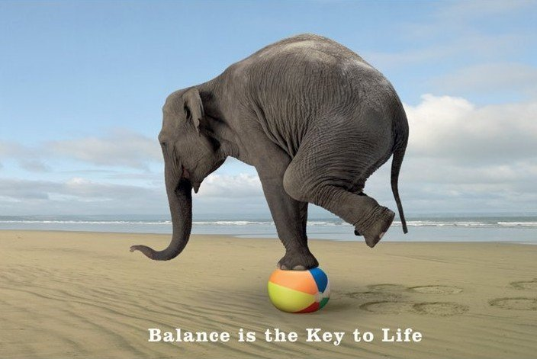
Teacher Time
Lets take some time to think about you?
Stress the Effects on your body
Low energy.
Headaches.
Nausea.
Aches, pains, and tense muscles.
Chest pain and rapid heartbeat.
Insomnia.
Frequent colds and infections.

Slide 15

And Sleep zzzzzzzzzzz
Steps to get a good nights sleep
Give yourself a bedtime. Pick a time at night when you typically start feeling tired and go to sleep every night at that time—even on the weekends. ...
Move, move, move. ...
Unwind. ...
Smoke and drink no more. ...
Build a cave. ...
Make it a rule: Your bedroom is for sleeping on

Slide 16



How to contact us
hullsport@hull.ac.uk
http://sport.hull.ac.uk/
Call: 01482 466491
/HullUniSport

