Slide 1


Numbers
wánɡ zhì línɡ
王 志 玲

Slide 2

How to say 2019 in Chinese?
Which number is the lucky
number in China?

Slide 3
Numbers
from 1-10

Slide 4
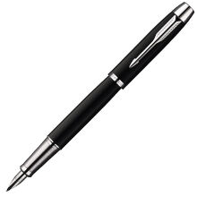

yī

Slide 5
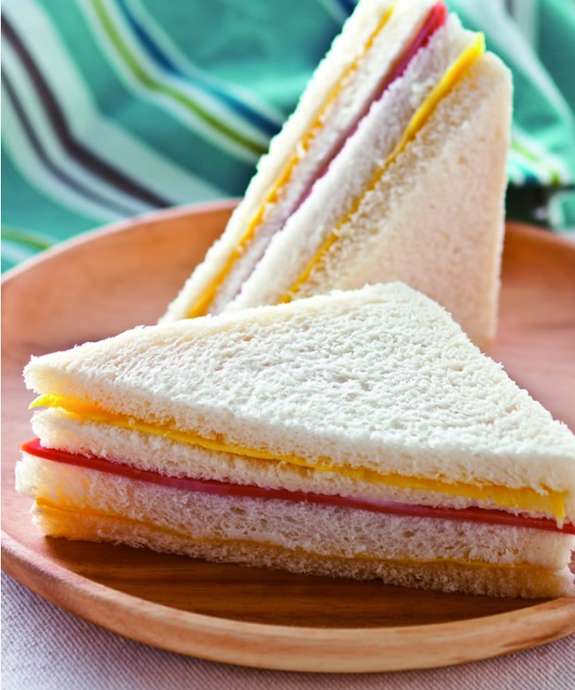

èr

Slide 6
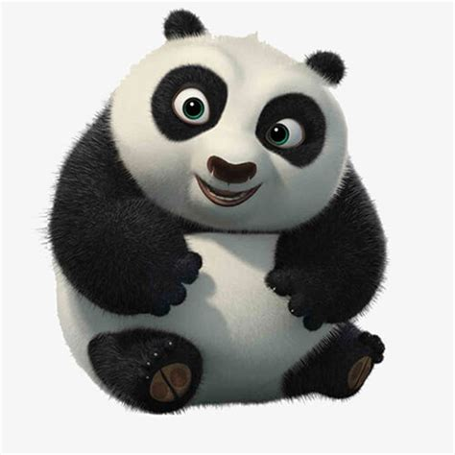
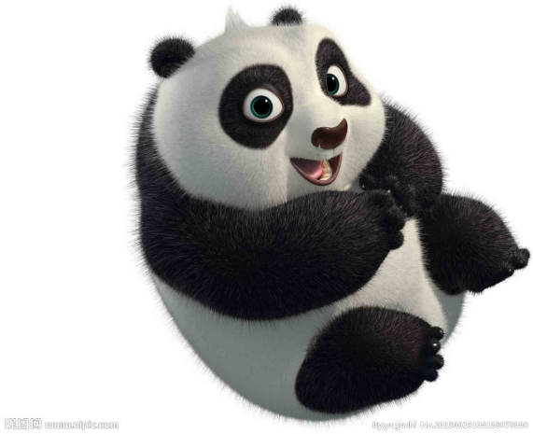
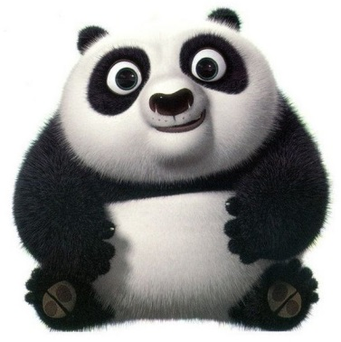

sān

Slide 7
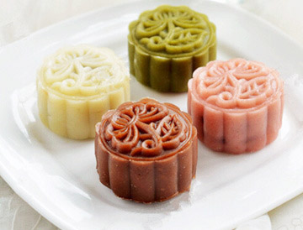

sì

Slide 8
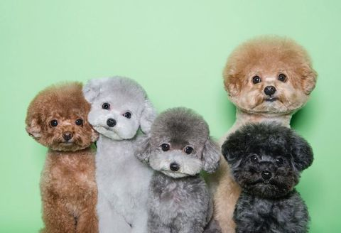

wǔ

Slide 9
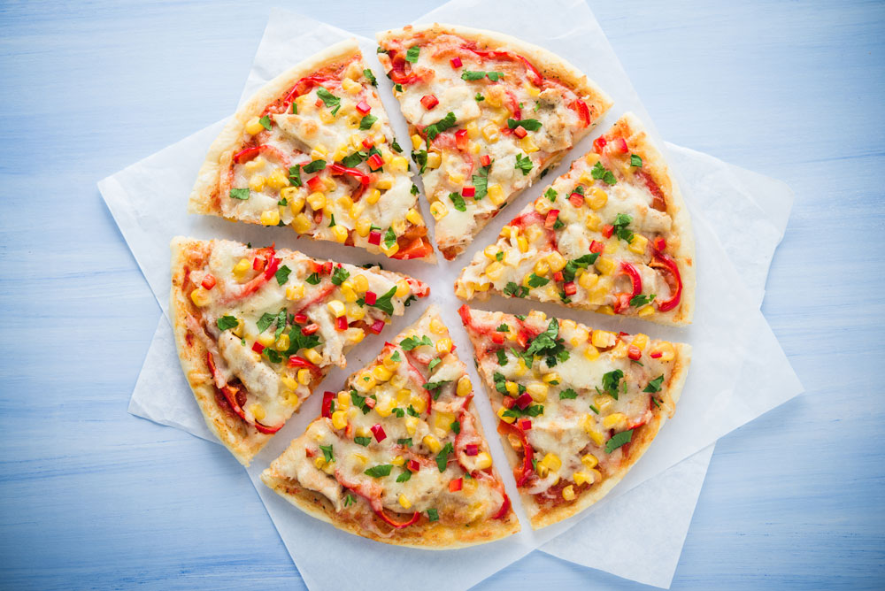

liù

Slide 10
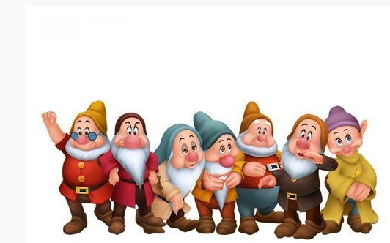

qī

Slide 11

bā

Slide 12


jiǔ

Slide 13

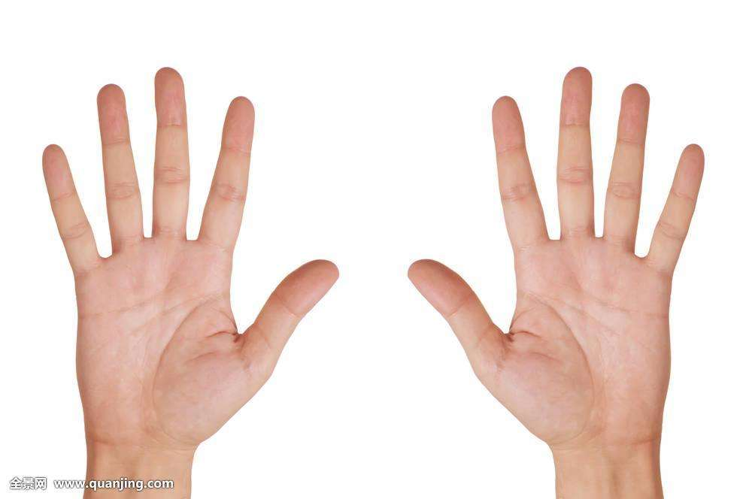
shí

Slide 14
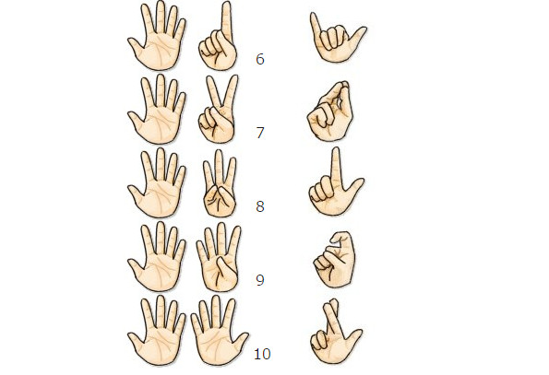

Slide 15

yī | èr | sān | sì | wǔ
一 | 二 | 三 | 四 | 五
1 | 2 | 3 | 4 | 5
liù | qī | bā | jiǔ | shí
六 | 七 | 八 | 九 | 十
6 | 7 | 8 | 9 | 10
How many times did I clap my hands?

Slide 16
yī | èr | sān | sì | wǔ
一 | 二 | 三 | 四 | 五
1 | 2 | 3 | 4 | 5
liù | qī | bā | jiǔ | shí
六 | 七 | 八 | 九 | 十
6 | 7 | 8 | 9 | 10
When meet 4,please keep silent.
When meet 8, please say yes!
N+2

Slide 17
yī | èr | sān | sì | wǔ
一 | 二 | 三 | 四 | 五
1 | 2 | 3 | 4 | 5
liù | qī | bā | jiǔ | shí
六 | 七 | 八 | 九 | 十
6 | 7 | 8 | 9 | 10
Can you read telephone number:
8613343204828; 8613756839204;
8615817968888; 07799956146

Slide 18
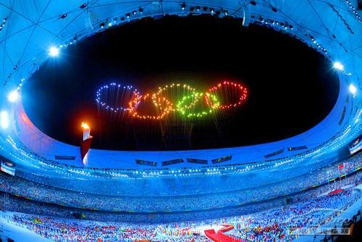
Lucky Number
8
8:00pm
08/08/2008

Slide 19

Unlucky Number
4
sǐ
死

Slide 20
10 1
10 2
10 3
10 4
10 5
10 6
10 7
10 8
10 9
11 shí yī
12 shí èr
13 shí sān
14 shí sì
15 shí wǔ
16 shí liù
17 shí qī
18 shí bā
19 shí jiǔ

Slide 21
èr shí
二 十 20
sān shí
十 30
sì shí
四 十 40
wǔ shí
五 十 50
liù shí
十 60
qī shí
七 十 70
bā shí
八 十 80
jiǔ shí
九 十 90
2 10
3 10
4 10
5 10
6 10
7 10
8 10
9 10

Slide 22
Fun Time
who is my friend?

Slide 23
Tips
1 N+2
2 number chain
3 sharp eye

Slide 24
1 | 2 | 3
4 | 5 | 6
7 | 8 | 9
 | 10
1 | 2 | 3
4 | 5 | 6
7 | 8 | 9
 | 10

Slide 25
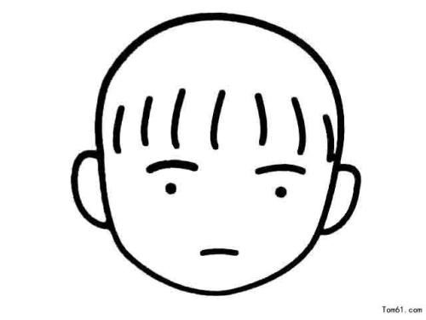
5 draw picture

Slide 26
6 which is missing?
7 hide and seek
8 guess and say
( S1 picks up one card, T guesses, if right, SS
read together. If wrong, SS tell T what it is.)
9 postman (Group work: words make up
sentence---post)
10 fishing

Slide 27
Thank You!

