Slide 1
Starting the conversation:
Dr Julie Brierley

Slide 2
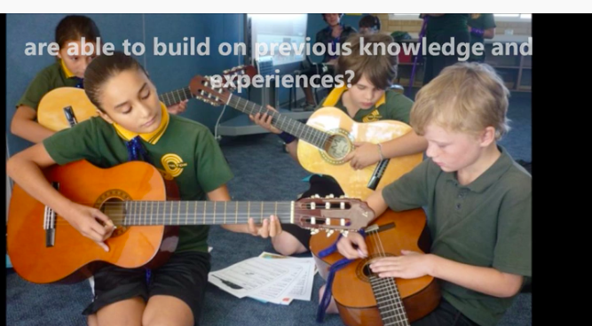
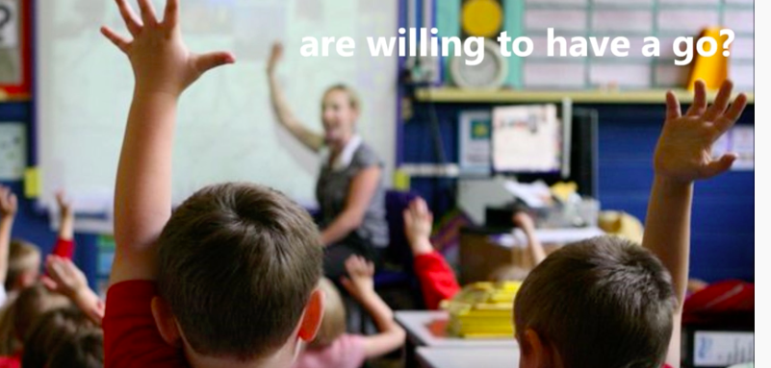
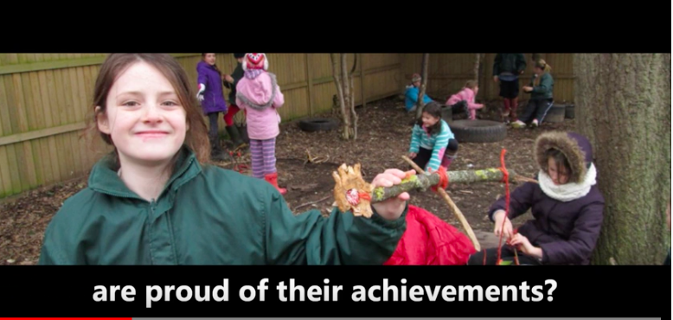
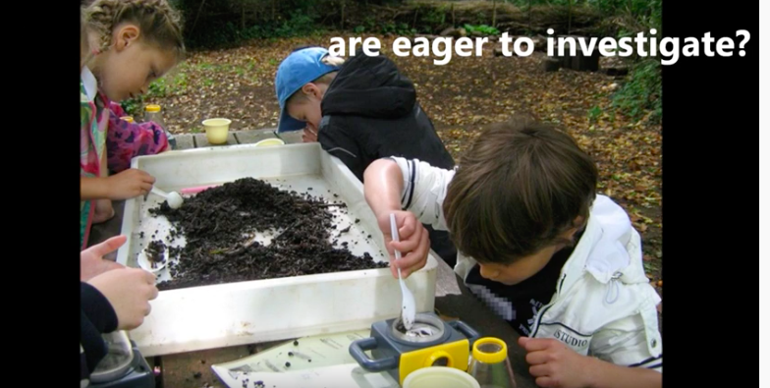
Lets consider what we want children to be like….

Slide 4
The Characteristics of effective learning -
lets start the conversation
Notes:
This is the conversation I want to start today – the focus on the how of learning and not just the what of leaning
The characteristics of learning help us to understand the how

Slide 5
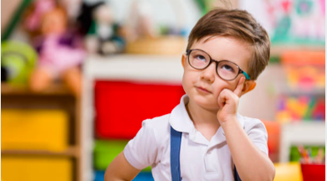
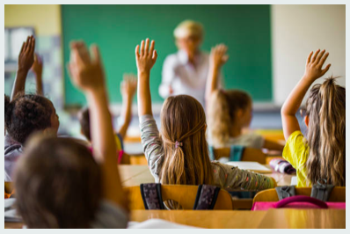
Its not a secret…
We fully understand and acknowledge learning theory requires learners to build their own understanding, through engaging and experiencing the subject in a relevant and contextual way.
Learning requires an active role, it is not about passively receiving knowledge, but
Requires children to make sense of the information
Notes:
There is a major growing body of evidence that individual differences in how children approach learning are a major source of differences in their achievements
Learning requires an active role, it is not about passively receiving knowledge, but
Requires children to make sense of the information

Slide 6
Notes:
What are the CoEL
CoL are easy to spot, meaning you can nurture and grow them in your own students

Slide 7
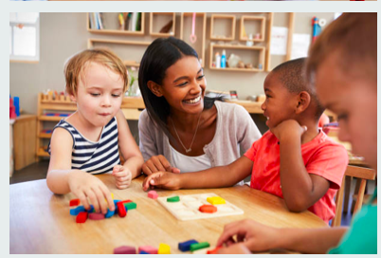
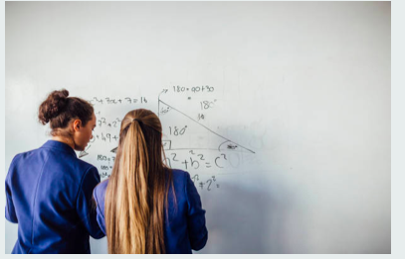
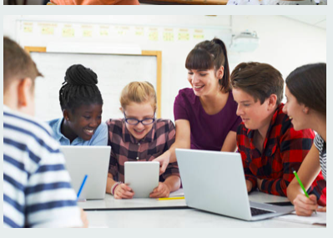
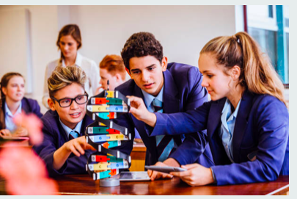
The characteristics of effective learning:
Engagement
Motivation
Thinking
Notes:
Focussing on how children and infact adult learn implies a particular way of looking at the relationship between teaching and learning. It turns on its head a view that teaching comes first – that the teacher decides & presents to the child what needs to be learned, tells or presents it to the child, and the child soaks it up the knowledge by remembering.
There is a long and well established knowledge of developmental theory out there – some where??? constructivism, Piaget’ ideas of how children construct their knowledge based on their own theories and expreiences.
Vygotsky and Bruner describe the notion of social constructivism, scaffolding the learning

Slide 8
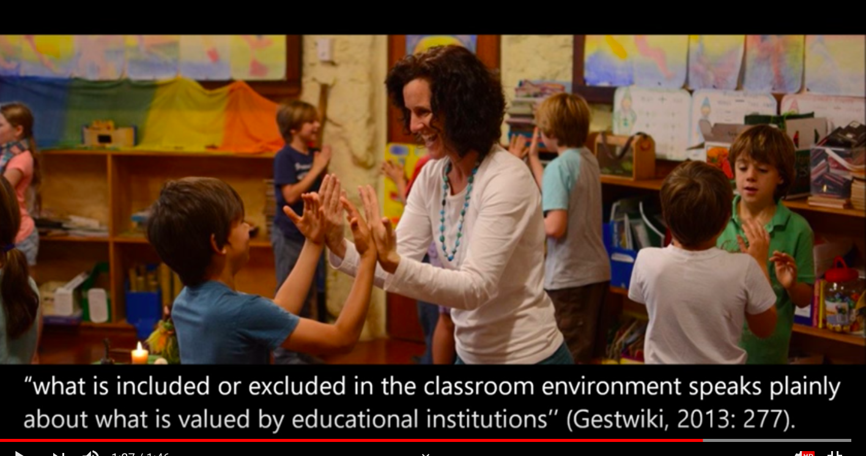
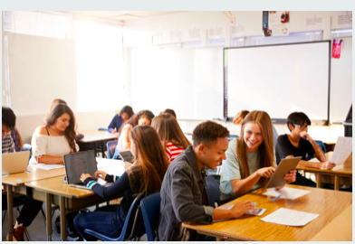
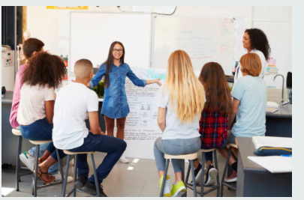
Engagement
Children develop and learn in the context of the relationship and environment around them – That means you and the space you provide……
Do you remember your favourite teacher at school?
Did you try harder in those lessons?
Notes:
Children’s developments depend on both genetic patterns and interaction with their environments – the stimulation and support that comes from other people and the physical world

Slide 9
Motivation
Learning is not always easy
To stick with it
To keep trying
To over come obstacles
The development of a growth mindset
What do you know about Carol Dweck the mindset lady?
Notes:
Motivated to learn
Intrinsic motivation is a better basis for learning
Extrinsic – motivation come from external features (task performance ) – to avoid punishment/gain reward
Children’s drive to learn comes from an innate , inborn desires – Humans have psychological needs such as
To be competent – growth mindset, against a fixed mindset – Carol Dweck
To make sense of experiences – to be confident to try to have ago
To have autonomy and control – mastery rather than performance – mastery charts progress
To build relationships with others – are very important provides a sense of well being and emotional support to take risks in our learning, to have a go
The most motivating activities involve a degree of challenge otherwise they become
Routine and boring
Involvment – leuvens scale
Flow -

Slide 10
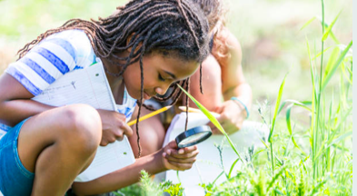
Thinking
Creativity is about flexible thinking
Critical thinking is about a rationale approach
Being aware of, reflecting on and controlling our thinking, builds self regulation and more capable learners
Creativity is nurtured in an environment where questions are valued, different points of view are encouraged
Notes:
Children need to learn to think for themselves,– its not enough for children/students to just memories and reproduce information – They must learn to control their minds to process information and the ideas they encounter
The links of language to thought - Vygotsky
The ability to think creatively and critically are essential for children and long term for society to flourish
Creativity can be thought of as the ability to think flexibly – to see things from different points of view – to recognise multiple possibilities – and original ideas
Creativity is not about the arts it is a way of thinking it applies across all experiences and all learning– creative thinking needs to be nurterd
Critical thinking involvesanalysing information, comparing and classifying using reasoning to draw conclusions making decisions, evaluating thinking and ideas- it is relavent to all ares of learning – how to express feelings in a piece of art – to how to deal with climate change. (critical thinking is linked to developing the skills of self regulation- research makes links between self regulation and schoolachievement)
Children need to be able to think both creatively and critically

Slide 11
So…Lets start the conversation….
Notes:
Will not develop if we focus only on the what of teaching – as this sells short the opportunities for your children learning
Learning to learn has been identified by the Educational council Council of the European Union as the most important competence people need

Slide 12
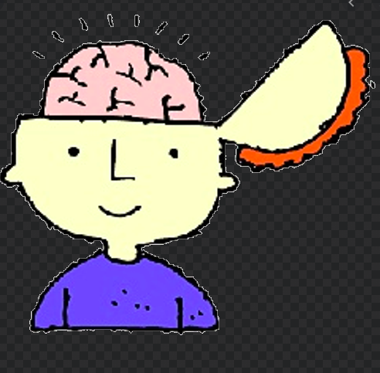
Warning Learning requires an active role, it is not about passively receiving knowledge….. Children are required to actively engage in the process if they are to make sense of the information Warning…..
There is no point in trying to to engage the front of the brain if the child isn't in a good state emotionally
The child bring their emotional state with them, whether they're feeling well, safe, well looked after – emotional stability is essential to learning

