Slide 1
Managing work and life
14th February 2020
Julie Rippingale

Slide 2
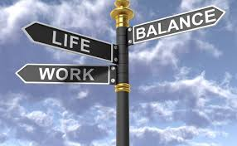
Session aims
To focus on what is strong not what is wrong - by focusing on what is strong we can build on that.
To discuss what works for you in managing work as an NQT and explore your ‘dreams’
To share tools and tips for managing work and life
To introduce the ‘Getting things done’ system

Slide 3
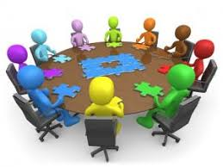
Group check in and discussion
On your tables introduce yourself, where you are from and one thing that makes you smile
Circle practice:
Listen with Attention
Speak with Intention
Tend to the wellbeing of the group

Slide 4
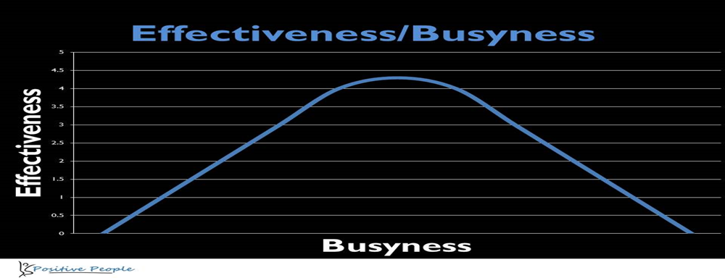
What works – In pairs
Discuss the things that you have done in the past that have worked well in relation to managing work and/or life.
What is working well for you now in managing your work as an NQT?
What do you observe others doing which is working well?
What are the key ingredients when you feel at your most effective?
Draw up a list of the above on flipchart

Slide 5
Sharing resources
Group feedback

Slide 6
GTD (Getting Things Done) Getting Things Done Animated Summary David Allen (7mins)

Slide 7
To do lists – top tips
Lists often start with the words ‘Organise’, ‘Plan’ these are not tasks they are projects. We often find we don’t end up doing these or we put them off as they require much more time and planning.
Tasks that can be done straight away should not go on a to do list, you should just do them. If you can’t then they should go on a plan. Thus you need a system for organising

Slide 8
Task lists – top tips
Must begin with a verb e.g. Speak to, download, find
Be next action focused
Group tasks by themes e.g. project focused, telephone calls, all the things you need to speak to a particular person about

Slide 9
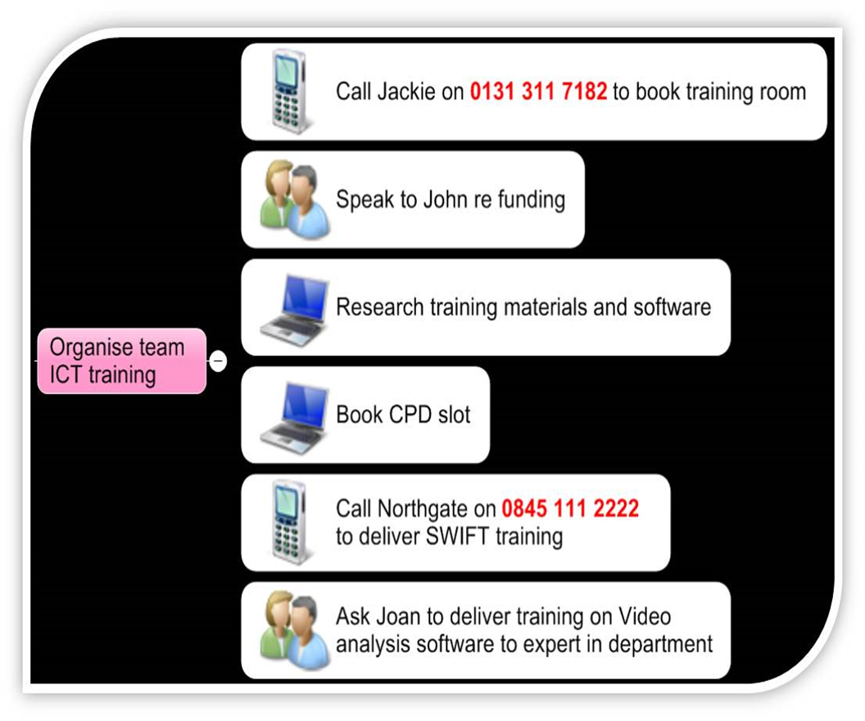
Tasks and projects
Tasks are physical actions that you take – they may not be part of a project. As soon as something has two tasks it becomes a project
Projects have end dates and have a whole number of tasks associated with them

Slide 10
Context, time, energy, priority
Context is the key limiting factor. You should be aware of the context of your tasks- where do you need to be to do them?
Time – how much time do you need to do that job well and how much time do you have?
Energy – how much energy do we have and match that to the energy needed to accomplish the tasks available
Priority is made up of two elements, importance and urgency. These two factors will determine priority at any given moment
Importance will be based around your values, your vision and goals
Priorities will often shift as the day progresses

Slide 11
Getting things done - Workflow
Capture – tools for capturing what you need to do e.g. Evernote, notepad and pen
Clarify – what is the next action?
Organise – calendar and task
Reflect
Engage – the doing part

Slide 12
Clarify
Capture
Capture tools need to get back to nothing on them. You need to liberate the action notes out of the notebook! They can be low tech (notepad and pen) or high tech (Evernote, Office lens, brain toss).
Tip: If people ask you to do something in passing rather than hold them in your head you could ask them to send you an email
This is the stage people miss out. With the capture notes you ask what is the next step?
Sort capture notes, ask is this actionable ? if no then either trash, incubate or reference e.g. someday/maybe
Someday/maybe is a good place to store ideas
Is it actionable ?– yes – will it take less than 2 minutes? – yes – do it

Slide 13
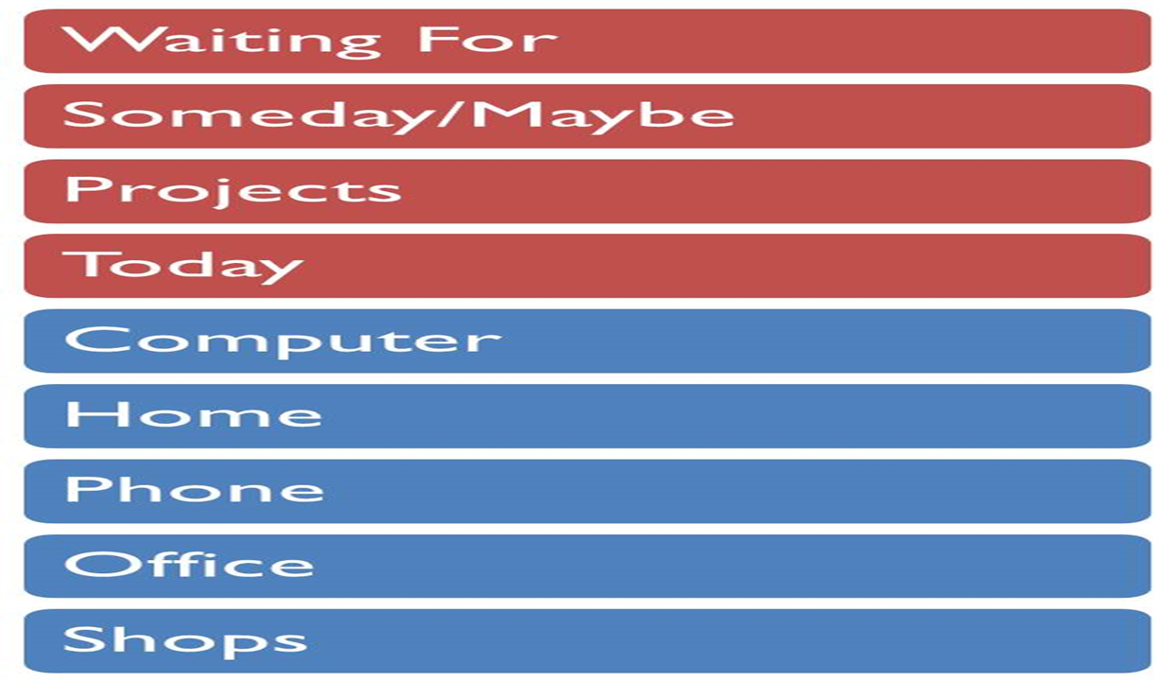
Organise
In this stage we take all the items we have identified and park them in a system that makes us feel on top of our commitments and work rather than being buried by it
Paper or electronic system. Can be good to try paper and pen as it removes one element of complexity - learning the application and allows us to get focused and organised
One system or two? E.g. work and personal?

Slide 14
Reflect
Stage four is critical to success. You can call it weekly planning or weekly review but the message is the same. Take some time out on a regular basis to take stock of all your commitments
Regularly treat yourself to some reflection time . However a regular review is not a luxury it is a requirement. The busier you are the more important this becomes

Slide 15
Reflect - Weekly review
Stage four is critical to success. You can call it weekly planning or weekly review but the message is the same. Take some time out on a regular basis to take stock of all your commitments
Regularly treat yourself to some reflection time . However a regular review is not a luxury it is a requirement. The busier you are the more important this becomes

Slide 16
Engage
Now you have collected, clarified, organised and reviewed you are going to need to do it. Without ‘doing’ the previous four stages are pointless.

Slide 17
Tools to set up your GTD System
If using the paper based system:
A4 ring binder
Card board
Labels
Post it notes
Pencil/Pen

Slide 18
Realising the dream
Brick wall

Slide 19
In pairs discuss
1. What is your dream? Think of one issue that you would love to address in relation to managing your work what would it be? E.g. to be able to do my planning within the working week
2. People – Who are the people that could support you to make this happen?
3. Places – everything in life takes place somewhere – what are the places where you can explore this dream, where are the people that can help make this happen?
4. Resources – what resources are actually required to move a dream towards reality?
If you hit a brick wall, this issue becomes the focus of the dream – for now
5. What are the next steps to make the dream a reality?

Slide 20
Thank you

