Slide 1
Reasoning in Maths
Mike Cooper
29/01/16

Slide 2
Starter activity
Which number does not belong?
23
25
15
20

Slide 3
(Harder?) Starter activity
If 0.3 x 0.5 = 0.15
is 0.3 x 0.2 = 0.6
?

Slide 4
Why reason?
When is reasoning needed?
Thinking about your Maths lessons?

Slide 5
The national curriculum for mathematics aims to ensure that all pupils:
reason mathematically by following a line of enquiry, conjecturing relationships and generalisations, and developing an argument, justification or proof using mathematical language

Slide 6
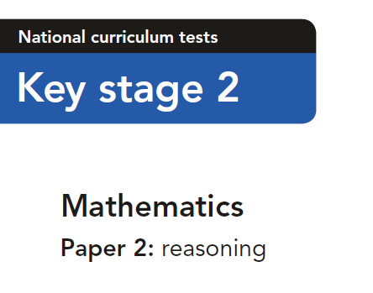
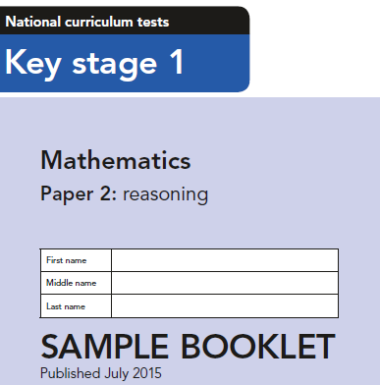
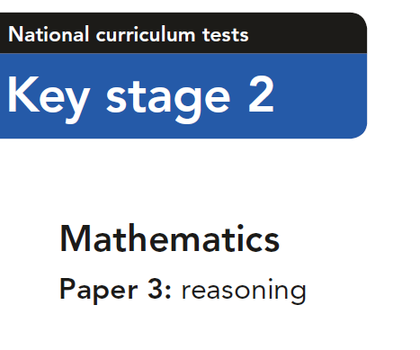

Slide 7
The national curriculum for mathematics aims to ensure that all pupils:
become fluent in the fundamentals of mathematics, including through varied and frequent practice with increasingly complex problems over time, so that pupils develop conceptual understanding and the ability to recall and apply knowledge rapidly and accurately

Slide 8
The national curriculum for mathematics aims to ensure that all pupils:
can solve problems by applying their mathematics to a variety of routine and non-routine problems with increasing sophistication, including breaking down problems into a series of simpler steps and persevering in seeking solutions

Slide 9
Assessment objectives – GCSE Maths
AO1: Use and apply standard techniques
Students should be able to:
accurately recall facts, terminology and definitions
use and interpret notation correctly
accurately carry out routine procedures or set tasks requiring multi-step solutions.
AO2: Reason, interpret and communicate mathematically
Students should be able to:
make deductions, inferences and draw conclusions from mathematical information
construct chains of reasoning to achieve a given result
interpret and communicate information accurately
present arguments and proofs
assess the validity of an argument and critically evaluate a given way of presenting information.
AO3: Solve problems within mathematics and in other contexts
Students should be able to:
translate problems in mathematical or non-mathematical contexts into a process or a series of mathematical processes
make and use connections between different parts of mathematics
interpret results in the context of the given problem
evaluate methods used and results obtained
evaluate solutions to identify how they may have been affected by assumptions made.

Slide 10
Why reason?
When is reasoning needed?
Thinking about your Maths lessons?

Slide 11
When is reasoning needed?
When encountering a new challenge
When logical thinking is needed
When a range of starting points is possible
When there are different strategies to solve a problem
When there is missing information
When problem solving
When there is more than one solution

Slide 12
Examples of reasoning opportunities
STOP
In pairs/threes
Have a go at one of the tasks on your table
10 minutes

Slide 13
When is reasoning needed?
When encountering a new challenge
When logical thinking is needed
When a range of starting points is possible
When there are different strategies to solve a problem
When there is missing information
When problem solving
When there is more than one solution
Feedback?

Slide 14
Progression in reasoning
Describing
Explaining
Convincing
Justifying
Proving
Verbal or Written?

Slide 15
Why reason?
When is reasoning needed?
Thinking about your Maths lessons?

Slide 16
Getting started?
Nrich SoW/Website
EYFS & KS1
KS2
KS3 & KS4
National Strategies books (Primary)
Challenges Book
Reasoning in Number
Team teach?

Slide 17
Any Questions?
m.r.cooper@hull.ac.uk
Give out the handout

