Slide 1
So what are you expecting?
A PowerPoint to tell you all about teaching….

Slide 2
Well teaching is easy!
Teaching to learn is more challenging!
Transition seems almost impossible!

Slide 3
Meet Ben

Slide 4
FSM – so Ben was ½ as likely to achieve 5a*-C GCSEs including English and mathematics
Neither parent was working so Ben was much more likely to have challenging behaviour at 5 years old
Socially disadvantaged – 50% start with delayed language and so Ben’s language delay would significantly impact on his attainment
½ of 10 and 11 year old boys on FSM are not at the standard for mathematics and English – so Ben would not be secondary ready
Summer born children get consistently lower results and tend to be more unhappy with less chance of getting into high performing universities…..

Slide 5
So begin with a passion and your own vision!
My Journey!

Slide 6
Immersive Learning

Slide 7
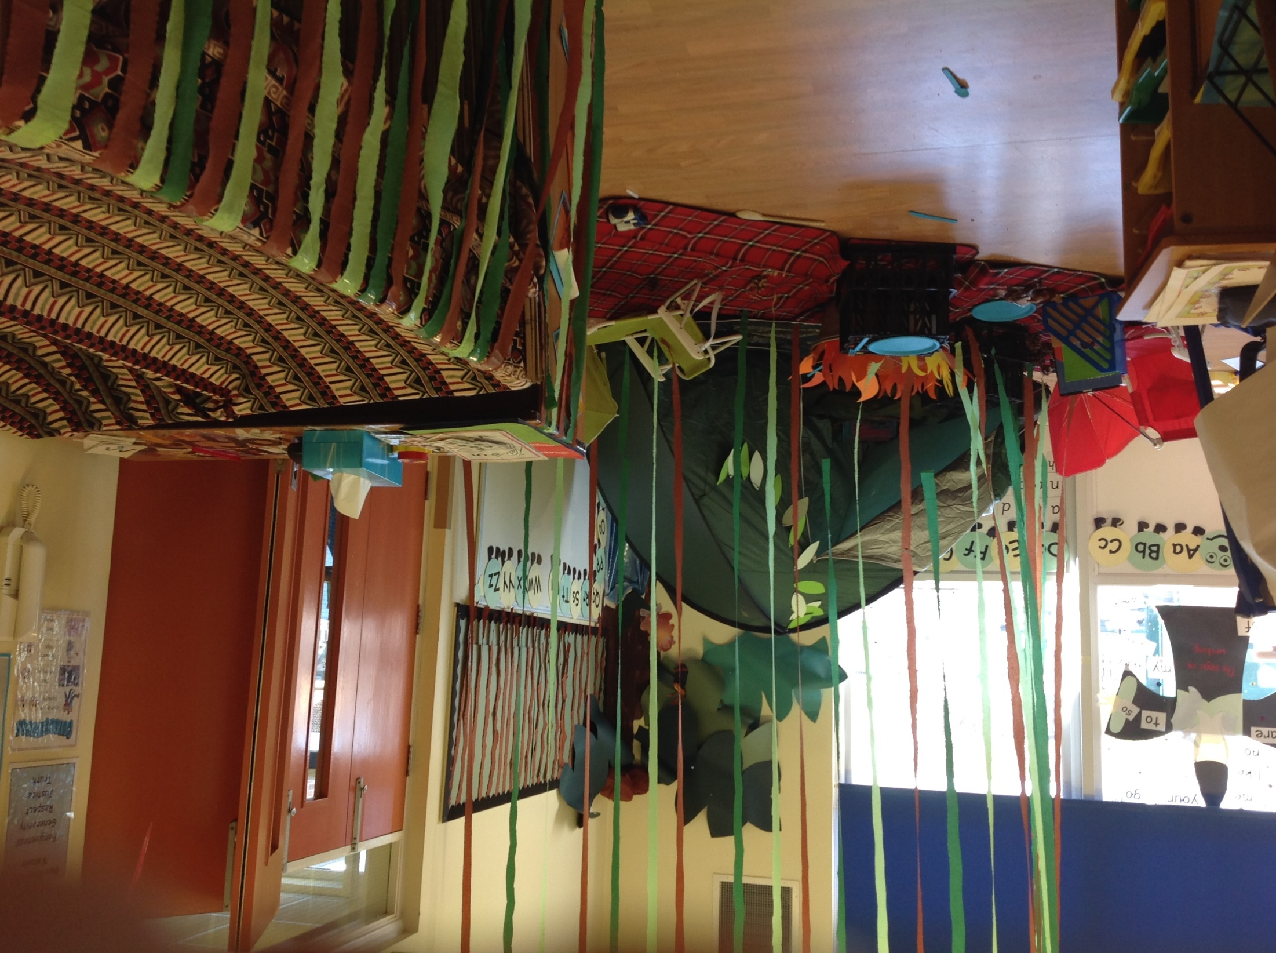

Slide 8
Teaching Children To Learn

Slide 9
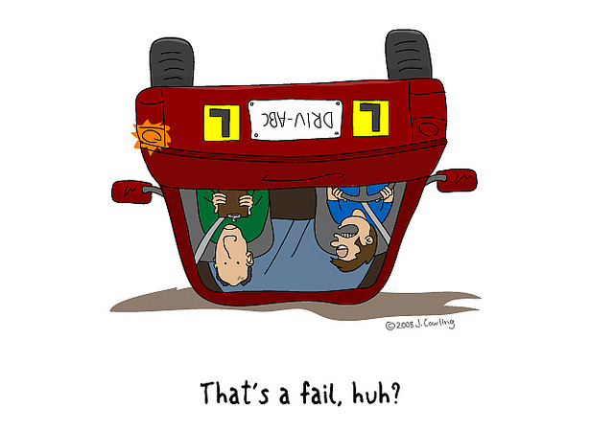
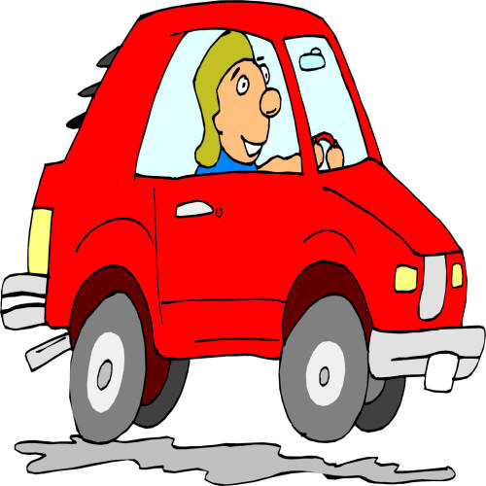
Teaching Children To Learn Metacognition
Mastery – a deeper understanding of a concept
"I can drive a car!“
How much support is needed?
LOTS SOME NONE

Slide 10
Challenge
Skills
Apply

Slide 11
So what makes a great learner
Confidence
Resilience
Independent thinking
Making links
Questioning
Reflection
Collaboration
Taking risks
Perseverance - ‘not there yet’ attitude
Noticing things that are happening around them
Managing their own distraction
Taking pride in what they do
Resourcefulness
Having high expectations of themselves

Slide 13
Transition

Slide 14
Working Together
In the beginning…..
Reading
PE
Science
Fitness
Fixed Term Exclusions

Slide 15
Make a Difference
Take Risks Be different
Care
Be proud
Learn to accept you will never finish
Accept support
Be happy
Learn to act

Slide 16
DON’T ALLOW A CULTURE OF SAYING:
OUR CHILDREN CAN’T…
OUR PARENTS WOULDN’T…
THAT’S NOT POSSIBLE…
IT COSTS TOO MUCH…
CHILDREN DON’T RESPECT
HE/SHE IS NAUGHTY/BADLY BEHAVED

Slide 17
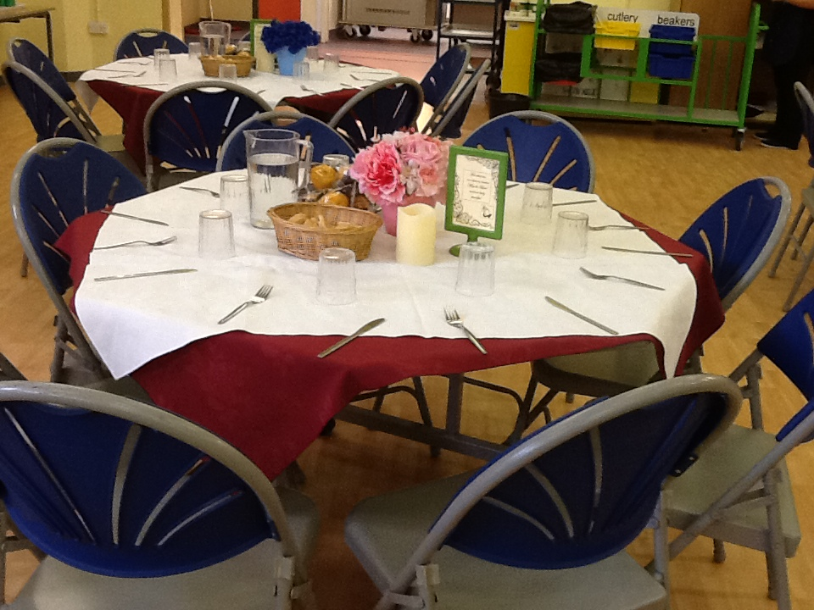

Slide 18
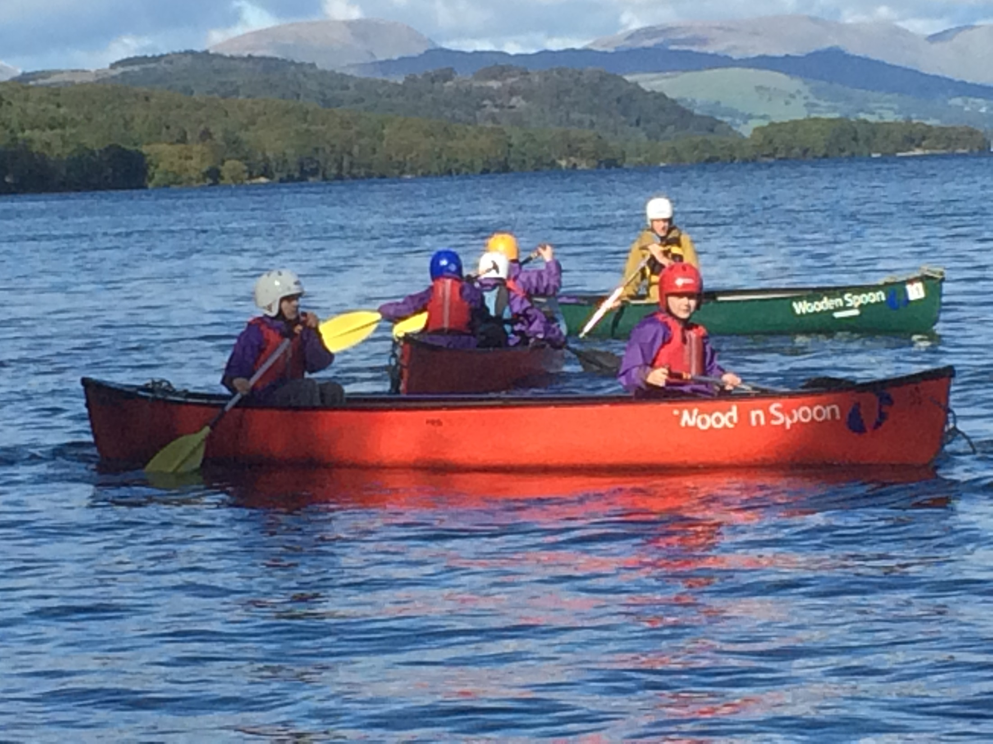

Slide 19
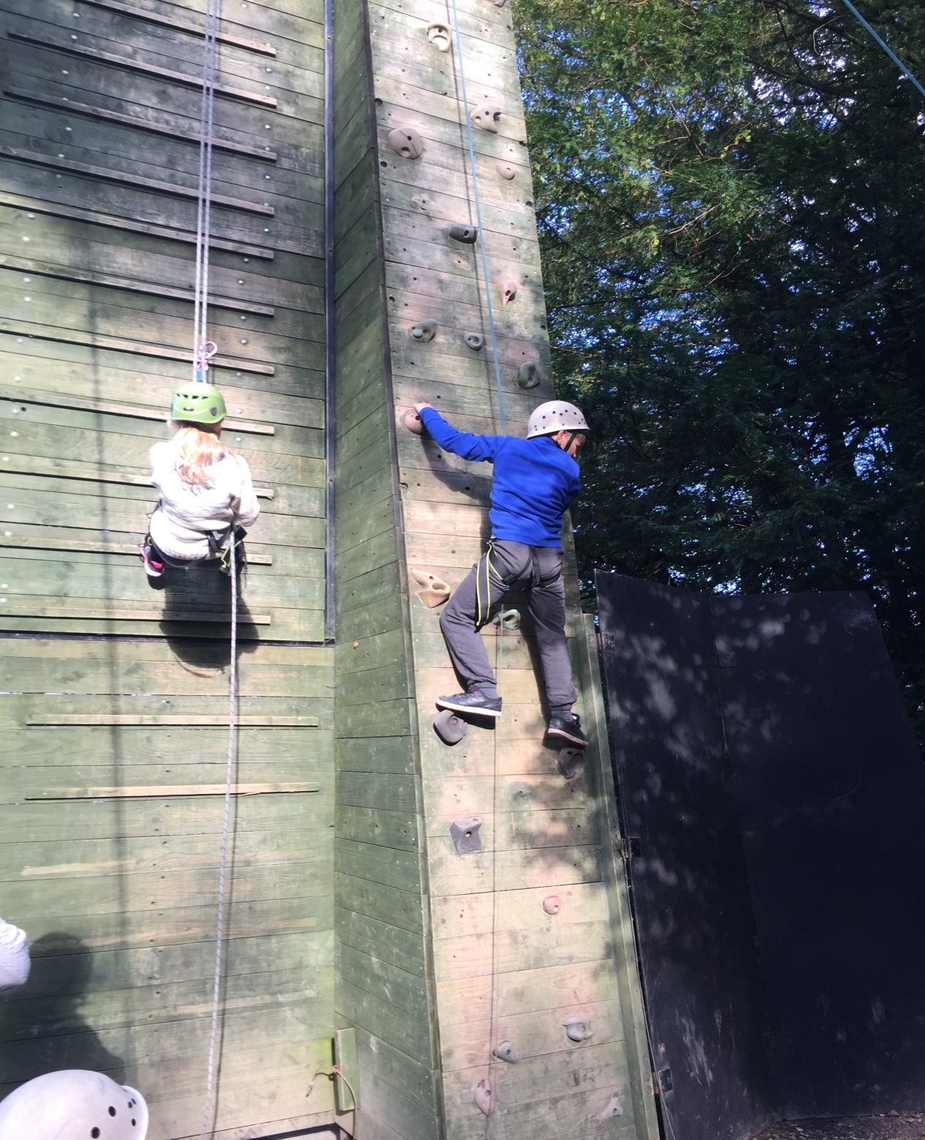

Slide 20
Swimming

Slide 21
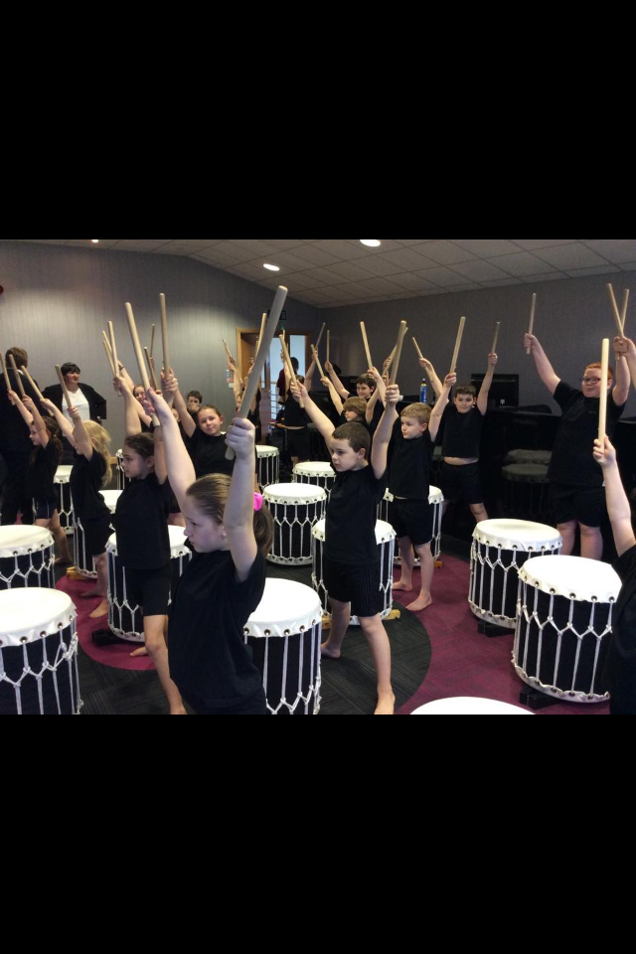
PROUD!
Performing is their interview!

