Slide 1


Riding Forward TSA
Assessing Without Levels
Michael Loncaster Head Teacher &
Matthew Britton Assistant Head Teacher
of Molescroft Primary School & Riding Forward TSA

Slide 2
ASSESSMENT IN CLASSROOMS... A brief history!
Everything based on tests

Slide 3
ASSESSMENT IN CLASSROOMS... A brief history!
Testing became practically a crime against childhood

Slide 4
ASSESSMENT IN CLASSROOMS... A brief history!
Observation testing

Slide 5
ASSESSMENT IN CLASSROOMS... A brief history!
Levels

Slide 6
ASSESSMENT IN CLASSROOMS... A brief history!
Ticking boxes

Slide 7
ASSESSMENT IN CLASSROOMS... A brief history!
Ticking strands of boxes

Slide 8
ASSESSMENT IN CLASSROOMS... A brief history!
C.A.S.S.

Slide 9
ASSESSMENT IN CLASSROOMS... A brief history!
Records of Achievement

Slide 10
ASSESSMENT IN CLASSROOMS... A brief history!
A.P.P

Slide 11
ASSESSMENT IN CLASSROOMS... A brief history!
NO MORE LEVELS!!!
Parents did not understand them?
Teachers spent too much time measuring them?
Schools to design their own systems for measuring pupil progress.
Really!
What about moderation?
What about a national standard?
How will we cope?
What do we do?

Slide 12
ASSESSMENT IN CLASSROOMS.
Actually all is not lost if we remember we are assessing against new national expectations for each year of the National Curriculum.
The Government agenda is to ensure that at least 85% of pupils are secure across the learning goals each year for the enhanced expectations of the new National Curriculum.
So this is the focus of our assessment.
  Are the pupils secure?
  Who is not?
  Assessment clearly influences teachers next planning steps.
  A net is cast through which children do not fall.
  Those who are secure are given the opportunity to enhance their learning and develop their understanding in new circumstances.

Slide 13


Slide 14



ENGLAND
FRANCE
CHINA

Slide 15
ENGLAND
FRANCE
CHINA

Slide 16
ENGLAND
FRANCE
CHINA

Slide 17
ACTION ZONE
ENGLAND
FRANCE
CHINA

Slide 18
ASSESSMENT IN CLASSROOMS.
So lets go back to the drawing board.
What do we actually want assessment to do?

Slide 19
What is required from an assessment system?
An assessment tool that is completely intuitive to a teacher’s practice.
Assessment that travels directly from the classroom and can be completed without any fuss when learning happens.
Assessments that can be made by teachers and teaching assistants simultaneously.
Assessments that can be made during a lesson or during marking or following formal assessments and automatically uploaded from any location.
A system that allows assessments to be made by any number of staff at any time.
A system which is paper free and needs no transferring of data from a mark book, scheme or into a spreadsheet.

Slide 20
What is required from an assessment system?
Assessments which are literally a flick, can be made on iPads, tablets or smart phones.
A system which is pre populated with assessment criteria / objectives for EVERY SUBJECT including Primary Languages and Early Years from birth.
A system which enables schools to edit the pre populated objectives prior to the to setting up.
A system which assesses the security of pupil understanding working within any year’s objectives.

Slide 21
What is required from an assessment system?
A system which ensures that gaps in learning are not forgotten in transfer from one year to the next.
A system which highlights pupils who may not be ‘secure’ in their understanding but are ‘developing’ their understanding or ‘enhancing’ their understanding.
A system which enables schools to add bespoke objectives for pupils working at the extremes of the learning spectrum.
A system which enables coordinators and senior leaders to view pupil achievement and progress at any time anywhere and for any aspect of the curriculum and to make comparisons of their choice for example different groups of children including Pupil Premium.

Slide 22
What is required from an assessment system?
The ability to choose your own threshold for measurement of pupil achievement.
The ability to see how many children in any cohort or class or group are secure in their learning objectives for any subject including Reading, Writing, Maths etc.
The ability to know how any pupil is performing at any time.
To demonstrate progress within a year and across years
To automatically provide reports for parents, Senior Leadership, LA, Governors and Ofsted.

Slide 23
How do you assess the Arts, P.E, D&T?

Slide 26
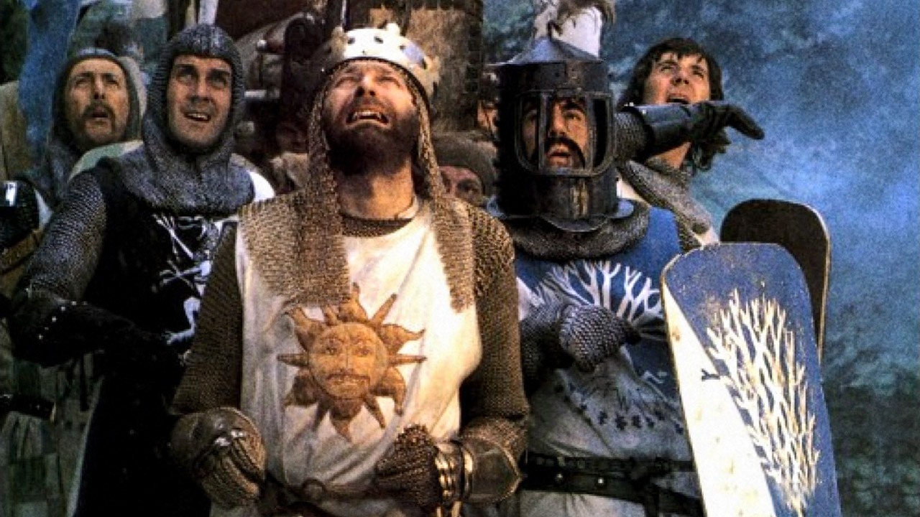
The Holy Grail of Assessment
Framing Learning in Classrooms

Slide 27
emails
mbritton@molescroftprimary.net
mloncaster@molescroftprimary.net
jlines@molescroftprimary.net
stevedpo@me.com
Telephones
Riding Forward 01482 679139
Molescroft Primary School 01482 861762

