Slide 1

Supporting learners with
English as an Additional Language
Kamil Trzebiatowski
The University of Hull
Newly Qualified Teachers Conference
29 January 2016
EAL Coordinator at Newland School for Girls, Hull
EAL Academy Associate Trainer
Member of NALDIC Publications Committee
ATL Rep
MA Linguistics, MEd Inclusive Education
Pedagoo Curator
Member of NALDIC, NATE and UKLA
Teacher, Trainer, Speaker, Writer, Blogger
Twitter: @ktlangspec / email: ktlangspec@gmail.com / KTrzebiatowski@newland.hull.sch.uk
http://valuediversity-teacher.co.uk/
Notes:
Quick presentation of research – and findings
Focus on English teachers are (not) teachers of English
Move to Maton’s theory

Slide 2
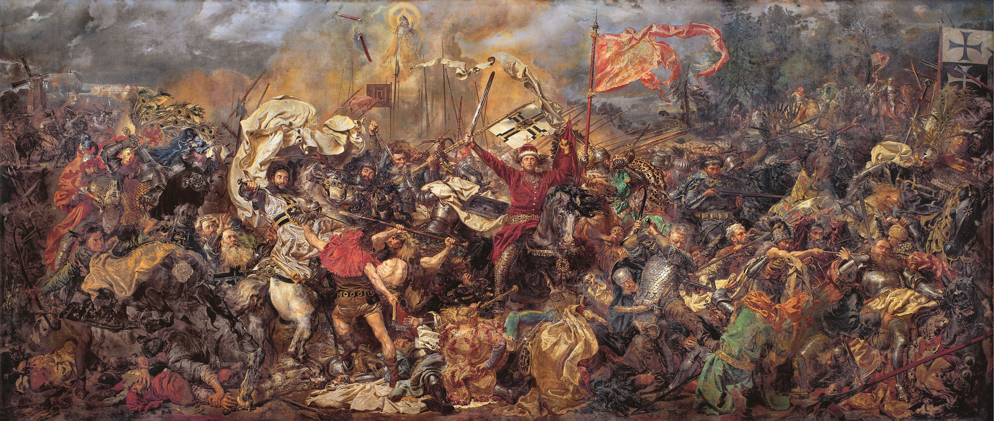
Temat: Co przedstawia obraz Matejki?
Słowa kluczowe:
Bitwa
Grunwald
Jan Matejko
unia polsko-litewska
Rzeczpospolita Obojga Narodów
Zakon Krzyżacki
1410r.
Cel lekcji:
Będę umiał/a wytłumaczyć, co się dzieje na obrazie Jana Matejki (ustnie).
Będę umiał/a napisać krótki tekst na ten temat.
Notes:
Na dzisiejszej lekcji zapoznamy się z obrazem „Bitwa pod Grunwaldem”. Przedstawia on bitwę, która miała miejsce w roku 1410 między unią polsko-litewska, znaną też jako Rzeczpospolita Obojga Narodów, a Zakonem Krzyżackim. Była to jedna z największych bitew tamtych czasów. Obraz namalował Jan Matejko.

Slide 3
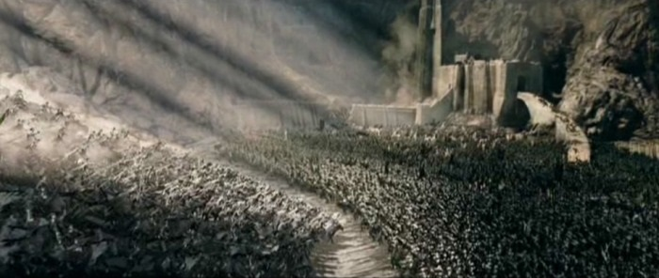
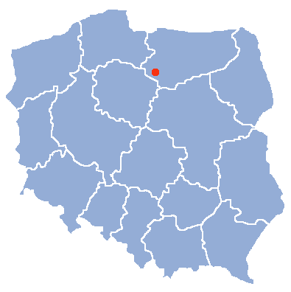
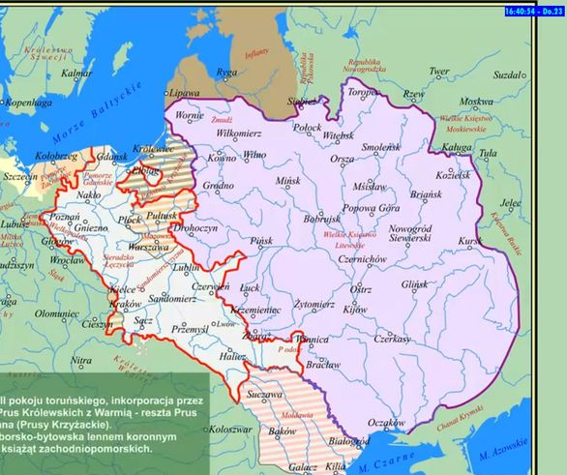
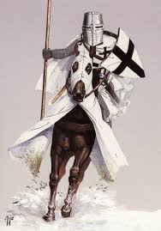
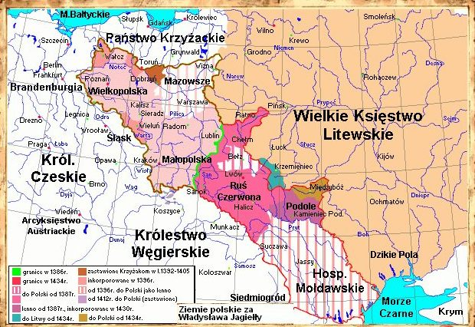
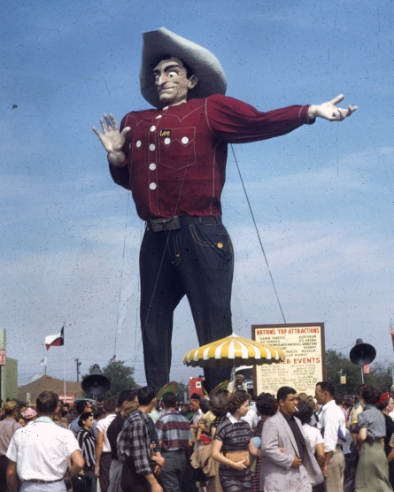
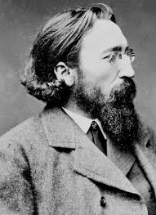

Temat: Co przedstawia obraz Matejki?
Słowa kluczowe:
Obraz
Bitwa
Grunwald
Jan Matejko
unia polsko-litewska
Rzeczpospolita Obojga Narodów
Zakon Krzyżacki
1410r.
1410r.
2016r.
45 000
Notes:
Na dzisiejszej lekcji zapoznamy się z obrazem „Bitwa pod Grunwaldem”. Przedstawia on bitwę, która miała miejsce w roku 1410 między unią polsko-litewska, znaną też jako Rzeczpospolita Obojga Narodów, a Zakonem Krzyżackim. Była to jedna z największych bitew tamtych czasów. Obraz namalował Jan Matejko.

Slide 4
Temat: Co przedstawia obraz Matejki?
Słowa kluczowe:
Bitwa
Grunwald
Jan Matejko
unia polsko-litewska
Rzeczpospolita Obojga Narodów
Zakon Krzyżacki
1410r.
Cel lekcji:
Będę umiał/a wytłumaczyć, co się dzieje na obrazie Jana Matejki (ustnie).
Będę umiał/a napisać krótki tekst na ten temat.
Notes:
Na dzisiejszej lekcji zapoznamy się z obrazem „Bitwa pod Grunwaldem”. Przedstawia on bitwę, która miała miejsce w roku 1410 między unią polsko-litewska, znaną też jako Rzeczpospolita Obojga Narodów, a Zakonem Krzyżackim. Była to jedna z największych bitew tamtych czasów. Obraz namalował Jan Matejko.

Slide 5
Who are English as an Additional Language Learners?
Learning in another language
Learn through another language
Come from backgrounds and communities = different understandings and expectations of education
NALDIC (1999) The Distinctiveness of English as an Additional Language: a cross-curriculum discipline: A Handbook for All Teachers

Slide 6
Factors influencing language development of EAL students
Age when they enter the educational system
Their previous experience of school (or lack thereof)
Their literacy in their L1 (first language)
Their knowledge and understanding of language and school curriculum
Home expectations and understanding of the education system
Support for learning and language at school and community
NALDIC (1999) The Distinctiveness of English as an Additional Language: a cross-curriculum discipline: A Handbook for All Teachers

Slide 7
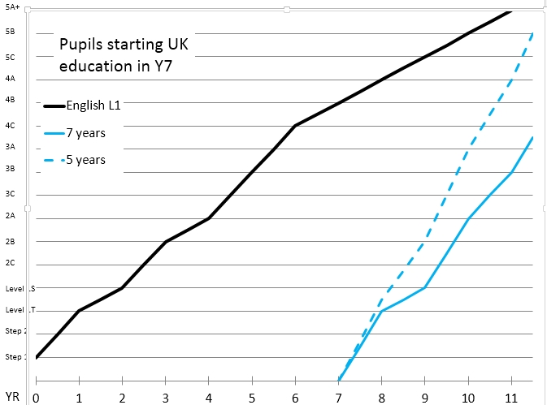
The task ahead of EAL learners
Catching up is essentially EAL children’s problem – curriculum doesn’t wait.
EAL children have a moving target.
EAL Learners have to:
Learn English
Learn content through the curriculum
Socialise with other children in the yet-unlearnt language
Learn culturally-embedded social practices of the classroom
If a child is 3 years behind (linguistically), every year they need to make 1 ½ years of progress (for 6 years) to catch up with native speakers.
BASS (2006) Distinguishing the difference – SEN or EAL?
NALDIC (1999) The Distinctiveness of English as an Additional Language: a cross-curriculum discipline: A Handbook for All Teachers

Slide 8
EAL Pedagogy
Classroom context
Level of English
Strategies: Support English language development
In context
Prior knowledge
Age
Socio-economic background
Cultural background
L1 literacy
Attitude to learning

Slide 9
Cummins’s Framework Quadrant
Cognitively demanding work
Activities requiring deep thinking
B
C
Abstract
Context reduced (pupils have little knowledge and can’t relate to it)
Concrete
Context embedded
A
D
Cognitively undemanding work
Activities that can be completed without much thought
For CALP, Quadrant B is required; for lessons in C: linguistic and contextual support is required; D is tempting (copying is one example), but should be avoided!

Slide 10
Cummins: Thinking Skills
Cognitively demanding
Argues a case using evidence
Identifies criteria persuasively
Develops and sustains ideas
Justifies opinion or judgment
Evaluates critically
Interprets evidence & makes deductions
Forms hypotheses, asks further questions for investigation, predicts results
Applies principles to new situation
Analyses, suggests solution and tests
Generalises
Compares and contrasts
Summarises
Plans
Classifies by known criteria
Transforms and personalises
Recalls and reviews information
Seeks solutions to problems
B
C
Context embedded
D
Context reduced
A
Reading to find specific
information:
• Identifies, names, matches, retells
Transfers information from one
medium to another:
• Applies known procedures
• Describes observations
• Sequences
• Narrates with sense of
beginning, middle, and end
Parrots: repeats utterances of adult or peers
Copies: reproduces information from board or texts
Cognitively undemanding

Slide 11
Good practice for pupils learning EAL
Activate prior knowledge
Questioning
Provide rich contextual background
Key visuals (aka graphic organizers)
Encourage comprehensible output
Key grammar points made explicit
Develop learner independence
KWL charts
Brainstorming
Discovery tasks
Peer tutoring
Collaborative learning
Drama / role play
Scaffolding (scaffolded writing)
E.g. expressing doubt (may/might)
E.g. ways of talking about the past (I did vs. I was doing)
E.g. language to express politeness when making requests
Scanning texts
Looking at subheadings prior to reading
Dictagloss
Using diagrams to show knowledge

Slide 12
Delivering the content to EAL learners
Scaffolding (substitution tables, writing frames, oral frameworks)
Realia, video, artefacts, charts
Key visuals / graphic organizers
Modelling of the use of key language features
Demonstrations
DARTs and CLIL
Different forms of questioning: closed, open, concrete, abstract
Collaborative learning

Slide 13
Mohan: Knowledge Structures, Graphic Organizers and Associated Language
CLASSIFICATION | PRINCIPLES | EVALUATION
DESCRIPTION | SEQUENCE | CHOICE
To describe something you need to be able to classify,
a description of triangles in Maths requires understanding the types of triangles
A description of games in PE requires understanding types games, strategies and equipment
We create order informed by our understanding of principles behind the order. We create sequences because we know what we’re trying to achieve:
Instructions for lab reports (Science)
Mathematical solutions (Maths)
Baking (Food Technology)
In order to make a choice, one has to be able to evaluate available options. We have to understand how these options are justified.
In a salt-and-sand mixture (Science) we do not pick salt with tweezers; we use understanding of solubility to wash the salt out.
Adapted from:
Mohan, Mohan, B. (1986) Language and Content. Addison-Wesley: Reading, Massachusetts.
Slater, T. and Gleason, J. (2011) Integrating Language and Content: The Knowledge Framework

Slide 14
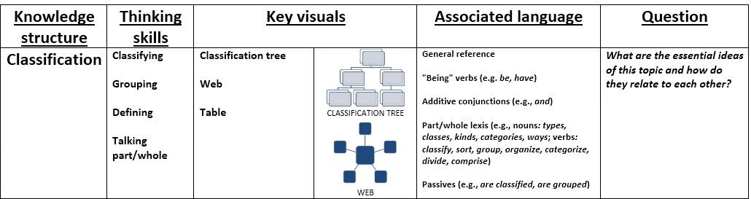
Classification

Slide 15
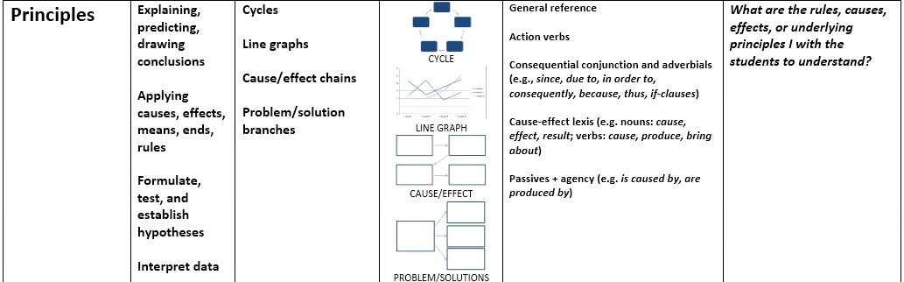
Principles

Slide 16
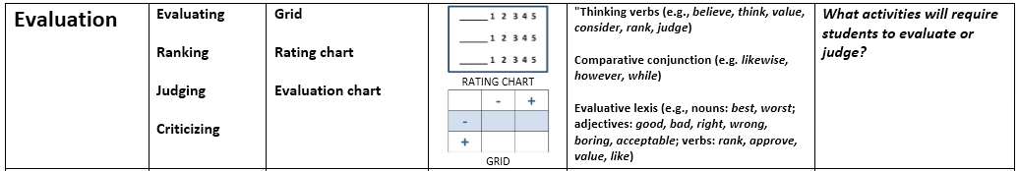
Evaluation

Slide 17
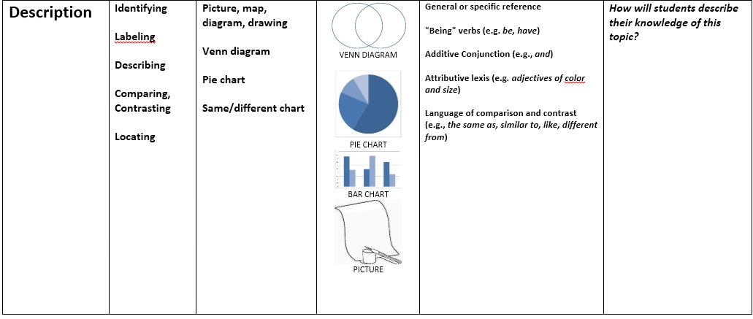
Description

Slide 18
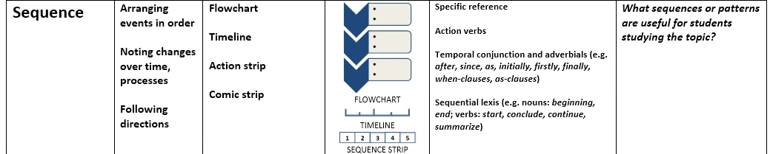
Sequence

Slide 19
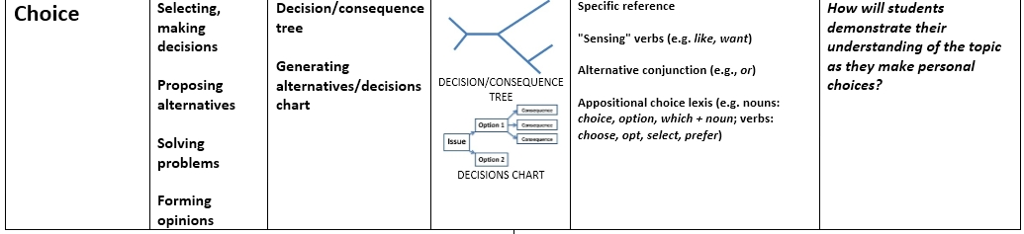
Choice

Slide 20
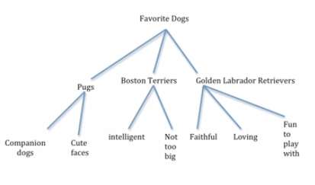
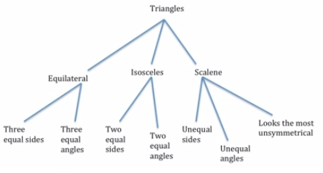
There are three kinds of dogs that I like best. I like Pugs because they are companion dogs and have cute faces. Boston Terriers are on my list because they are intelligent and not too big. I also like Golden Labrador Retrievers because they are faithful, loving, and fun to play with.
There are three types of triangles: equilateral, isosceles and scalene. Equilateral triangles are made up of three equal sides and three equal angles. Isosceles triangles are made up of two equal sides and two equal angles. Scalene triangles are made up of unequal sides and unequal angles. Scalene triangles look the most unsymmetrical.
Adapted from http://tslater.public.iastate.edu/kf/powerpoint.html

Slide 21
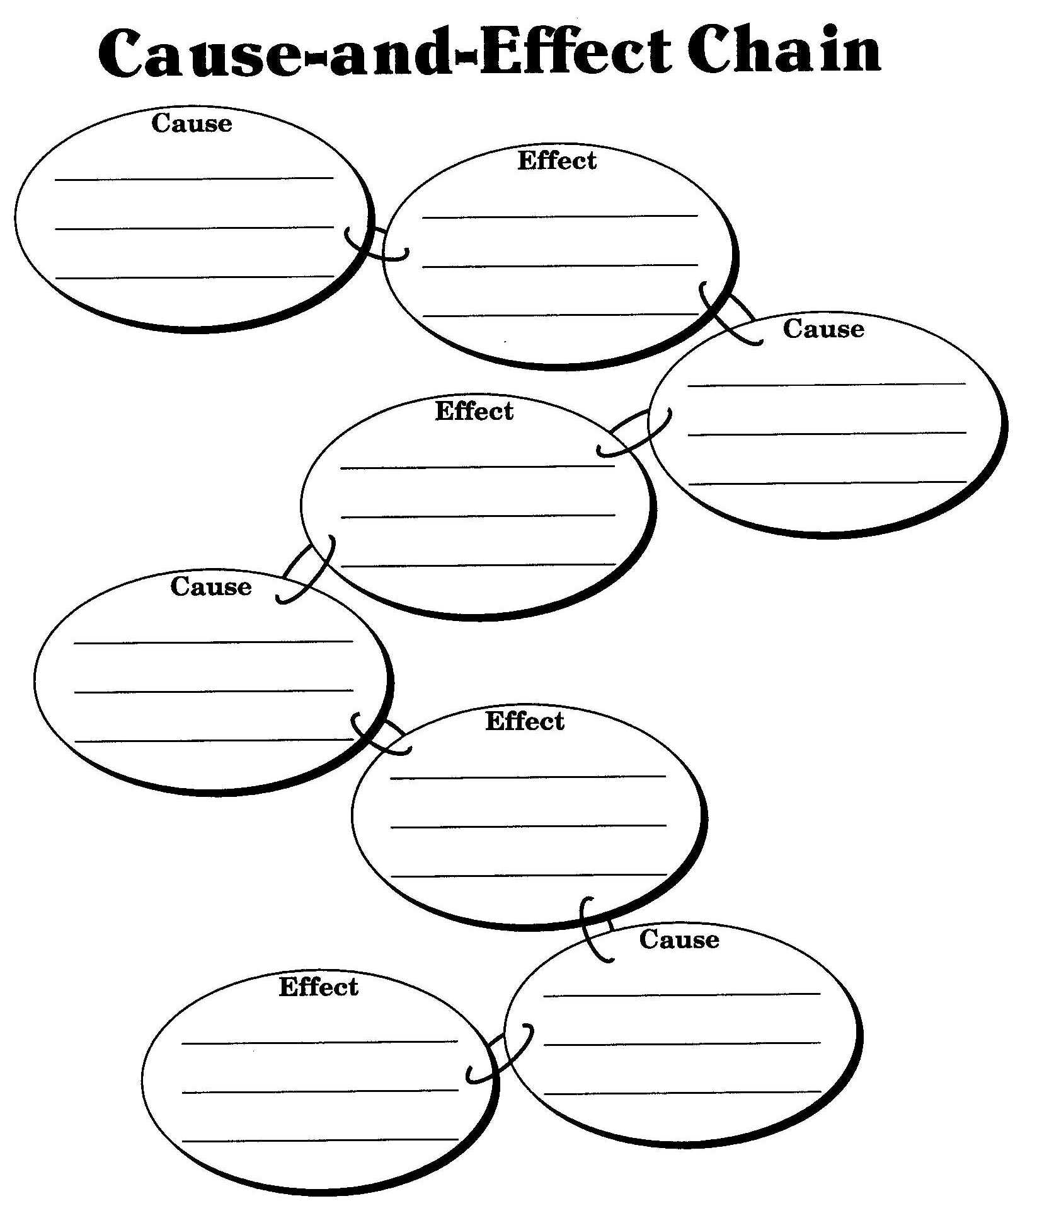
Because of this…
Therefore…
That’s why…
Hence…
Thus…

Slide 22
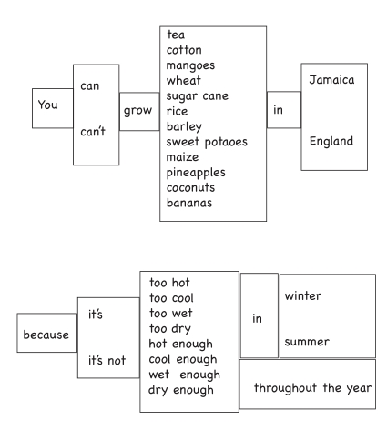
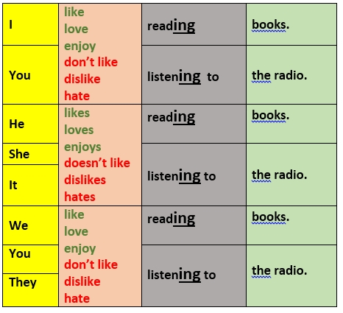
Substitution tables

Slide 23
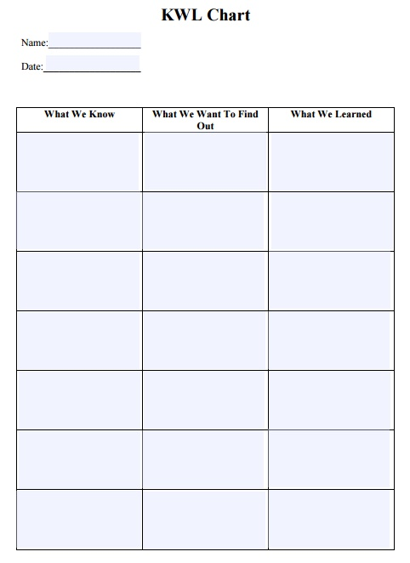
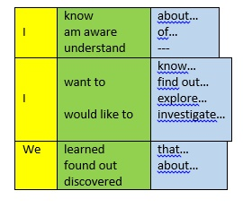
Activating Prior Knowledge
STRATEGY:
KWL WITH LANGUAGE
Questioning
KWL (Know, Want to find out, Learned) charts
brainstorming in small groups or pairs
discovery tasks
enabling use of first language.
What’s missing here?
Language!

Slide 24
Substitution tables
Stevie Smith creates the persona of a river with enduring physical power.
Stevie Smith The author The writer The poet | creates forges constructs devises | the persona the personality the character | of a river with | enduring lasting strong unyielding persistent | physical power.
All the parts are a working circulation system.
All | the parts the elements the components | are constitute compose form make up | a an | working functioning operational | circulation system.

Slide 25
DARTs:
Directed activities related to text
Alternative to typical comprehension questions
Encourages students to work with texts in a way that promotes greater understanding
Chance for learners to “read between the lines” (implied meaning) – not only basic understanding
Supporting learners in analysing and reconstruction of texts

Slide 26
CHANGE THE TEXT A LITTLE
USE THE ORIGINAL TEXT
Sequencing – words, paragraphs, sentences
Labelling a diagram
Grouping parts of texts according to categories
Completing a table, diagram or flowchart
Gap-fills: missing words, phrases or sentences
Underline or highlight parts of texts: e.g. adjectives, adverbs, connectives
Give each paragraph a title
Draw a table or diagram using information from a text
Write questions about a text

Slide 27
SPECIFIC CLOZE
Remove only certain types of words, e.g. subject-specific words, parts of speech or tenses
Many different possibilities to fill in the gap
A ___________ is a group of ____________ teachers that have got together to ____________ ideas.
Functional (grammar words): one option only
_____ TeachMeet is a group ________ enthusiastic teachers that have got together _______ share ideas.
!
Discuss when there are many possibilities and when there is just one
First and last sentence should remain unmodified – so that students have a context for reading it all.

Slide 28
VANISHING CLOZE
Write a few sentences on the board – what you feel needs practising
Get them to read it out loud
Erase one word – they read it
Repeat until all words are erased
VANISHING CLOZE
An
equilateral
triangle
is
a
triangle
with
all
three
sides
of
equal
length.
!
A great tool for students to explore parts of speech and sentence structure bit by bit.

Slide 29
GAP-FILLS WITH A DIFFERENCE
Provide a list of words in a box
Ensure they are all one category (e.g. prepositions or verbs)
Discuss how they’re used in sentences (word order)
A PREPOSITION GAP FILL
She was dressed __ rich materials - satins, and lace, and silks - all __ white. Her shoes were white. And she had a long white veil dependent ____ her hair, and she had bridal flowers __ her hair, ___ her hair was white. Some bright jewels sparkled __ her neck and __ her hands, and some other jewels lay sparkling __ the table. Dresses, less splendid than the dress she wore, and half-packed trunks were scattered _____. She had not quite finished dressing, ___ she had ___ one shoe __ - the other was __ the table ____ her hand - her veil was half arranged, her watch and chain were not put __, and some lace ___ her bosom lay ____ those trinkets and ____ her handkerchief, and gloves, and some flowers, and a prayer-book-, all confusedly heaped _____ the looking-glass.
Choose from the words in the box
In | near | on | of
with | about | but | from
for
What part of speech are all these words?
Are the verbs before or after them?

Slide 30
CLIL – Focus on language through your content
STRATEGY:
DARTs: REMOVE SPECIFIC GRAMMAR ITEMS
1. The Scottish army is ____ war with the Norwegian army.
2. Duncan, king _____ Scotland, meets a captain returning from battle.
3. The captain informs them _____ Macbeth and Banquo's bravery _____ battle.
4. He also describes Macbeth's attack _____ the castle _____ the treacherous Macdonald, _____ which Macbeth triumphed and planted Macdonald’s head _____ the battlements _____ the castle.
5. The Thanes of Ross and Angus enter _____ the news that the Thane _____ Cawdor has sided _____ Norway.
6. Duncan decides to execute the disloyal thane and give the title _____ Cawdor _____ Macbeth.
Why not give these as strips and get your EAL learners to reorder them after putting in prepositions?
Differentiate by providing a box with missing prepositions under the activity (or not).
Summary of Sc 1, Act 2 from: http://www.gradesaver.com/macbeth/study-guide/summary-act-1

Slide 31
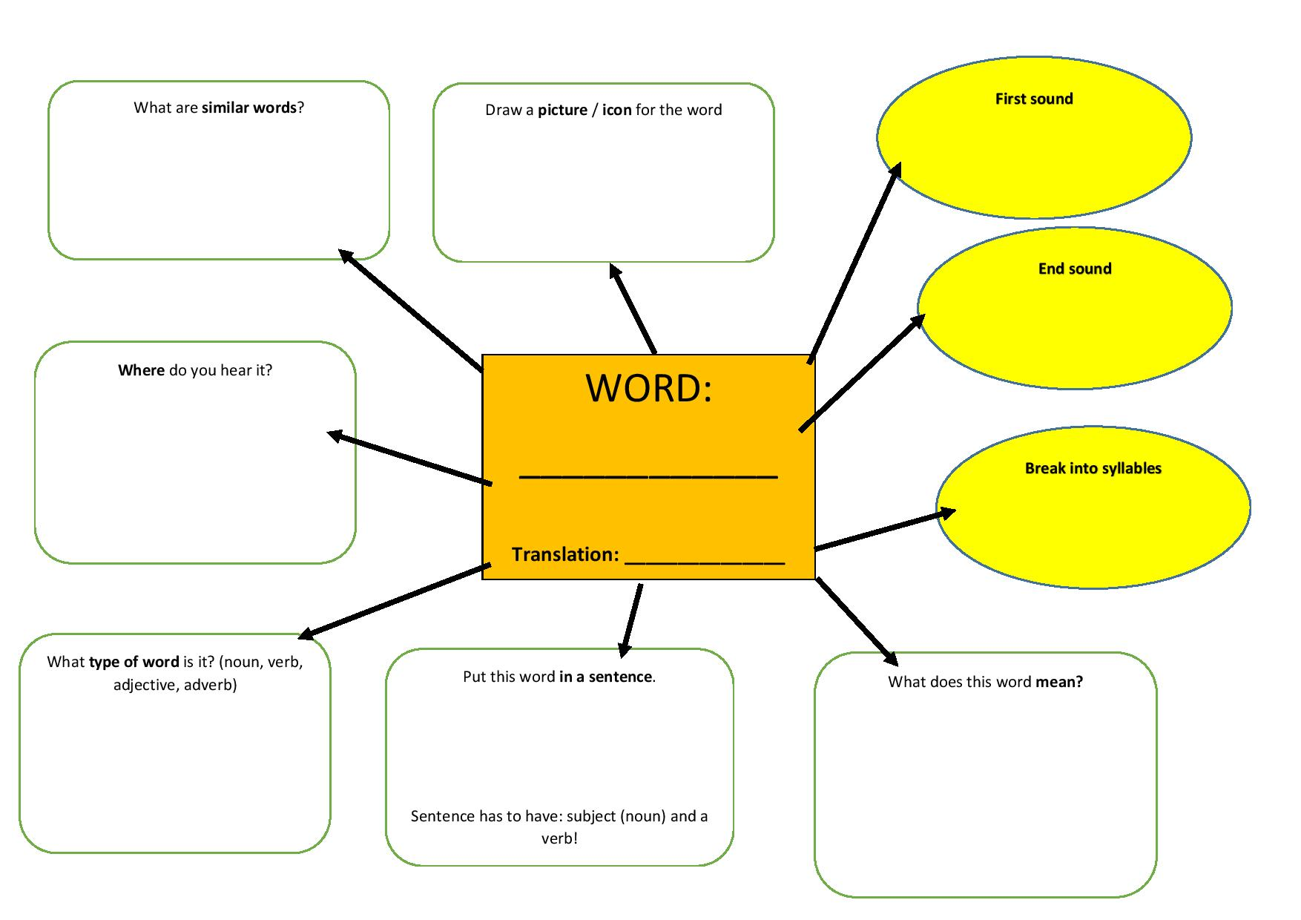
STRATEGY:
PLENARY (or starter) WORD MAP
Adapted from material presented by @DiLeed at EAL TeachMeet at Harris Academy (June 2014)

Slide 32

CERTAINLY
SEEMS TO BE
APPEARS TO BE
UNDOUBTEDLY
USUALLY
IRREFUTABLY
UNLIKELY
LIKELY
CAN
MIGHT
MAY
COULD
OUGHT TO
IS
MIGHT POSSIBLY
Adverbs / adverbial phrases of certainty
Modal verbs of certainty/uncertainty
NEXT
FURTHER
SUBSEQUENTLY
FOLLOWING THIS
LATER
AFTERWARDS
THEN
Spoken-like to academic

Slide 33
Practical tasks: choose one:
1
Think about a lesson you’ve had either this week, or you’ve already had planned for the new week.
Create a graphic organizer on the A3 sheet of paper.
2
Look at the material provided to you.
Can you present the information to the student using a substitution table?
3
Look at the text given to you.
Create a CLIL/DARTs activity where what is asked of a student focuses specifically on language not content (e.g. present simple tense use, prepositions, articles, adjectives only, etc).

Slide 34
Essential Reading and Resources
Creese, Angela. Teacher Collaboration And Talk In Multilingual Classrooms. Clevedon [England]: Multilingual Matters, 2005. Print.
Deller, Sheelagh, and Christine Price. Teaching Other Subjects Through English. Oxford: Xford University Press, 2007. Print.
Derewianka, Beverly. Exploring How Texts Work. Print.
Distinguishing The Difference: SEN Or EAL?. 1st ed. Birmingham: BASS, 2003. Web. 28 Jan. 2016.
Eal.britishcouncil.org,. "British Council EAL Nexus". N.p., 2016. Web. 28 Jan. 2016.
Gibbons, Pauline. English Learners, Academic Literacy, And Thinking. Portsmouth, NH: Heinemann, 2009. Print.
Gibbons, Pauline. Learning To Learn In A Second Language. Portsmouth, NH: Heinemann, 1991. Print.
Gibbons, Pauline. Scaffolding Language, Scaffolding Learning. Portsmouth, NH: Heinemann, 2002. Print.
Graf, Madeleine. Including And Supporting Learners Of English As An Additional Language. New York: Continuum International Pub. Group, 2011. Print.
Gravelle, Maggie. Planning For Bilingual Learners. Stoke-on-Trent: Trentham, 2000. Print.

Slide 35
Essential Reading and Resources
McWilliam, Norah. What's In A Word?. Stoke on Trent: Trentham Books, 1998. Print.
Mercer, Neil. The Guided Construction Of Knowledge. Clevedon: Multilingual Matters Ltd, 1995. Print.
Meshguides.org,. "EAL | Meshguides". N.p., 2016. Web. 28 Jan. 2016.
Mohan, Bernard A, Constant Leung, and Chris Davison. English As A Second Language In The Mainstream. Harlow, England: Longman, 2001. Print.
Naldic.org.uk,. "NALDIC | Home". N.p., 2016. Web. 28 Jan. 2016.
Nassea.org.uk,. "NASSEA". N.p., 2016. Web. 28 Jan. 2016.
Pim, Chris. 100 Ideas For Supporting Learners With EAL. New York: Continuum, 2012. Print.
Schneider, Claudia. School Approaches To The Education Of EAL Students. Cambridge: The Bell Foundation, 2014. Print.
Thomas, Wayne, and Virginia Collier. A National Study Of School Effectiveness For Language Minority Students' Long-Term Academic Achievement. CREDE, 1997. Web. 28 Jan. 2016.
Washbourne, Alice, and Phil Hailstone. EAL Pocketbook. Alresford: Teachers' Pocketbooks, 2011. Print.

Slide 36
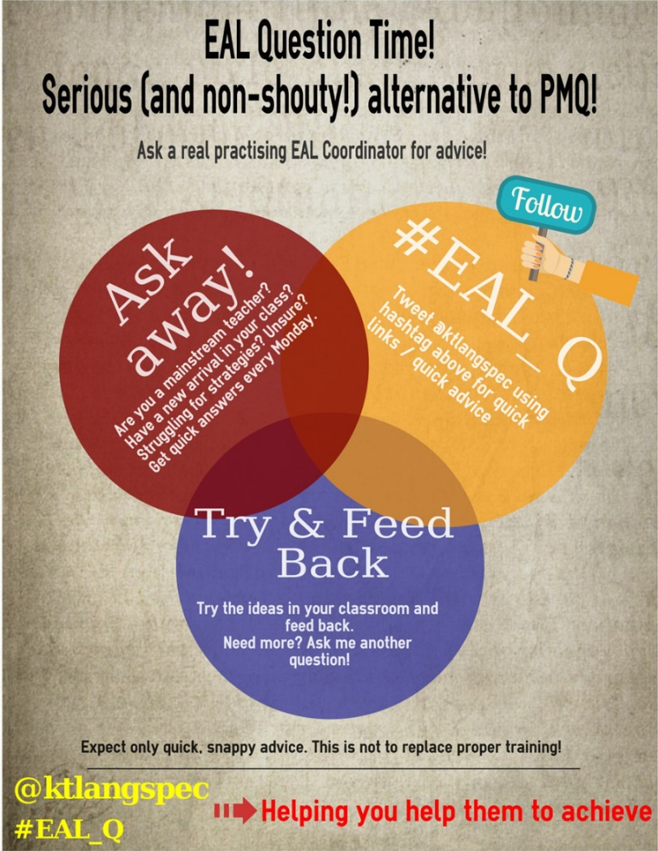

Slide 37


Slide 38
EAL Conference
1 July 2016
Newland School for Girls
Kingston-upon-Hull
Not for EAL specialists; aimed directly at mainstream teachers. Individual subject workshops. Workshops will be led by some of the top specialists in the country.
Stay in touch for updates as the date draws near.

