Slide 1
Developing literacy skills across the curriculum: every teacher is a teacher of reading

Slide 2
Today we will:
Consider some of the challenges we face in developing pupils’ literacy skills
Look at the challenges pupils face throughout school
Consider strategies for teaching and learning
Consider some key principles

Slide 3

WE WERE NEVER BORN TO READ. HUMAN BEINGS invented reading only a few thousand years ago.
Wolf, M, 2008 Proust and the squid

Slide 4
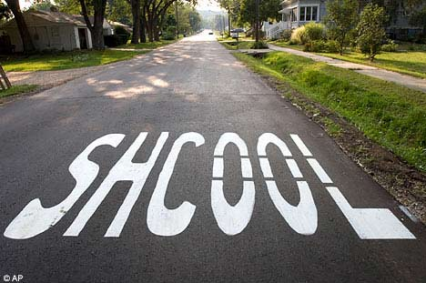

Slide 5
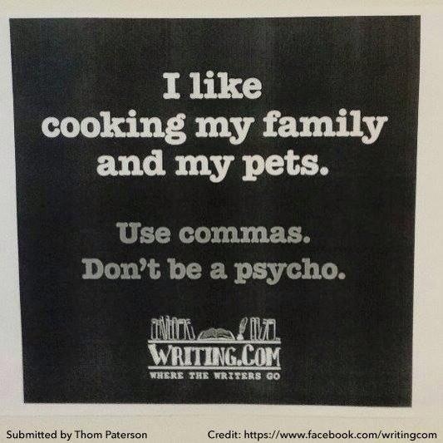

Slide 6
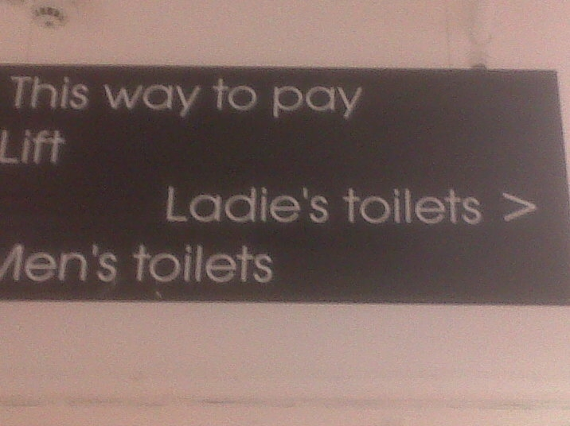
Debenhams in Stockton-on-Tees

Slide 7
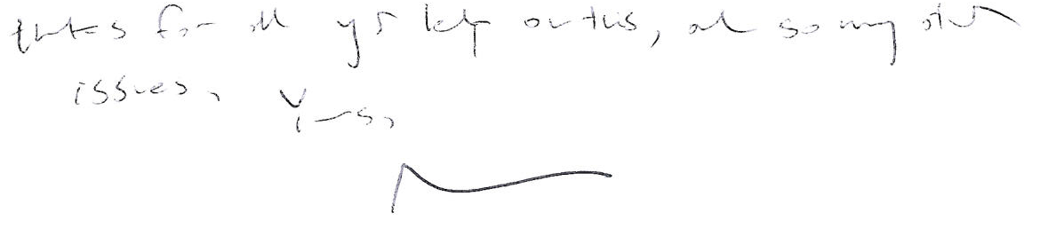
Who do you think wrote this?

Slide 8
Michael Gove: Secretary of State for Education

Slide 9
Context
Literacy has a significant relationship with:
educational attainment
economic well-being
aspirations
family circumstances
physical and mental health
civic / cultural participation
employment
crime rates
25% of young offenders have a reading age below
7 yrs.
70% of permanent school exclusions and 60% of the prison population have difficulties with basic literacy

Slide 10
daeR sihT ylluferaC
I evah devil ni ro raen lluH rof ytriht sraey. tI si a yrev yldneirf ytic dna eht elpoep ekam "srengierof" ekil flesym yrev emoclew.
yllanigirO, I emoc morf retsacnoD dna I devil ni a gib tip egalliv erehw ym dad llits sevil. yllarutaN, I ma a retsacnoD srevoR retroppus, tub I osla troppus dnalrednuS.
erA ouy gnitteg eht gnah fo siht won? s'tI ton yrev ysae, si ti? fI uoy kniht s'ti drah ot daer, uoy dluohs yrt gnitirw siht yaw!

Slide 11
+
Good language comprehension, poor word recognition
Good word recognition, good language comprehension
Word Recognition
-
+
Good word recognition, poor language comprehension
Poor word recognition, poor language comprehension
-
Language comprehension
Notes:
11
SVR - model to provide an overall framework for understanding the broad landscape of reading

Slide 12
What are the key challenges for children’s reading in Y7?
Unfamiliar vocabulary – ‘new’ subject jargon and terminology
Unfamiliar phrasing, e.g. passive tense
Texts which sometimes disguise simple tasks within complex sentence structures
More frequent encounters with unfamiliar grapheme representations of phonemes, e.g. puy, avalanche, crevice, precipice
Inappropriate reading matter (reading age of text books)
Lack of teachers’ consideration of these issues – or of explicit teaching of reading strategies??
Notes:
12
Lots of new or different subjects
Different teaching styles
Tendency to focus on content

Slide 13
“tricky words” subject specific language
    archaeology
    bisect
    les mains
    urbanisation
    centrifugal
All are words children might come across in Y7. What strategies could you use to help them to pronounce and understand them?

Slide 14
A key principle
Give learners meaningful messages

Slide 15
Children can be fascinated by words
We need to talk about words with them
We can help them to extrapolate by discussing phonemes, morphemes, syllables and word origins
By developing children’s word recognition skills we will help develop their comprehension skills
Notes:
Extrapolate – infer more widely from known facts
15

Slide 16
How can you support children?
Ensure worksheets and other resources take account of access needs
  Look carefully at texts and anticipate where problems might arise
  Talk about vocabulary with them, e.g. bisect, bicycle, biped. Talk about roots and prefixes.
  Develop their language comprehension by giving context to new vocabulary
  Support and consolidate learning through ‘Key Words’ lists/ graphic organisers etc
Use speaking and listening activities to underpin learning

Slide 17
Support continued . . .
Develop marking / assessment policies that address literacy competence and highlight its importance
Model reading and writing strategies
Demonstrate active reading strategies, e.g. sequencing, highlighting, restructuring information, cloze activities, etc
Find out more about children’s learning difficulties (Inclusion Development resources)
Access support documents on the archived Strategies website

Slide 18
A key principle
Model and scaffold for learners

Slide 19
“We were learning about like morphemes”
like
unlike
unlikely
likes
dislikes
alike
likeable
liked

Slide 20
Does spelling matter?
Aoccdrnig to rscheearch at an Elingsh uinervtisy, it deosn't mttaer in waht oredr the ltteers in a wrod are, the olny iprmoetnt tihng is taht frist and lsat ltteer is at the rghit pclae. The rset can be a toatl mses and you can sitll raed it wouthit porbelm. Tihs is bcuseae we do not raed ervey lteter by it slef but the wrod as a wlohe.

Slide 21
Common difficulties in spelling
Writers often have difficulties in the following areas:
Adding prefixes and suffixes to words
Vowel choices in unstressed syllables (e.g. the second syllable in ‘farmer’, ‘doctor’)
Consonant doubling (e.g. ‘embarrass’ but ‘harass’)
Homophones – words which sound the same but are spelled differently such as ‘right’ and ‘rite’
For lists of common spelling errors try:
http://global.oup.com/booksites/content/0199296251/essentials/commonspellingerrors/
http://oxforddictionaries.com/words/common-misspellings

Slide 22
Spelling rules – OK?
With your neighbour, write as many spelling rules as you can.
Who wrote i before e except after c?
Now name another spelling rule.

Slide 23
Work out spelling rules for each of the following:
Plurals for words ending with y
Changing adjectives ending with y into nouns and abstract nouns, e.g. happy to happiness
Making words ending with s into plurals
Adding –ed or –ing to word
Adding endings to words ending with one l, e.g. careful

Slide 24
What strategies do good spellers use?
A phonic approach (spelling it the way it sounds)
Analogy – spelling it like other known words (e.g. mission and fission)
Knowledge of root words (finite and definite, for example)
A visual approach (often writing the word in two or three different ways and deciding which looks right).

Slide 25
Spelling Strategies
  Break it into sounds (d-i-a-r-y)
  Break it into syllables (re-mem-ber)
  Break it into affixes (dis + satisfy)
  Use a mnemonic (necessary – one collar, two sleeves)
  Refer to word in the same family (muscle – muscular) (word webs)
  Say it as it sounds (Wed-nes-day) (spellspeak)
  Words within words (separate – there’s a rat in separate)
  Refer to etymology (bi + cycle = two + wheels)
  Use analogy (bright, light, night, etc)
  Use a key word (horrible/drinkable for -able & -ible / advice/advise for -able & -ise)
  Apply spelling rules (writing, written)
  Critical features – length, height, visual cues
  Learn by sight (look-cover-write-check)

Slide 26
A spelling investigation
In your classes you will find children whose names may be spelt in unconventional ways – sometimes far more phonically regular than usual! In one school there were:
Kohnnerr, Connor, Conor, Konnor, Issak, Khyle, Kourtney, Kallum, Rachiel.
There were also some “invented” names, including Kekezza, Shakonce, Nevaeh (Heaven reversed) and Jelisa.
How many ways could you spell each of:
Ben, Sam, Tom, Pat and Jade?
How many ways could you spell Katharine?

Slide 27
A key principle
Talk about language with learners

Slide 28
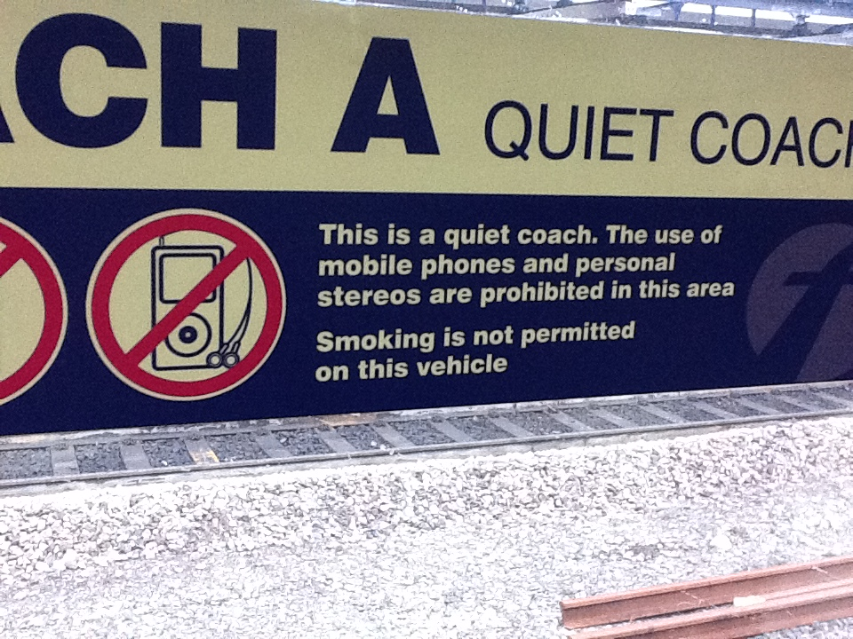

Slide 29
SO WHAT ANNOYS YOU?
http://www.youtube.com/watch?v=1IvWoQplqXQ&feature=youtube_gdata_player
MISPLACED APOSTROPHES?
8 ITEMS OR LESS
DIFFERENT TO
CONFUSING PRACTICE AND PRACTISE
INCORRECT SUBJECT-VERB AGREEMENTS

Slide 30
Why is punctuation important?
PRIVATE.
NO SWIMMING
ALLOWED
PRIVATE?
NO! SWIMMING
ALLOWED.

Slide 31
Why is punctuation important?
John sat down on the television there was a herd of elephants in his bedroom his father was tidying up

Slide 32
John sat down. On the television there was a herd of elephants. In his bedroom, his father was tidying up.
John sat down on the television. There was a herd of elephants in his bedroom. His father was tidying up.

Slide 33
Two different letters: same words
Dear Jack
I want a man who knows what love is all about. You are
generous, kind, thoughtful. People who are not like you
admit to being useless and inferior. You have ruined me
for other men. I yearn for you. I have no feelings
whatsoever when we’re apart. I can be forever happy – will
you let me be yours?
Jill

Slide 34
Dear Jack
I want a man who knows what love is. All about you are
generous, kind, thoughtful people, who are not like you.
Admit to being useless and inferior! You have ruined me!
For other men, I yearn! For you, I have no feelings
whatsoever. When we’re apart, I can be forever happy.
Will you let me be?
Yours
Jill

Slide 35
USE OF ENGLISH
“Jones was sent off for an elbow.”
The Times
"Do Britain's drug laws need a shot in the arm?"
Radio 4
Police shoot man with knife
Local paper
Dogs must be carried on the Underground
London Transport

Slide 36
SIMPLE ENGLISH
I myself personally think that it is not unlikely that rain will fall tomorrow.
I think it will rain tomorrow.
At this present moment in time, we have an ongoing negative precipitation situation.
It isn’t raining.
Each and every person in the class had to stay in at playtime.
Everyone had to stay in at playtime.
Sasha has got a new bicycle and Daniel has got one too.
Sasha and Daniel have new bicycles.

Slide 37
Which year group?
noun, noun phrase
statement, question, exclamation, command
compound, adjective, verb
suffix
tense (past, present)
apostrophe, comma

Slide 38
Year 2
noun, noun phrase
statement, question, exclamation, command
compound, adjective, verb
suffix
tense (past, present)
apostrophe, comma

Slide 39
YEAR | TERMINOLOGY FOR PUPILS
1 | letter, capital letter word, singular, plural sentence punctuation, full stop, question mark, exclamation mark
2 | noun, noun phrase statement, question, exclamation, command, compound, adjective, verb, suffix tense (past, present) apostrophe, comma
3 | adverb, preposition conjunction word family, prefix clause, subordinate clause direct speech consonant, consonant letter vowel, vowel letter inverted commas (or ‘speech marks’)
4 | determiner pronoun, possessive pronoun, adverbial
5 | modal verb, relative pronoun relative clause parenthesis, bracket, dash cohesion, ambiguity
6 | subject, object active, passive synonym, antonym ellipsis, hyphen, colon, semi-colon, bullet points

Slide 40
YEAR | TERMINOLOGY FOR PUPILS
1 | letter, capital letter word, singular, plural sentence punctuation, full stop, question mark, exclamation mark
2 | noun, noun phrase statement, question, exclamation, command, compound, adjective, verb, suffix tense (past, present) apostrophe, comma
3 | adverb, preposition, conjunction word family, prefix clause, subordinate clause direct speech consonant, consonant letter vowel, vowel letter inverted commas (or ‘speech marks’)
4 | determiner pronoun, possessive pronoun, adverbial
5 | modal verb, relative pronoun relative clause parenthesis, bracket, dash cohesion, ambiguity
6 | subject, object active, passive synonym, antonym ellipsis, hyphen, colon, semi-colon, bullet points

Slide 41
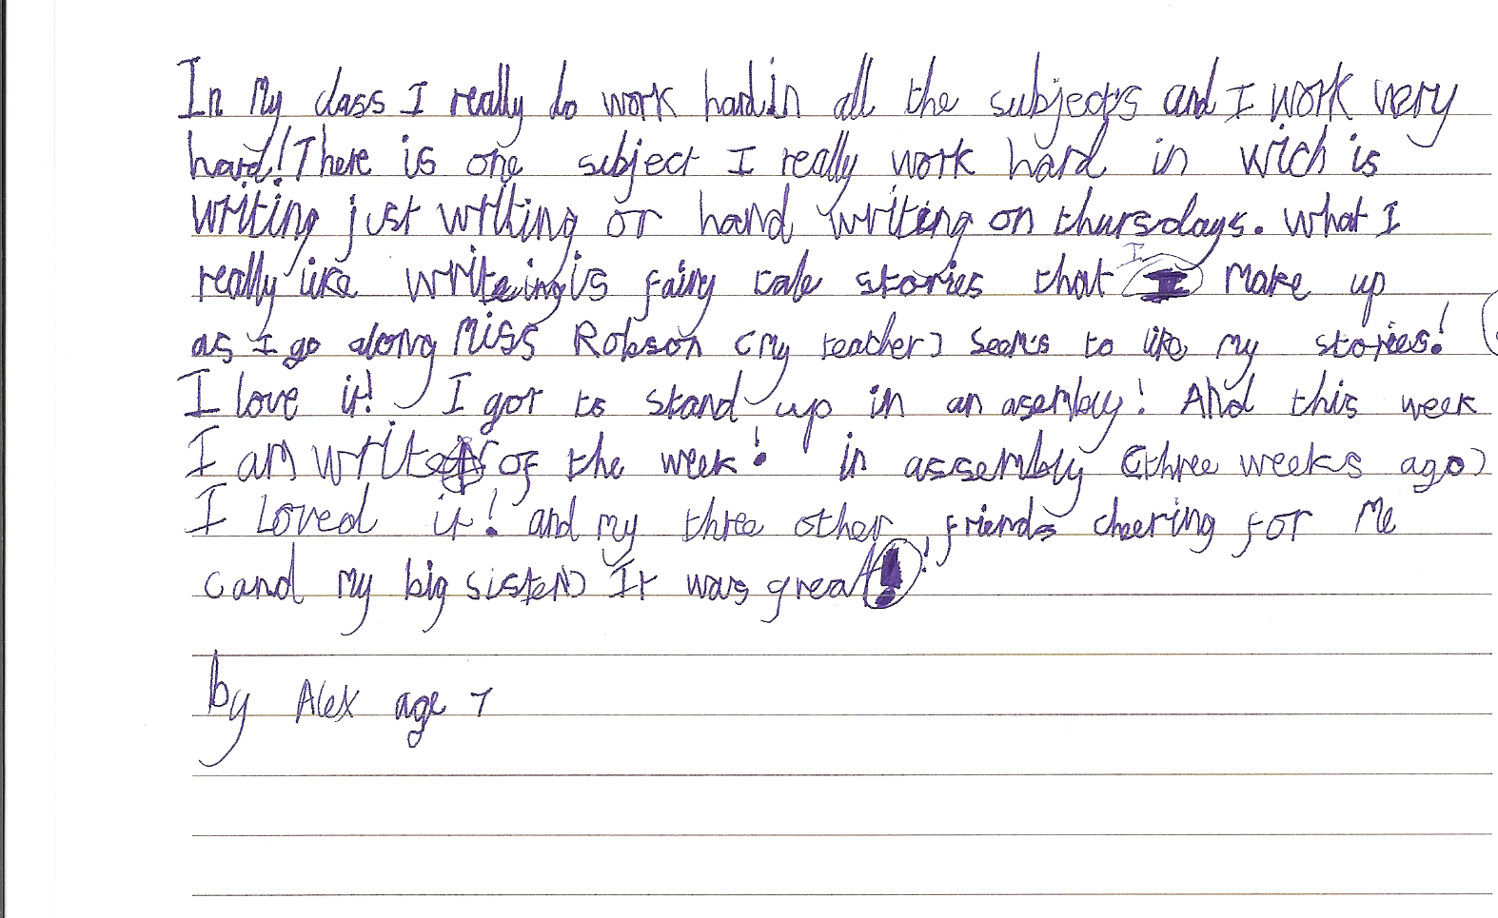
What does Alex know about grammar?

Slide 42
Strategies which can work across key stages
Create word banks
When introducing writing activities, write key vocabulary on the board or on pieces of card which can later be placed in alphabetical order as a reference point. This will not only help students to spell more accurately, but it will also provide prompts to help their composition.
Make word and definition cards Use words from your word bank and discuss their meanings. Write definitions on separate pieces of card and use the word cards and the definition cards for a matching/snap activity which will help reinforce students understanding of the vocabulary.
Create glossaries
Use word and definition cards to create subject- or topic-specific glossaries as an alphabetical reference point. These glossaries can be used as revision aids at examination times.
Word cluster posters Draw students’ attention to the common letter patterns and morphemes in words. Explain their meanings and ask students to create word clusters for display in subject rooms. For example, equal, equalise, equate, equilateral, equality, equation, equidistant, equilibrium, and so on) pointing out their common root (equa/equi, from the Latin word meaning to make even) and how that helps with both spelling and meaning.

