Slide 1
Interactive Grammar
By Julie Woodward

Slide 2
WHO AM I?
I finished my BA Honours Degree and graduated from Hull University in 2009 with a 2:1.
Secured my first teaching job whilst still at Hull University.
I worked as a trainee teacher, NQT and Literacy Lead Specialist at Whitley and Eggborough CP School (app. 200 children), in North Yorkshire, till the end of 2013.
In 2014 secured my first senior position as Assistant Head at Kellington Primary School (app. 196 children), in North Yorkshire.

Slide 3
And today?
At present, I am Deputy Head of Standards, at West Road Primary School, Moorends (400 children) Doncaster.

Slide 4
Why am I here?
“My spelling is Wobbly. It's good spelling but it Wobbles, and the letters get in the wrong places.” ― A.A. Milne, Winnie-the-Pooh
“A man's grammar, like Caesar's wife, should not only be pure, but above suspicion of impurity.” ― Edgar Allan Poe
“The greater part of the world's troubles are due to questions of grammar.” ― Michel de Montaigne, The Complete Essays

Slide 5
Why should grammar be taught interactively?
file:///F:/2016_KS2_EnglishGPS_framework_PDFA.pdf

Slide 6
How can we ‘embrace’ and ‘embed’ grammar in everyday learning?
Here is how we at West Road Primary School do it…
Kung Fu Punctuation Clip to go here

Slide 7
Interactive Grammar Games
http://www.learninggamesforkids.com/vocabulary-games/contractions/contraction-memory-match.html
For Key Stage 2
http://www.ictgames.com/forestPhonics/forestPhonicsOnline/index.html
For Key Stage 1
http://www.bbc.co.uk/bitesize/quiz/q54692076
Take the Quiz

Slide 8
Pie Corbett – Talk4Writing
Talk for Writing enables children to imitate the key language they need for a particular topic orally before they try reading and analysing it. Through fun activities that help them rehearse the tune of the language they need, followed by shared writing to show them how to craft their writing, children are helped to write in the same style. Schools that have adopted the approach have not only increased their children’s progress but have found that children and teachers alike love it.

Slide 9
A Pie Corbett Grammar Challenge…
Noughts and crosses – subordinating conjunction style
This is a great game to play once the children understand subordinating conjunctions and it will really build their confidence while being an entertaining challenge. Children must spot the difference between a word like before when it functions as a subordinating conjunction, as opposed to when it functions as a preposition.
The ultimate challenge is to see if they can use all three words as subordinating conjunctions in one coherent sentence.

Slide 10
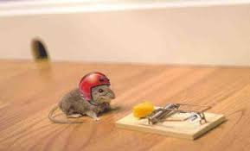
The Mouse with a helmet - Pie Corbett
“Although the mouse put on a crash hat when approaching the cheese in the trap, it was still hurt (as it wasn’t looking where it was going!)” (This claims the middle vertical line).

Slide 11
Step by Step guide to teaching tricky grammar
http://www.talk4writing.co.uk/wp-content/uploads/2015/01/Tricky-Grammar-PowerPoint.pdf

Slide 12
Punctuation Dance KS1 – West Road Style!

Slide 13
Actions Link to Grammar Word Classes

Slide 14
Grammar Cartoons…
https://www.youtube.com/watch?v=uoSBVNUO2LU
Similes and Metaphors
https://www.youtube.com/watch?v=8kcJzh6gqGM
Nouns

Slide 15
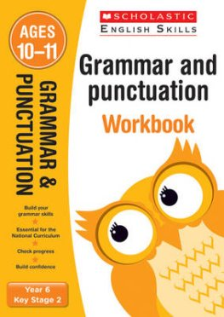
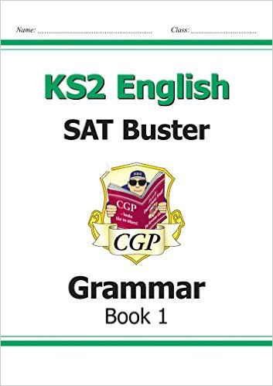
My 3 recommends…

Slide 16
Improving Spelling…
http://interactivesites.weebly.com/spelling.html

Slide 17
And if all else fails …
https://www.youtube.com/watch?v=AHyLqPspWR0

Slide 18
The secret is… make grammar fun!

