Slide 1
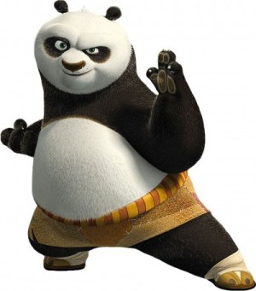
Kung Fu punctuation
By Ms Woodward
(stolen)

Slide 2
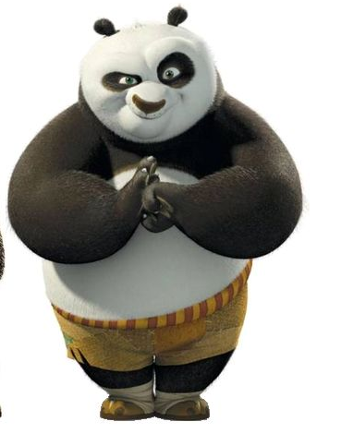
First rule of Kung Fu – Bow to opponent

Slide 3
Capital letter

Slide 4
Full stop . (HA!)

Slide 5
Inverted Commas “...” (stick tongue out and say hhoooollllllll)

Slide 6
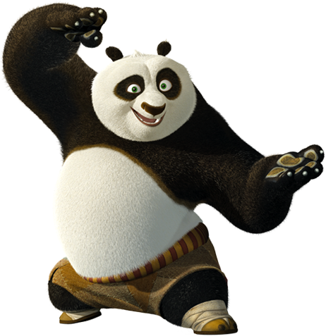
Comma , (She!)

Slide 7
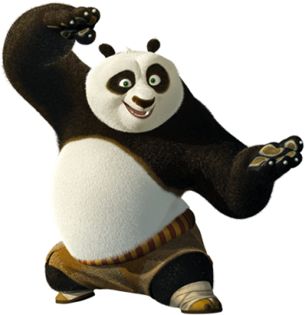
Question Mark ?
She!
She!
She!
HA!

Slide 8
Exclamation mark !
Shiiiiiiiiiii
HA!

Slide 9
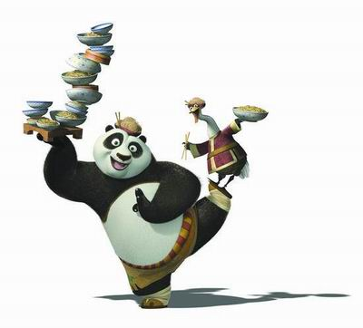
Apostrophe
(arch hand – She!)

Slide 10
Colon : (HA HA!)

Slide 11
Semi- Colon ; (HA SHE!)

Slide 12
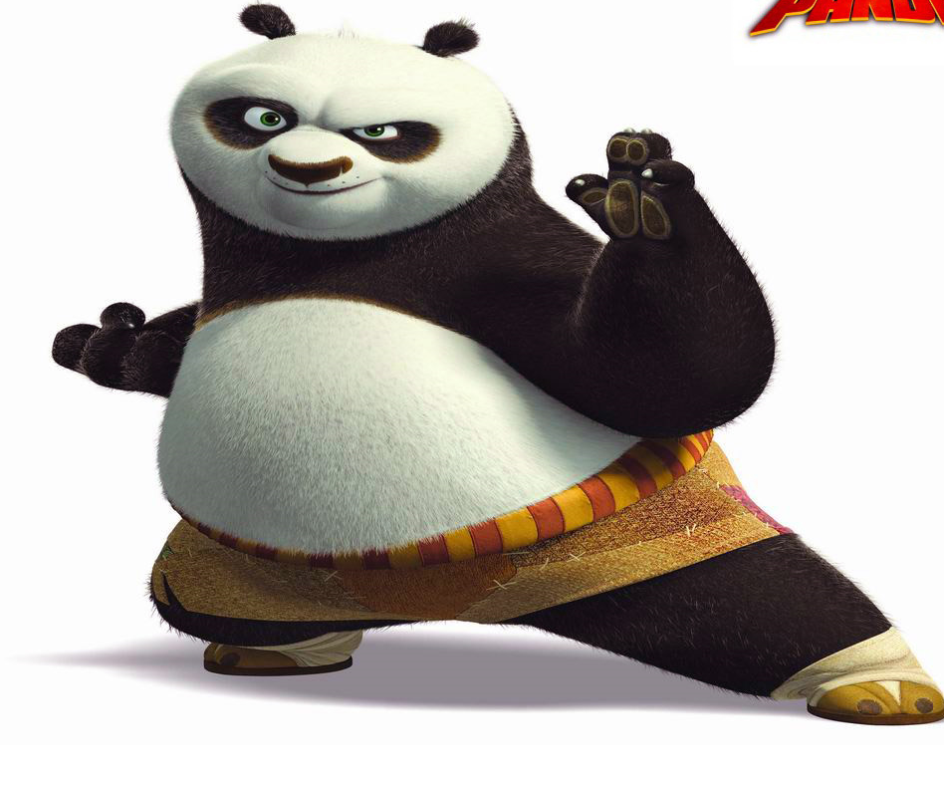
Hyphen/ dash - (HA!)

Slide 13
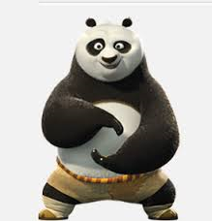
Parenthesis
(HA!)

Slide 14
Good work my students...remember to extend your learning by asking questions and changing the rules of the game!

Slide 15
Full stop .

Slide 16
Apostrophe ,

Slide 17
Speech marks “...”

Slide 18
Question Mark ?

Slide 19
Comma ,

Slide 20
Exclamation mark !

Slide 21
Hyphen/dash

Slide 22
Colon

Slide 23
Semi-colon

Slide 24
Capital letter

Slide 25
Parenthesis

